Slide 1
AI-powered cybersecurity and resilience

Slide 2
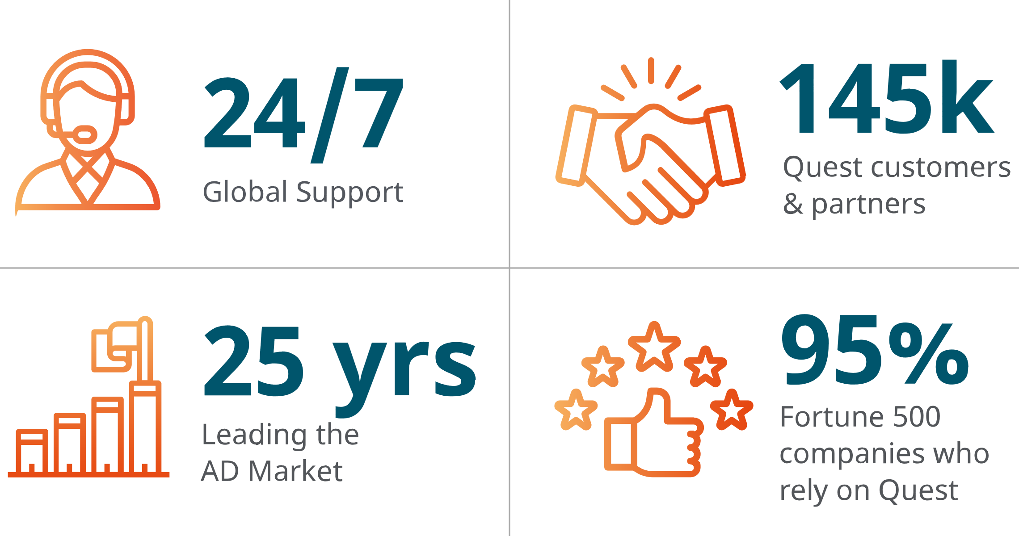
THE GO-TO for AD | Entra ID | Microsoft 365 Migrate, secure and recover with Quest.
40 years in business. More than 100PBs of data migrated. 37B Entra ID objects protected. Quest is one of Microsoft’s top strategic partners worldwide, earning Partner of the Year Award recognition six times.

Slide 3
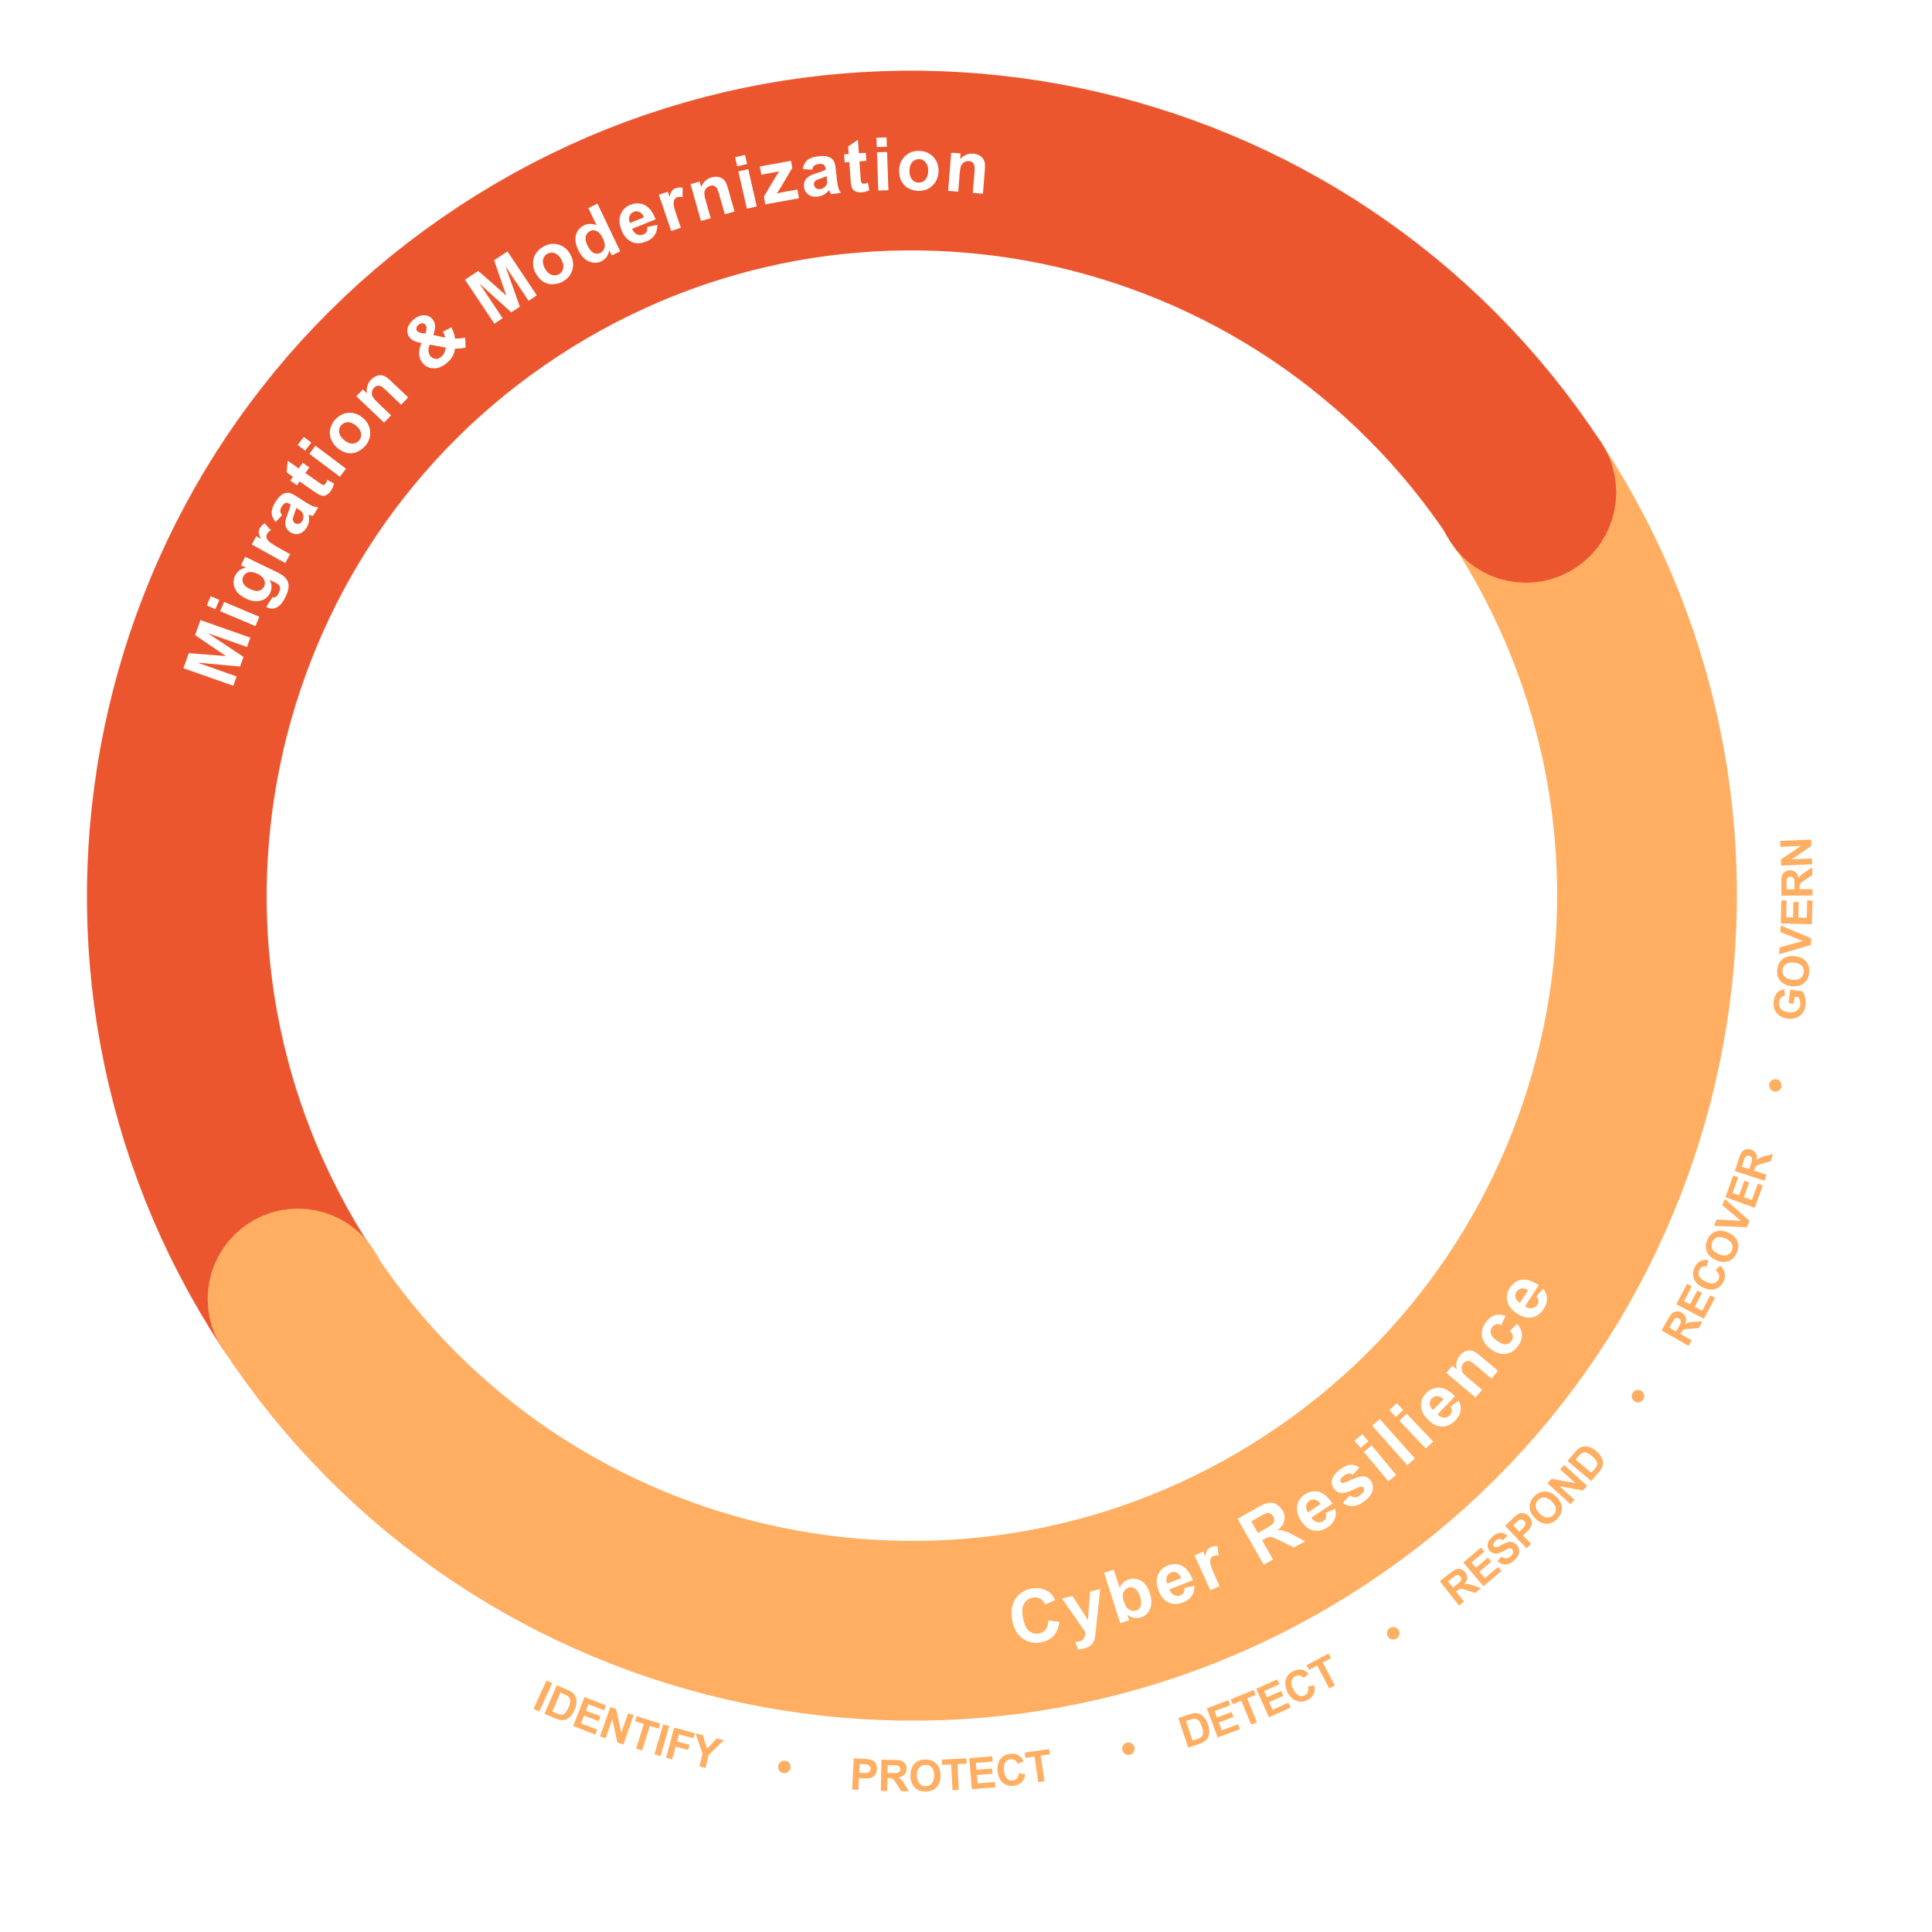
What We Do
Zero impact modernization – identities, data, devices
Identity threat prevention, detection, and response
Microsoft 365, AD & EntraID
Secure disaster recovery - integrity, flexibility, automation

Slide 4
What We Do - Focus
Cloud-based solutions:
Security, availability, TCO
Zero impact modernization – identities, data, devices
Identity threat prevention, detection, and response
Microsoft 365, AD & EntraID
Secure disaster recovery - integrity, flexibility, automation
AI-powered analytics, insights, & MS Copilot

Slide 5
Identity threat prevention, detection, and response – ITDR+
Quest On Demand
Secure disaster recovery - integrity, flexibility, automation

Slide 6
Quest On Demand

Slide 7
One Platform for Identity Modernization, Prevention, Detection, Response and Recovery
Quest On Demand
Modernization
Prevention
Detection
Response
Recovery
Recovery

Slide 8
Security Guardian
Identity threat prevention, detection, and response

Slide 9
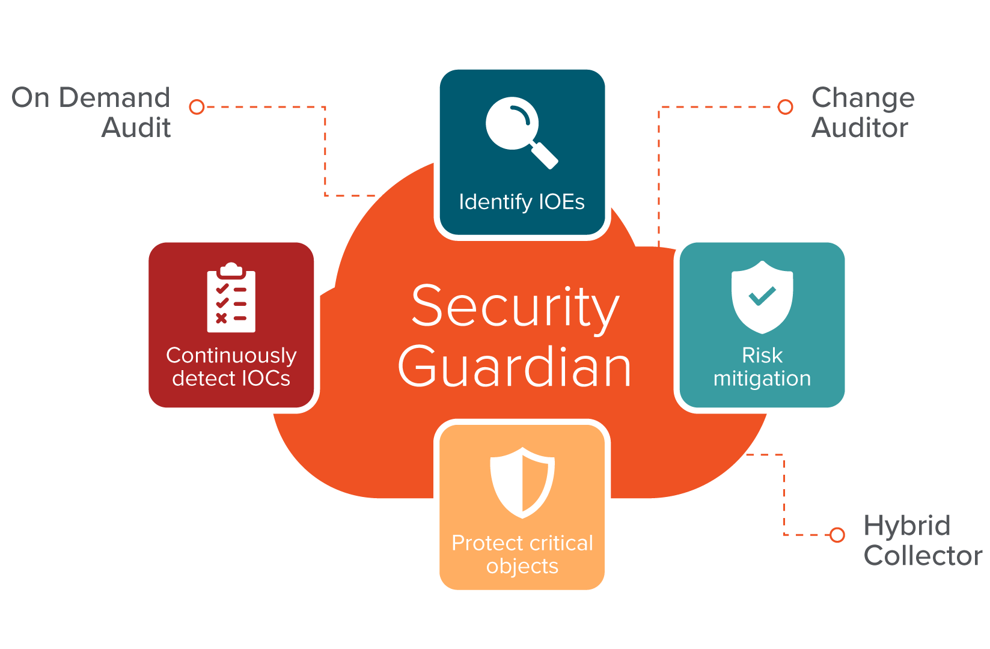
Quest Security Guardian
Establish a Tier 0 security boundary
Benchmark AD configurations against industry best practices
Identify vulnerabilities and misconfigurations
Detect potential anomalous behavior and malicious activities by attackers
Proactively protect critical Tier 0 assets, including GPOs
Exposure
Compromise
Tier 0

Slide 10
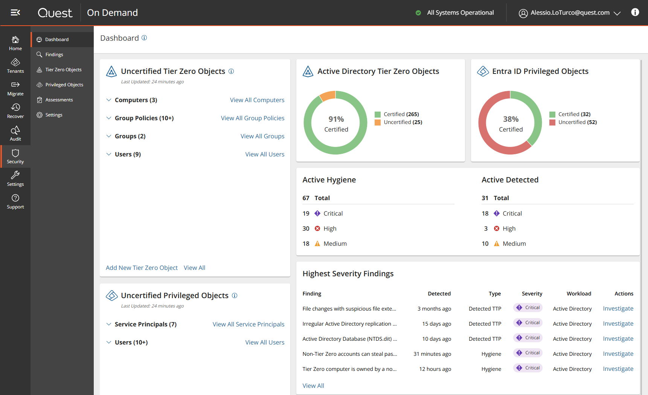
A unified and intuitive workspace
A single, seamless user interface
User-friendly design and functionality that reduces alert fatigue

Slide 11
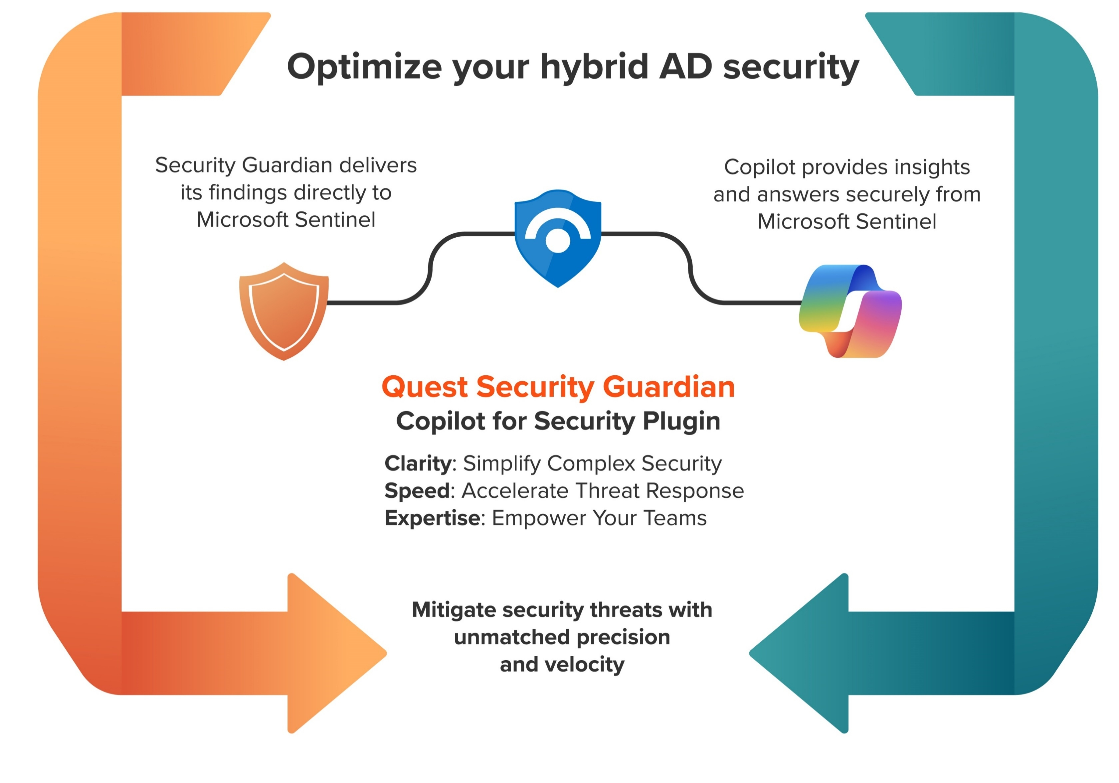
Microsoft CoPilot and Security Guardian

Slide 12
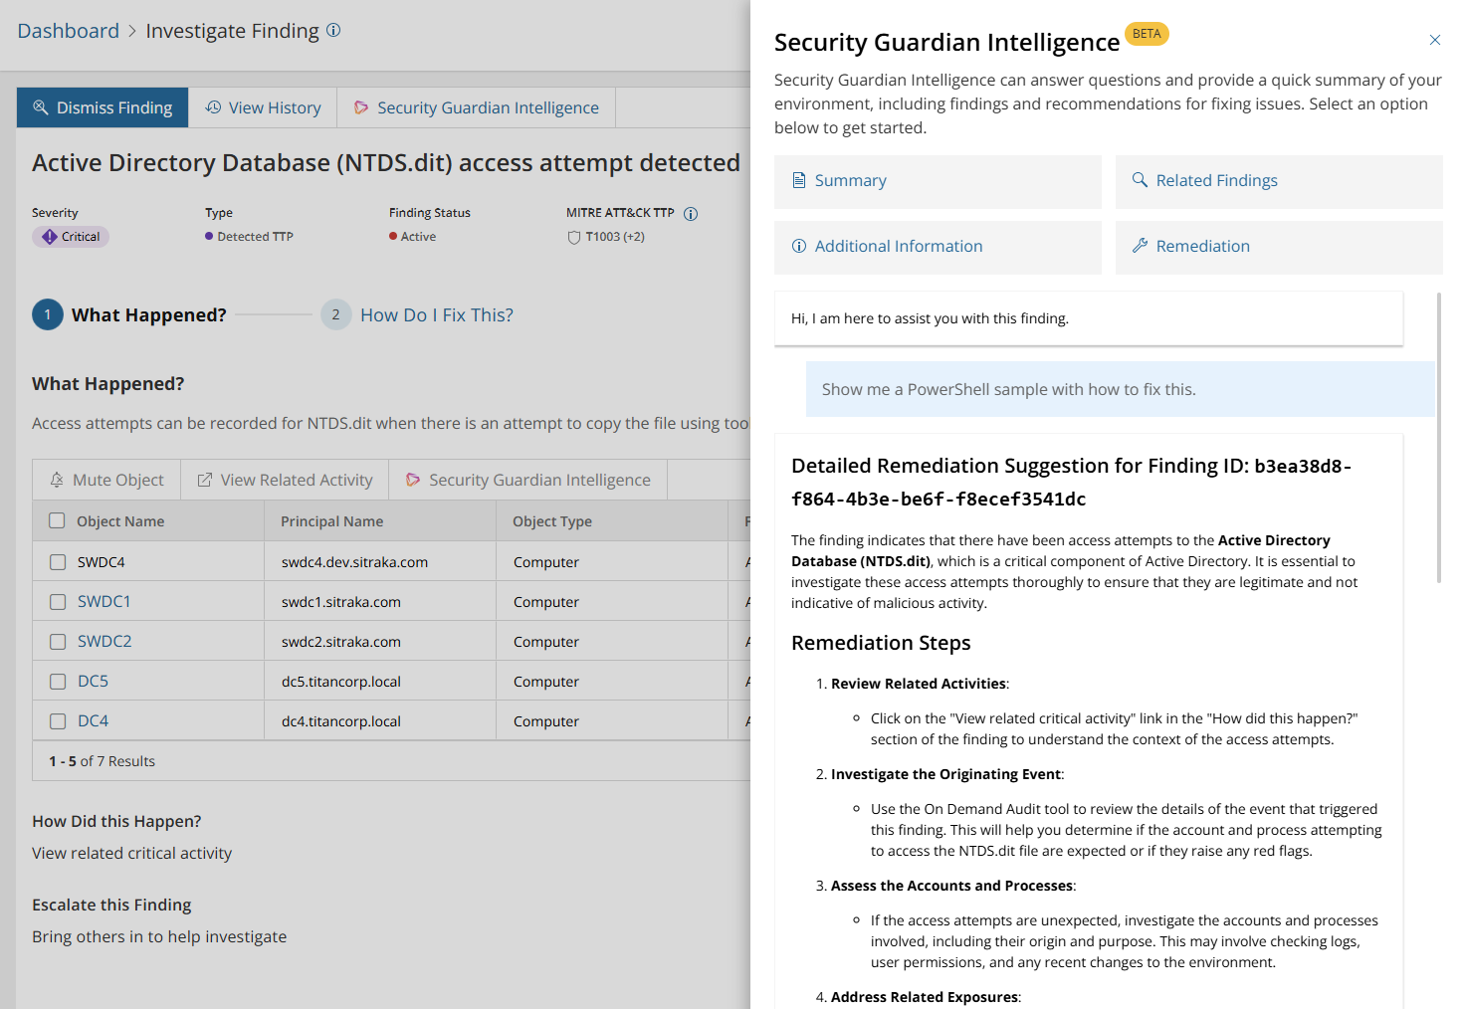
Security Guardian Intelligence

Slide 13
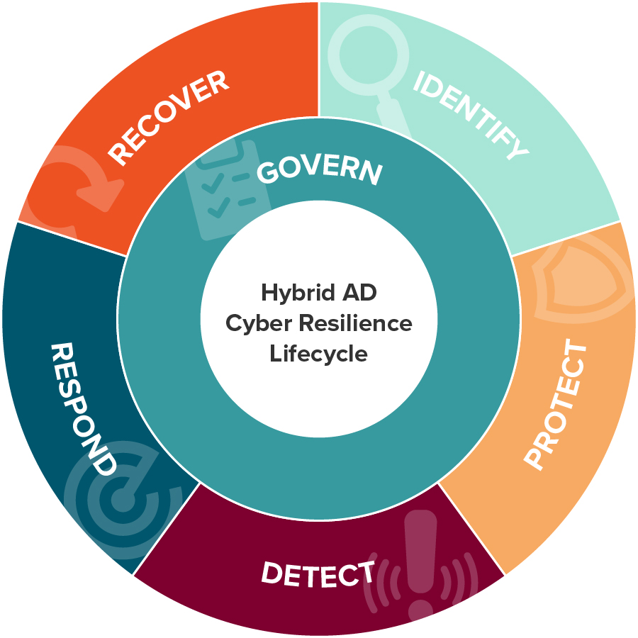
Security Guardian
Capabilities / functionality aligned to NIST & ITDR
Identify
Identify, prioritize and gain full control of Tier Zero assets as well as assess and benchmark your current AD configurations.
Protect
Secure and lock down Tier 0 assets, including GPOs, from compromise and misconfiguration.
Detect
Continuously monitor for indicators of compromise (IOCs) and configuration drifts.
Respond
Correlate threat signals effectively, highlighting indicators of exposure (IOEs) and indicators of compromise (IOCs) that demand attention; seamlessly forward IOEs and IOCs to SIEM tools.
Govern
Ensure AD doesn’t drift outside the “good” state set within industry best practices or organizational parameters.

Slide 14
Disaster Recovery for Identity and much more…
Secure disaster recovery

Slide 15
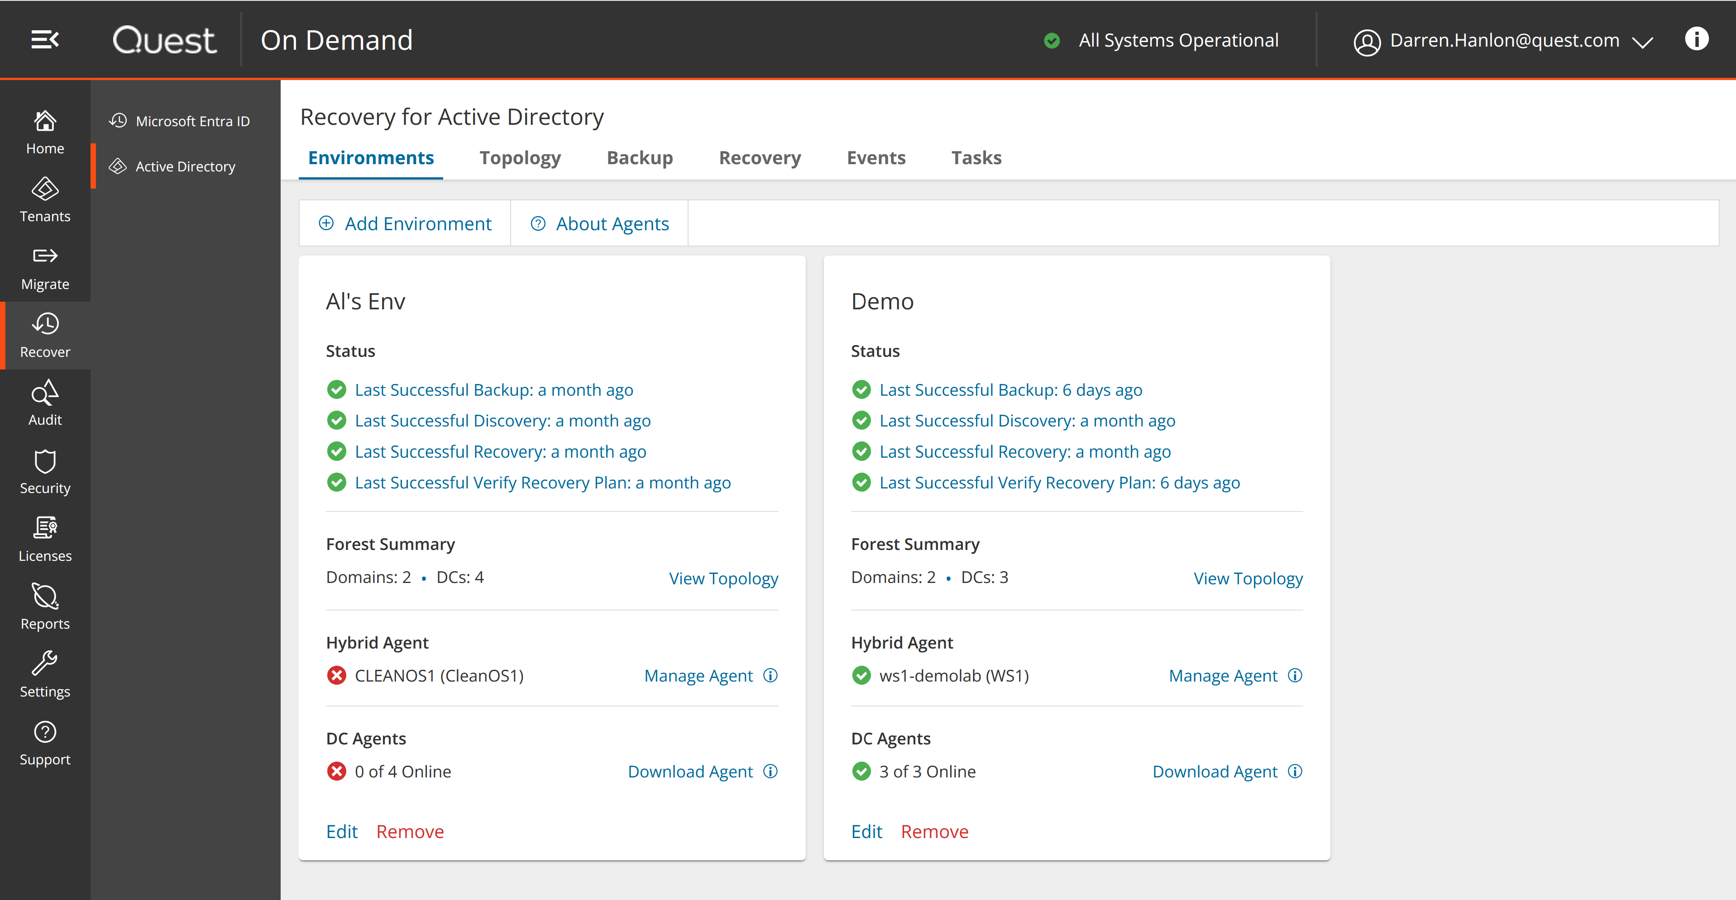
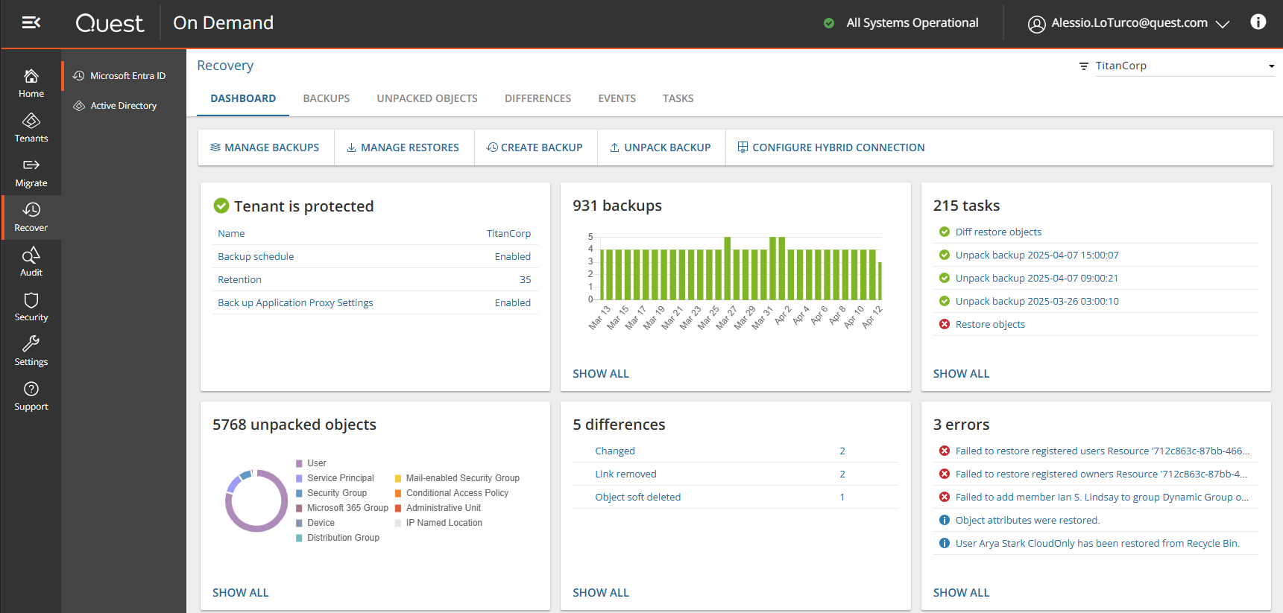
Best of both worlds: Active Directory and Entra ID in One Unified Identity Cloud Platform
One Platform
Disaster Recovery for Identity
Active Directory Disaster Recovery
Entra ID Object Recovery

Slide 16
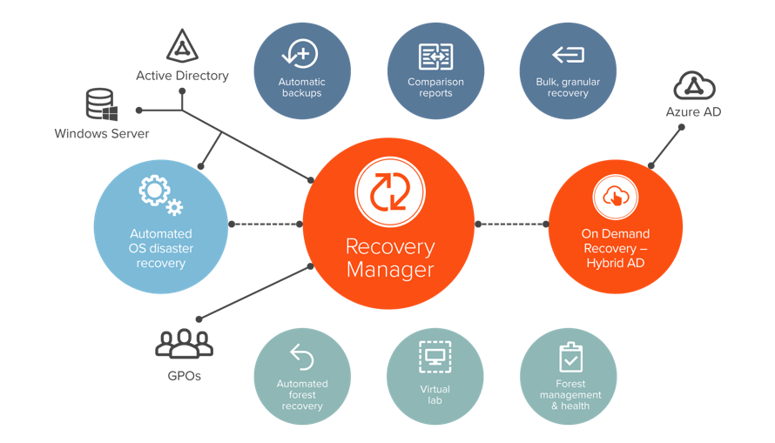
Recovery Manager for Active Directory
1) Multi level protection
Object level, Forest level, OS level
2) FAST fully-automated AD Forest Recovery
Automatically restore your entire forest in minutes/hours, not days/weeks
3) Active Directory protection
Protect Active Directory from re-infection and compromise during recovery
Certified by

Slide 17
Backup protection
Backup Availbility and Integrity – On Prem
Quest Secure Storage
Secure Storage backups are essentially air-gapped
Regular checks to confirm backup integrity
Backup Availbility and Integrity – Cloud
Azure Blob storage - has “immutable” option
Amazon S3 - has an “Object Lock” option
Regular checks to confirm backup integrity
Malware free backups
Quest AD Only backup
AD Database (DIT)
Windows registry
Data Center 1
Copy to Cloud
RMAD Server
Backup Commands
Secure Notification
Console
Data Center 2
Backup Commands
DC
DC
DC
DC
Backup Agent
Backup Agent
Backup Agent
Backup Agent
Backup Over SMB
Backup Over SMB
Tier 1 Storage
Tier 2 Secure Storage
Tier 1 Storage
Tier 2 Secure Storage
Pull over SMB
Storage Agent
Pull over SMB
Storage Agent
Backups
Backups
Backups
Backups

Slide 18
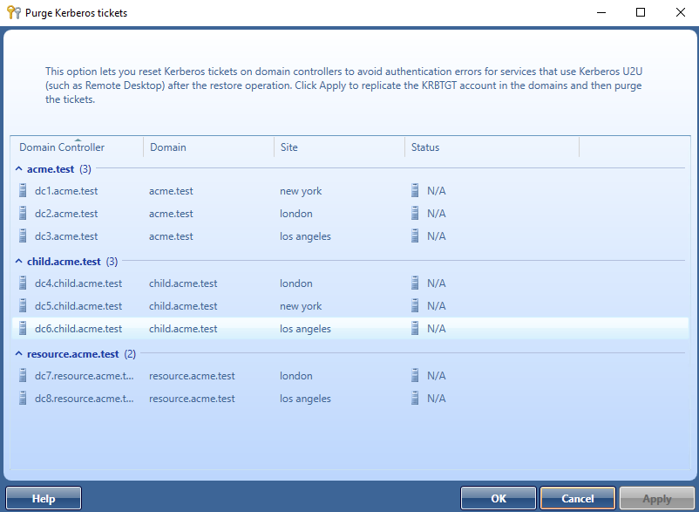
Active Directory protection
DCs Isolation
All DCs are fully isolated during the recovery operation, minimizing the risk of a DCSync/DCShadow attack
Kerberos Ticket Purge
All Kerberos tickets are purged during the recovery operation, golden and silver tickets included
Privileged accounts’ password reset
Reset the passwords of all privileged accounts during the recovery operation
Pause during recovery

Slide 19
Zero Trust Architecture

Slide 20
Zero Trust Architecture
Quest uses a Zero Trust R&D architecture
Performs no development in countries of security concern (TAA compliant)
Achieved 100% compliance with NIST SP800-218
Air gap architecture: Quest Supply Chain Risk Management - Microsoft Platforms Management
Quest Supply Chain Risk Management
ISO 27018, 27017, 27001 and Type 2 SOC 2 certified.
Started the FedRamp process
M365 Certification

Slide 21
Thank You!

