Slide 1


Introducing
Persistent Storage for Kubernetes Environments
Roberto Zaninello – Senior Solution Architect – Datacore Italia

Slide 2

Today‘s speaker
Roberto Zaninello
(Senior Solution Architect)
roberto.zaninello@datacore.com

Slide 3
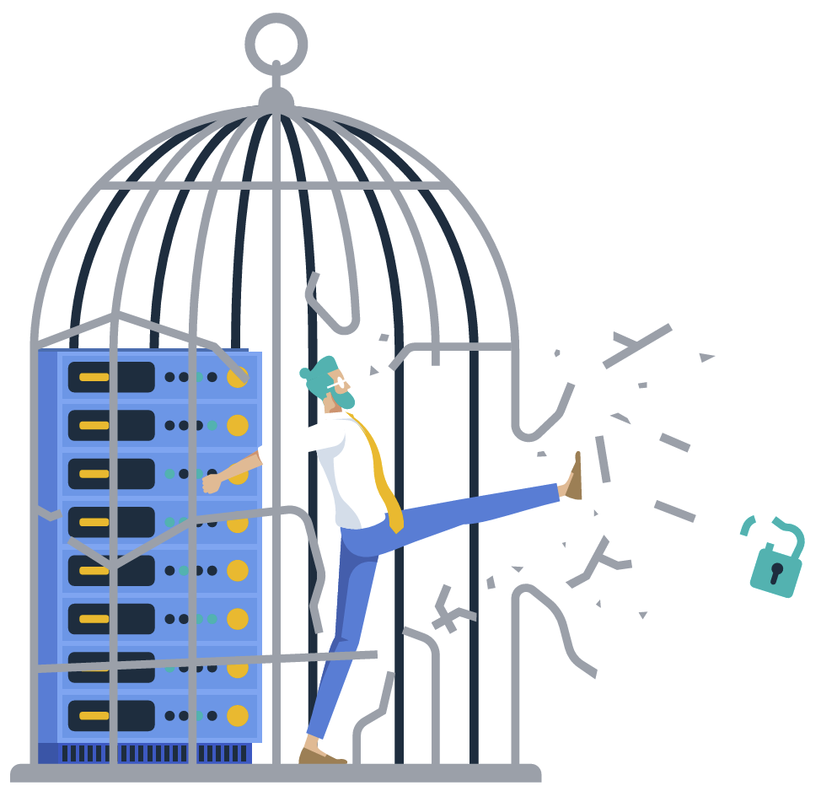
Why DataCore Exists
DataCore exists to give customers and partners
FREEDOM
Freedom from infrastructure constraints
Freedom from platform barriers
Freedom from data lock-in
Freedom to choose your tech stack
on your own terms

Slide 4
We Help You…
Modernize without disruption
Navigate through change easily
Optimize existing infrastructure to do more and save costs
Ensure operational continuity
Protect data against security threats and data loss risks
Gain freedom of choice
Simplify storage administration and data management
APPLICATIONS & USERS
SOFTWARE-DEFINED STORAGE
ANY STORAGE. ANYWHERE.
CORE | EDGE | CLOUD
AUTOMATED DATA SERVICES

Slide 5
DataCore: Building the Complete Portfolio
Block Storage
Object Storage
Container-Native Storage
Edge & SMB Storage
File Storage
Media Workflows
28 Years of Leadership with
SANsymphony
Active & Nearline Archive with Swarm, SNS
Entering Market Readiness with Puls8
HA with StarWind HCI
Appliance & Software
Storage for HPC/AI Workloads with Nexus
From Ingest to Archive
with
Pixitmedia

Slide 6
Agenda
1
Kubernetes and containers
2
What is Puls8
3
Use cases and resources

Slide 7
Kubernetes and Containers

Slide 8
Virtual Machines vs. Containers
VIRTUAL MACHINES
CONTAINERS
VM 1
VM 2
VM 3
Emulate entire operating systems
Require full guest OS, hypervisor, more overhead
Traditional way of isolating applications
App 1
App 2
App 3
Lightweight, share host OS kernel
Package apps with their dependencies
Faster to start, smaller footprint, ideal for microservices
Guest OS
Guest OS
Guest OS
App 1
App 2
App 3
Hypervisor
Container Runtime
Host Operating System
Host Operating System
Host Hardware
Host Hardware
Containers are like lightweight VMs – fast, portable, and perfect for modern app deployment

Slide 9
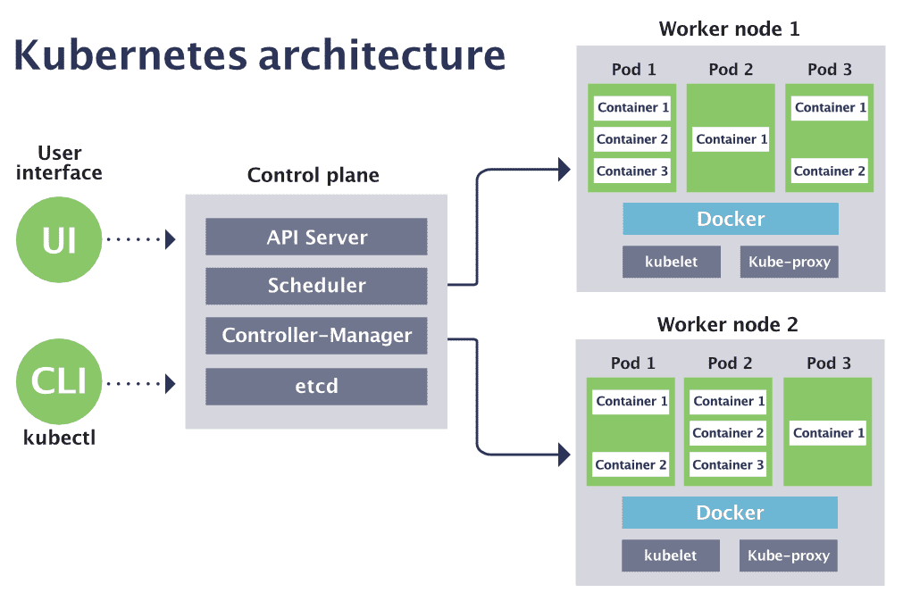
What is Kubernetes (K8s)?
The Orchestration Platform for Containers
Worker Node 1
Acts as Control Plane managing containers across a cluster of nodes
Control Plane → Nodes → Pods → Containers (Apps)
Distributes workloads for performance and high availability
Automatically restarts failed containers
Scales apps by running more container copies — like VM clustering
Provides networking, storage, security services for containers
Think of it like vCenter for VMs
Master Node
Container Runtime
Worker Node 2
Control Plane
Container Runtime

Slide 10
The Need for Persistent Storage in Kubernetes
Stateless apps have traditionally been more popular in Kubernetes environments
But stateful workloads (such as databases, AI/ML, and analytics engines, message queues, etc.) are rapidly increasing in adoption and importance
Kubernetes storage must evolve to support these needs stateful by being cloud-native, scalable, resilient, and developer-friendly

Slide 11
Challenges of Running Stateful Workloads in K8s
Native Kubernetes volumes lack enterprise-grade capabilities
Developers face challenges with provisioning, scaling, and ensuring data durability
Traditional storage systems lack the agility and flexibility Kubernetes requires
Containers are ephemeral by design: they can’t retain state
Most real-world applications are stateful
This creates a need for PERSISTENT STORAGE to support stateful workloads on K8s

Slide 12
Examples of K8s Stateful Workloads Requiring Persistent Storage
Stateful Workloads and Requirement for Persistent Storage
Databases | PostgreSQL, MySQL, MongoDB, Cassandra, Redis Require durable volumes for data files, transaction logs, backups
Message Queues & Streaming | Kafka, RabbitMQ, NATS Depend on persistent volumes to store message queues and offset data
Analytics & Data Processing Pipelines | Apache Spark, Hadoop, ClickHouse, Presto Need fast, scalable volumes to read/write datasets in real time
AI/ML Workloads | TensorFlow, PyTorch pipelines Use persistent volumes to store models, training data, and checkpoints
Content Management & File Storage Apps | WordPress, Nextcloud, OwnCloud Rely on persistent storage for file uploads, configuration, and user data
Logging & Observability Stacks | Elasticsearch, Loki, Fluentd with persistent queues Require durable storage for logs, metrics, and traces across cluster nodes and over time
Backup & Disaster Recovery (BDR) Workloads | Kasten K10, Velero, Restic, Stash Need persistent volumes to store snapshots and backups of cluster data and applications
Dev/Test Environments with Stateful Apps | Dev/DevOps workloads needing data persistence across pod restarts or CI/CD cycles KubeVirt virtual machines running on K8s containers needing persistent storage
Notes:
What is KubeVirt? KubeVirt is an open-source extension to Kubernetes that enables the deployment and management of virtual machines (VMs) alongside container workloads on the same platform. It allows organizations to modernize infrastructure by bringing legacy or VM-based applications into Kubernetes without requiring a complete rewrite into containers. By integrating with Kubernetes' native APIs, KubeVirt provides a unified way to orchestrate both VMs and containers, enabling consistent management, scheduling, and scaling. This is especially useful in hybrid environments where workloads may span both virtualization and containerization, such as development/test setups, legacy software, or infrastructure requiring full operating system environments.

Slide 13
Two Approaches to K8s Persistent Storage
 | External Storage (e.g., SAN) with CSI Plugin | Container-Native Storage
Where it runs | Outside the cluster (dedicated storage array) | Inside the cluster (runs as containers)
Latency / locality | Over the network (iSCSI, FC, NFS, NVMe-oF) | Local or node-attached – closer to the app
Provisioning | Via CSI plugin, but backed by external tools | Via CSI API, provisioned directly by K8s
Scalability | Storage doesn't scale easily with cluster growth | Scales as nodes/pods scale (horizontal)
App awareness | Blind to K8s pods or workloads | Native to K8s – storage follows the app
Ops model | Storage admin manages separately | DevOps/K8s team manages via K8s API

Slide 14
Empowering Stateful Data on Kubernetes

Slide 15
Introducing Puls8
Built on enterprise-grade storage technology with cloud-native simplicity
Container-native architecture that delivers performance, availability, and automation
Purpose-built persistent storage for Kubernetes environments

Slide 16
Puls8: Technical Benefits
Accelerate responsiveness of stateful workloads on NVMe
Replace complex storage management with native K8s
Gain observability to K8s storage behavior
Ensure portability of storage services without OS dependencies
Enhance data resilience through replication

Slide 17
How Puls8 Enables K8s Persistent Storage
Stateful Workloads
MySQL, PostgreSQL, Kafka, Prometheus, MongoDB, Cassandra, ...
Enables developers and platform SREs to easily deploy K8s stateful workloads
Provides fast and highly reliable block-based container-native storage
Turns built-in storage of K8s nodes into persistent volumes; no reliance on external storage systems
Freedom from infrastructure constraints and vendor lock-in
Kubernetes Storage Control Plane
Control Plane
CSI Drivers,
Storage & Data Engine Operators, Plugins, …
Storage Engines
Replicated Volumes: Mayastor
Local Volumes:
LVM, ZFS, hostpath
Enterprise Frameworks/Tools
Velero, Prometheus,
Grafana, EFK/ELK, …
Any Platform, Any Storage
On-premises/Cloud, Core/Edge, Bare Metal/Virtual, NVMe/SCSI, SSD/HDD

Slide 18
How Puls8 Enables HA for Stateful Kubernetes Workloads
Maintains fully replicated copies of persistent volumes on multiple nodes in the cluster
If a node fails, applications fail over automatically to another node with an intact replica
Volumes automatically re-attach as Kubernetes restarts pods
Node or component failures result in minimal to no disruption
Self-healing rebuild restores full redundancy automatically
Designed for Kubernetes-native failover patterns using CSI, ensuring storage stays aligned with workload movement

Slide 19
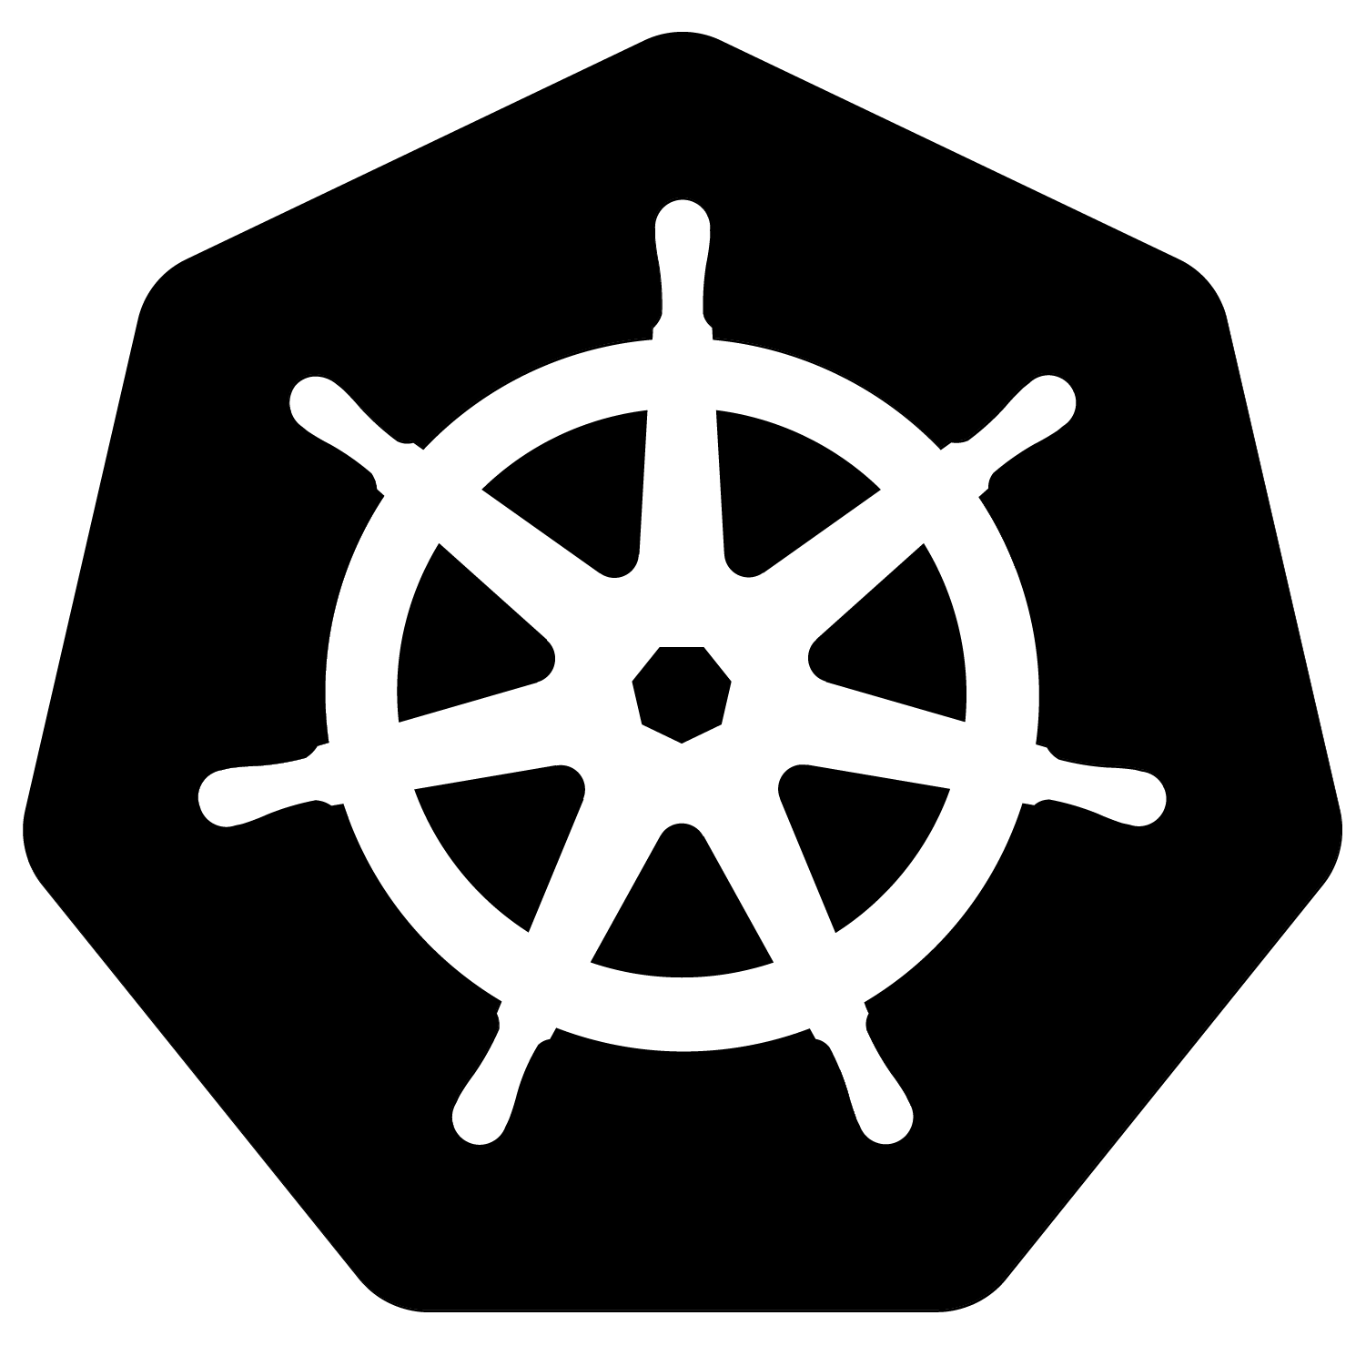
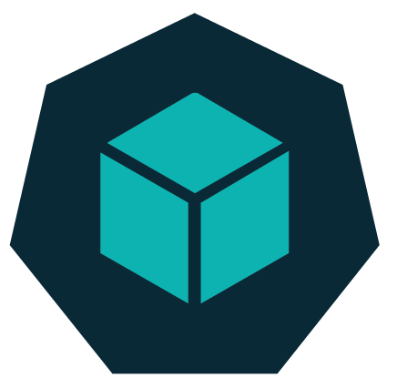
Puls8 I/O Path Architecture
Replication of volumes across nodes
Kubernetes Cluster
Node C
Node A
Node B
Application Pod
NVMe-oF/ TCP
Persistent Volume (PV)
Volume Storage Controller
NVMe-oF/TCP
NVMe-oF/TCP
Remote Replica
Local Replica
Remote Replica
Pool
Pool
Pool
SSD
SSD
SSD

Slide 20
Node Failure and Recovery with Puls8 ‘Lifeline’
Replication of volumes across nodes
Kubernetes Cluster
Node C
Node A
Node B
Application Pod
Application Pod
NVMe-oF/ TCP
NVMe-oF/ TCP
Persistent Volume (PV)
Persistent Volume (PV)
Volume Storage Controller
Volume Storage Controller
NVMe-oF/TCP
NVMe-oF/TCP
Remote Replica
Remote Replica
Local Replica
Remote Replica
Local Replica
Pool
Pool
Pool
SSD
SSD
SSD
Notes:
1st Click: Node fails, Pod enters “limbo” state and K8s is stuck in re-scheduling because storage controller state is also undefined.
2nd Click: Puls8 “Lifeline” automatically detects the state and moves the storage controller to a healthy replica allowing the Pod to re-attach and restart with the latest data state.
Additionally the system may try to scale the replica back to 3 copies if there are more suitable storage pools available in the cluster to satisfy the replication requirements of the PV.

Slide 21
How Puls8 Enables Backup & Recovery
Stateful Applications Running on Kubernetes
Example: MongoDB, RabbitMQ, Redis, Kafka, WordPress, TensorFlow, etc.
4
Recovery: Kasten triggers restore → pulls app config → instructs Puls8 to provision new volumes from snapshots → data rehydrated from object storage → Kubernetes redeploys pods with restored config + data
Backup Repository
Puls8 Takes Volume Snapshots of PVs
Kasten Saves Application Configuration (YAML Manifest)
2a
2b
Kubernetes-Native Storage
Public Cloud Storage
(Amazon S3, Azure Blob, Google Cloud Storage)
Any S3-Compatible Object Storage
(e.g., DataCore Swarm)
Kasten Triggers Backup and Instructs Puls8
to Take Snapshots of PVs
Kasten Exports Snapshots and App Config to Object Storage
3
1
*Backup & recovery is also supported with Velero
Notes:
Backup Workflow
Backup request initiated
A backup is triggered through Veeam Kasten, either manually or by policy.
2a. Volume snapshot created
Kasten instructs the Puls8 CSI driver to take a point-in-time snapshot of the application’s persistent volumes.
2b. Application configuration captured
At the same time, Kasten collects the Kubernetes resources (YAML manifests: Deployments, StatefulSets, Services, ConfigMaps, Secrets, CRDs,) that define how the application is deployed.
3. Data movement to object storage
Once the snapshot is complete, Kasten copies both the volume data (from the snapshot) and the application configuration to the chosen object storage repository (e.g., AWS S3, Azure Blob, Google Cloud Storage, DataCore Swarm, or other S3-compatible storage).
4. Restore when needed
During recovery, Kasten re-applies the saved Kubernetes configuration in the target cluster or namespace, while Puls8 provisions new volumes from the backup snapshots and rehydrates the data from object storage. Once the pods are redeployed and attached to these volumes, the workload comes back online with both configuration and data fully restored.

Slide 22
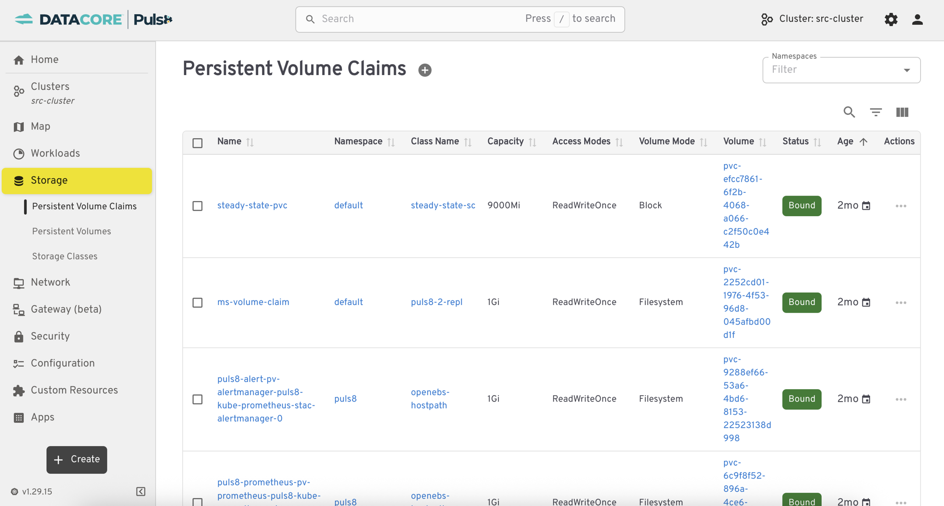
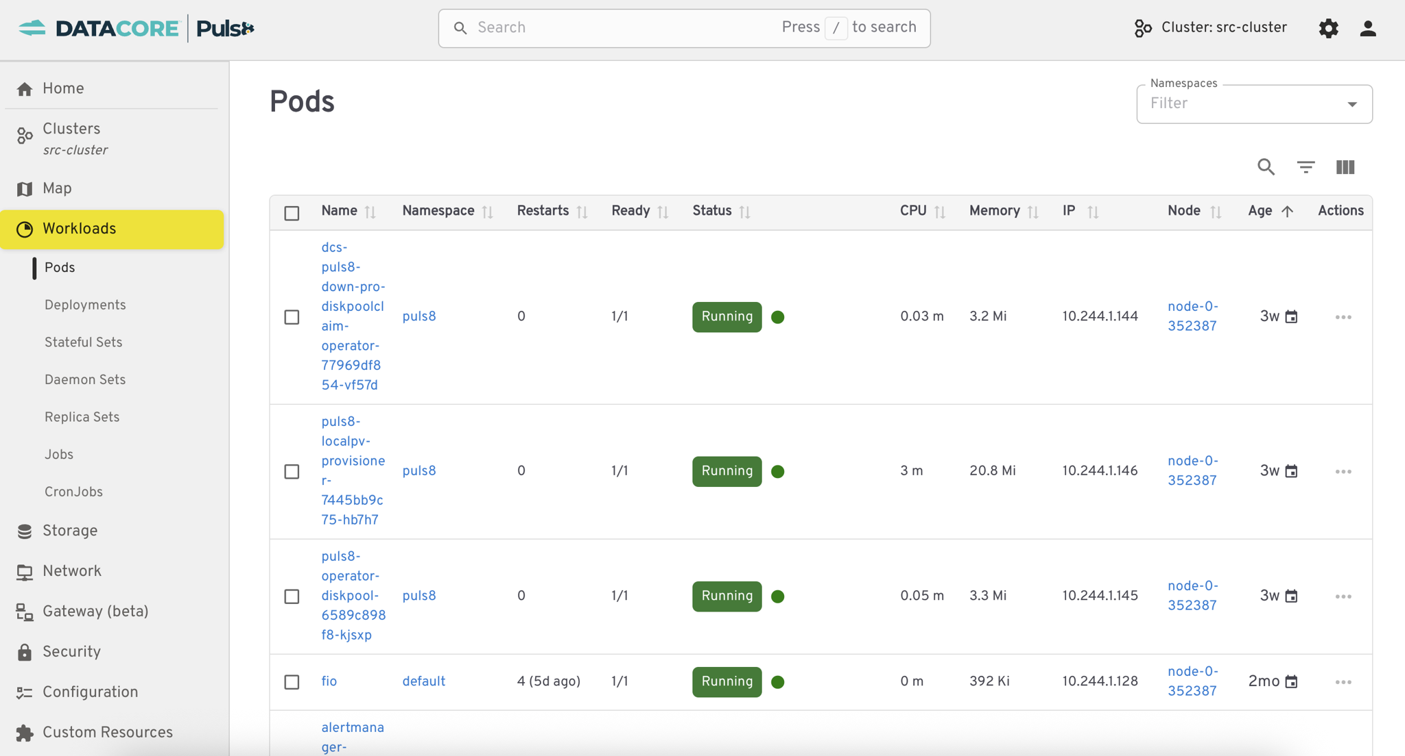
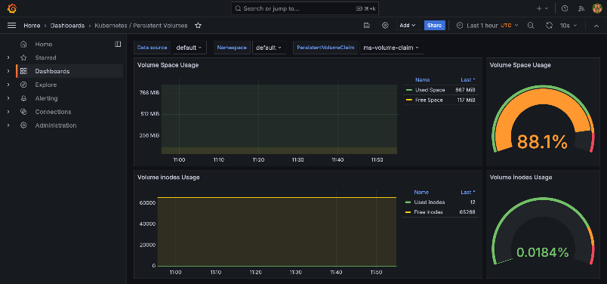
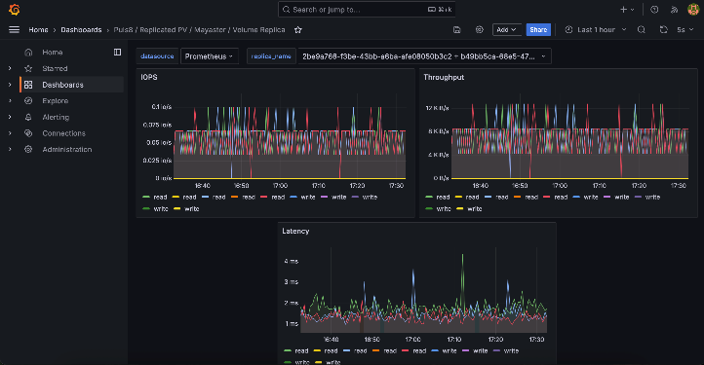
Puls8 User Interface & Observability Dashboards

Slide 23
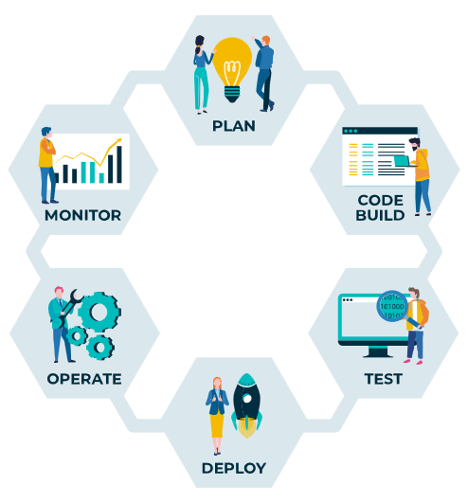
Seamlessly Deploy and Run Stateful Applications on Kubernetes
Performant: Accelerate responsiveness of stateful workloads through low-latency access to NVMe drives
Scalable: Easily scale storage capacity based on container lifecycle needs
Reliable: Safeguard your data by with volume replication and backups
Flexible: Hardware-agnostic software runs on bare metal or VM; on-premises or in the cloud
Cost-efficient: Reduce operational costs and storage TCO through smart storage orchestration and management
Programmable: Integrates easily with CI/CD workflows through APIs and CLI

Slide 24
Use cases and resources

Slide 25
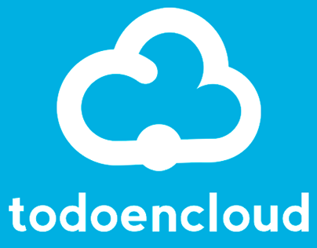
CSP Accelerates Kubernetes with Puls8
Challenges & Requirements
Solution with Puls8
Deliver Kubernetes-as-a-Service across 3 data centers in Spain
Run critical applications: electronic signature management, AI-driven document processing, business process automation
Need persistent, high-performance storage for K8s clusters
Need HA and resilience (zero downtime SLA for end-customers)
Provide flexibility to scale while keeping operations simple
Depend on responsive vendor support to accelerate delivery
Kubernetes-native high-performance persistent storage
High availability and replication across nodes / zones
Ultra-low latency and high IOPS for critical workloads
Flexible scaling to multi-cluster environments
Certified with Veeam Kasten for Kubernetes backup and recovery
Excellent support from DataCore during deployment and tuning
Competition
Solution Benefits
NFS CSI drivers: Limited in IOPS scaling, multi-site distribution
LongHorn (open-source): Good for testing, but not production-ready for heavy usage
Portworx (Pure Storage): Evaluated but fell short in some technical and operational aspects
Technical: Met all requirements, outperformed Portworx in tests
Financial: ~10% cost savings compared to alternatives
Operational: Simplified management, reduced storage overhead
Strategic: Positioned to scale Kubernetes services to 10 clusters
“More than just a supplier, DataCore has been a partner. Their combination of technological scale and human touch has been key to the success of our Puls8-based K8s project.” – CEO, TodoenCloud

Slide 26
THANK YOU!
info@datacore.com
www.datacore.com

