Slide 1
Massimiliano Capoccetti
Sr. Channel Manager

Slide 2
About Quantum (NASDAQ: QMCO)
We deliver end-to-end solutions to store, manage, and enrich unstructured data across its entire lifecycle.
Longtime leader in
data protection
Solutions for the
most demanding
video workloads
Leader in hyperscale
data archiving
End to end solutions
for the next era of data
10,000+
Customers
50%+ Fortune 100
44+ EB
Stored and Protected
Notes:
I think of our strategy as being to make our products and solutions:
easy to buy
easy to deploy
and easy to use
EASY TO BUY - TRANSITION TO SOFTWARE
To make our products easier to buy. We are well on our way to transitioning customers from perpetual license appliance sales model to a software subscription model. As part of that move, we have simplified our software licensing to an all-inclusive capacity-based cloud managed licensing system.
Second, technology is difficult to consume if it is difficult to deploy.
Quantum is simplifying the deployment of our products in a few ways. First, by being more solutions focused. We are bundling two or more products together to provide a solution for particular use cases. We're about to release a CatDV solution intended for small video production houses or edge deployments by bundling CatDV with StorNext file system on our H Series Box. It is end user installable, intended for use by creators, not storage administrators.
Second, we’ve begun partnering with major platform providers to deliver our software on their hardware. The benefits to Quantum customers are increased currency with platform updates, and geography specific product variations suited to international markets.
Third, moving forward, we're additionally providing our storage software on the major cloud platforms. This provides another simple consumption model for Quantum solutions, and enables hybrid cloud workflows. Our Storage Manager software allows you to easily move data from on prem to the cloud for processing and back to on prem.

Slide 3
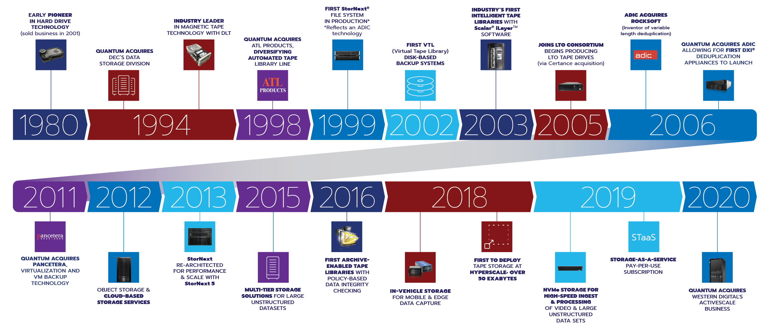
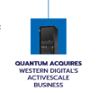
A history of innovation

Slide 4
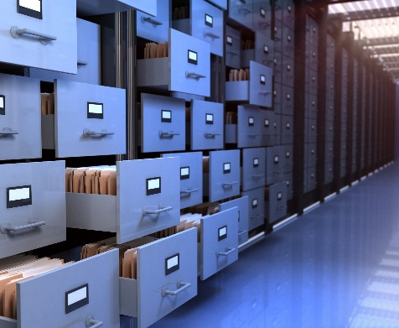
Customer Problems We Solve Today
DATA PROTECTION/BACKUP
RANSOMWARE RECOVERY
ARCHIVE
POST-PRODUCTION
VFX
GENOME SEQUENCING
SURVEILLANCE/SECURITY
AI

Slide 5
Customer Problems We Solve Today
Archiving
Data Protection
82%
Say concern for ransomware is greater than 2 years ago
69%
Expect to increase spending on cybersecurity
57%
Expect to increase spending on data protection and archive
Source: ESG Research Survey, 2023

Slide 6
Need to Address Massive Data Growth; Store Data for Decades and Longer…
10% Hot (<1ms)
30% Warm (<100ms)
60% Cold (minutes-hours)
3-4x cheaper
Storage Installed Base (Exabytes)
Gap
3-4x cheaper
Storage capacity growing 30%+ annually, IT infrastructure spend growing 10-15%*
60%* of all data is “cold”:
Inactive data that is accessed infrequently
*Source: IDC InfoBrief, sponsored by Quantum, “Data Deluge: Why Every Enterprise Needs a Cold Storage Strategy”, Doc. #US48119821, August 2021.

Slide 7
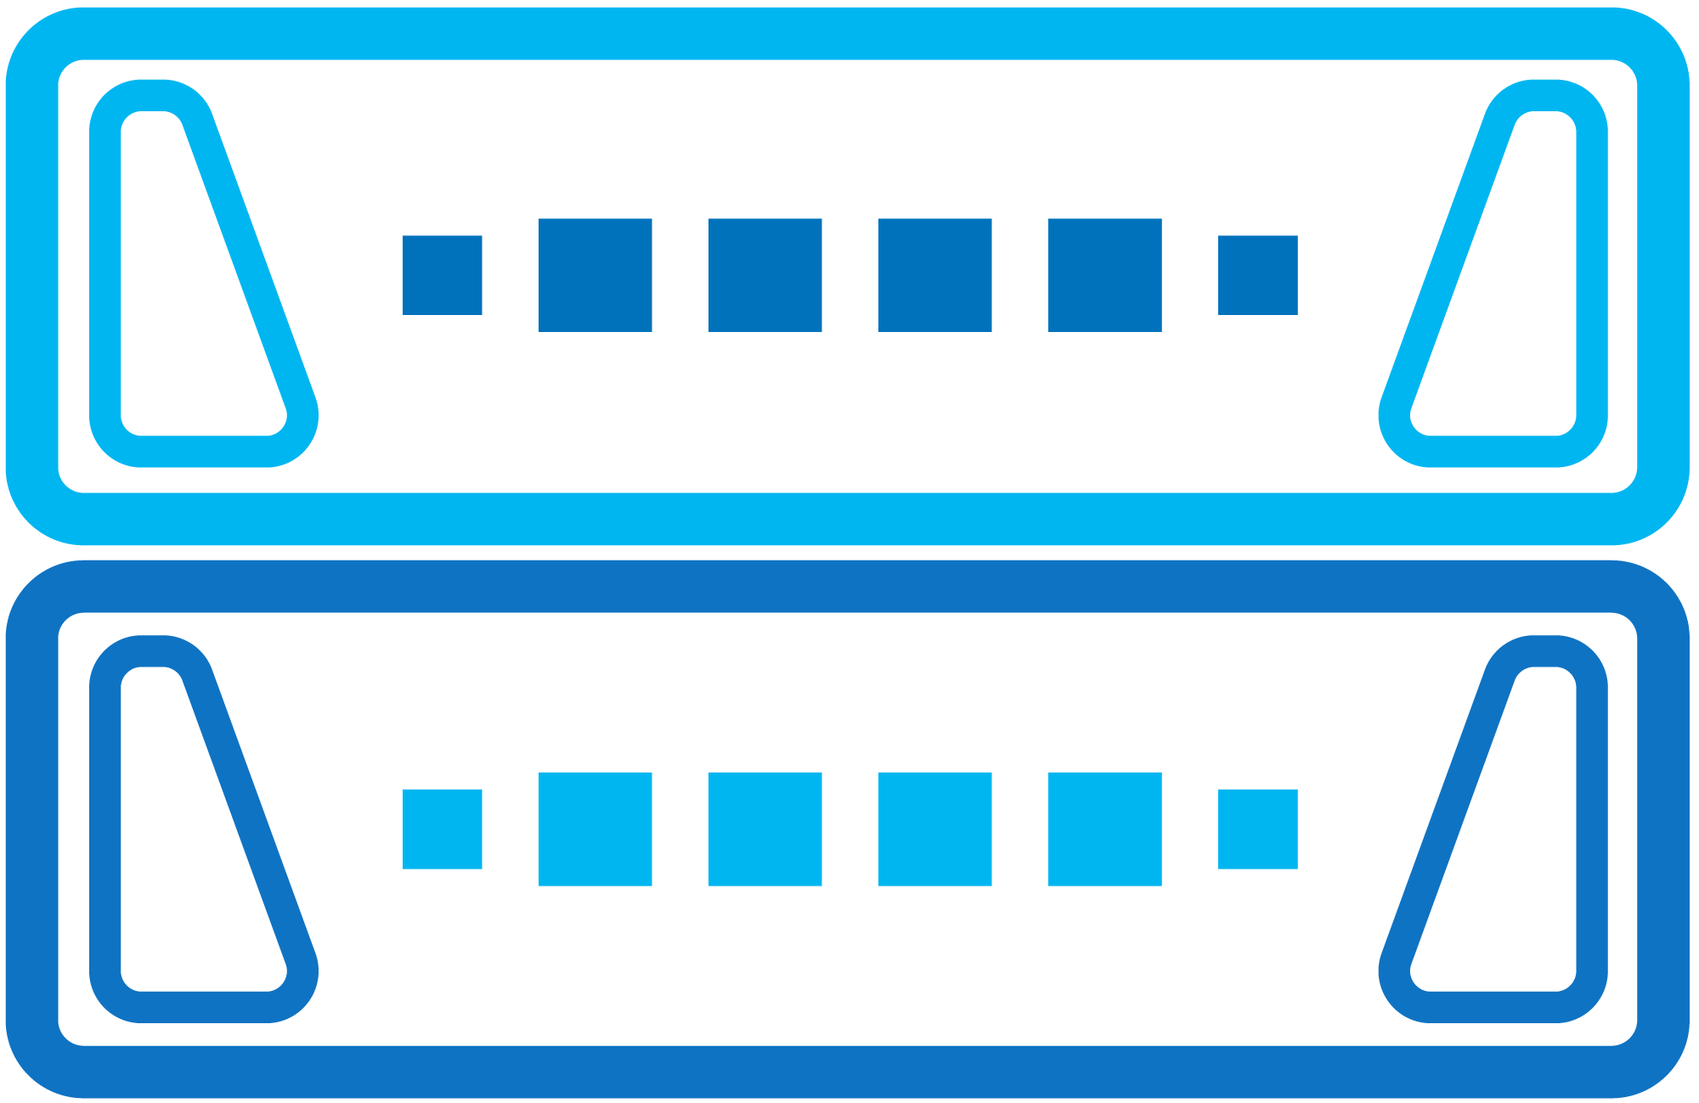
Quantum Solutions for Strengthening Data Protection and Cyber Resilience
DXi®
Backup Appliances
High performance appliances improve restore SLAs and backup efficiency
ActiveScale™
Object Storage
Immutable, durable storage with object locking. Easy to manage at any scale.
Scalar®
Tape Storage
The most secure, lowest cost air-gapped storage for offline cyber protection and archiving.

Slide 8
Quantum Solutions

Slide 9
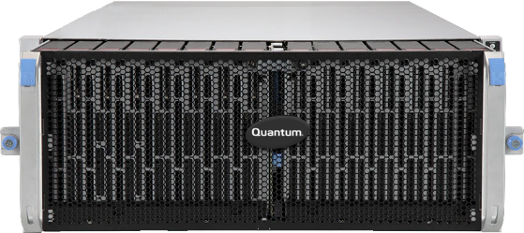
ActiveScale Secure, highly durable, and unlimited scalability
S3-Enabled Apps, Backup and Workflows
WAN, LAN, Internet
S3 and S3 Glacier Standard
Ultra-secure, green data storage
Manage exabytes with a single admin
Store and protect billions of files and objects

Slide 10
ActiveScale Deployment Options
Single site
Protects against disk, node, and component failure
3-Geo
Highest efficiency
Single data instance
Single namespace
Highest data durability
Protects against site failures
Site 1
Site 2
Site 3
Site 1
Two site
Site fault tolerance
Choose what buckets to replicate
Hybrid
Choose what buckets to replicate to the cloud
Site 1
Site 2
Site 1

Slide 11
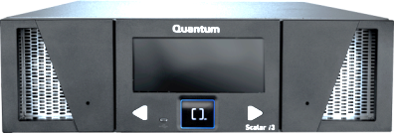
ActiveScale ColdStorage A New Class of Storage (Glacier on premises)
S3-Enabled Apps, Backup and Workflows
WAN, LAN, Internet
S3 and S3 Glacier Standard
Ultra-secure, green data storage
Manage exabytes with a single admin
Store and protect billions of files and objects
Unlimited Scalability
of both Active and Cold Storage
Automatic data moving with user defined lifecycle policies
Up to 19 9’s Data Durability
using patent-pending 2D erasure coding
Reduce Cold Storage Costs by 80%
using Quantum RAIL tape architecture
ActiveScale ColdStorage

Slide 12
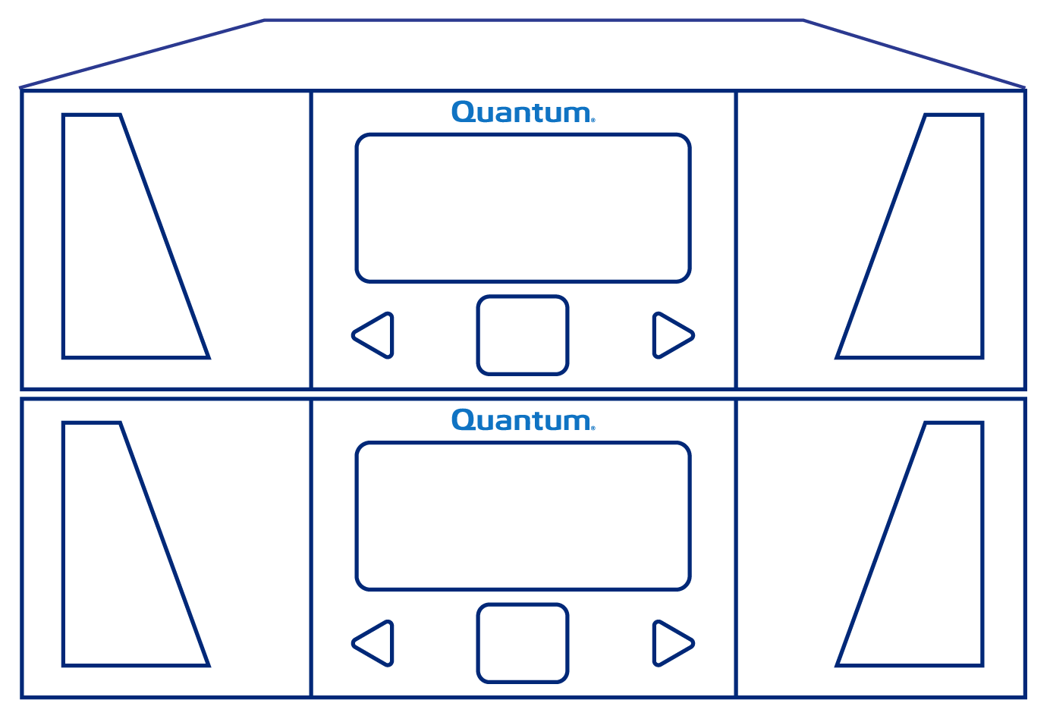
ActiveScale Cold Storage Low Cost, Durable, Secure Storage for Archiving and Long-Term Retention
Hyperscalers and Web Scale Businesses
Entertainment
& Sports
Research
Institutions
Government
Agencies
Telco &
Service Providers
Surveillance Archives
Finance and Banking
Objects (S3)
ActiveScale Object Software
1
ActiveScale
Disk Tier
Objects written to disk
using S3 Glacier API
ActiveScale
Cold Storage
Tier
2
Objects moved to cold storage based on lifecycle policy
Quantum Redundant Array of Independent Libraries (“RAIL”)

Slide 13
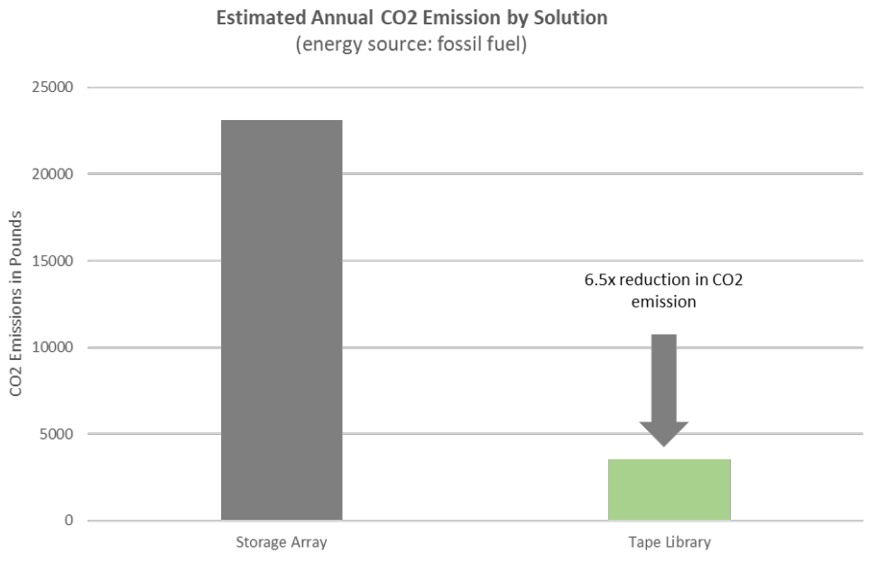
Why Tape?
Lowest Cost Storage
Up to 86% lower than disk or cloud (LTO Org)
Sustainability
Lower Energy
Lower Carbon Footprint
Reduce E-Waste
Reduce Recycling Carbon
Immutability
Portability
1 PB on just 23 tapes (compressed LTO-9)
Source: ESG, Sustainability Benefits of Deploying LTO Technology in Modern IT Ecosystems, 2022

Slide 14
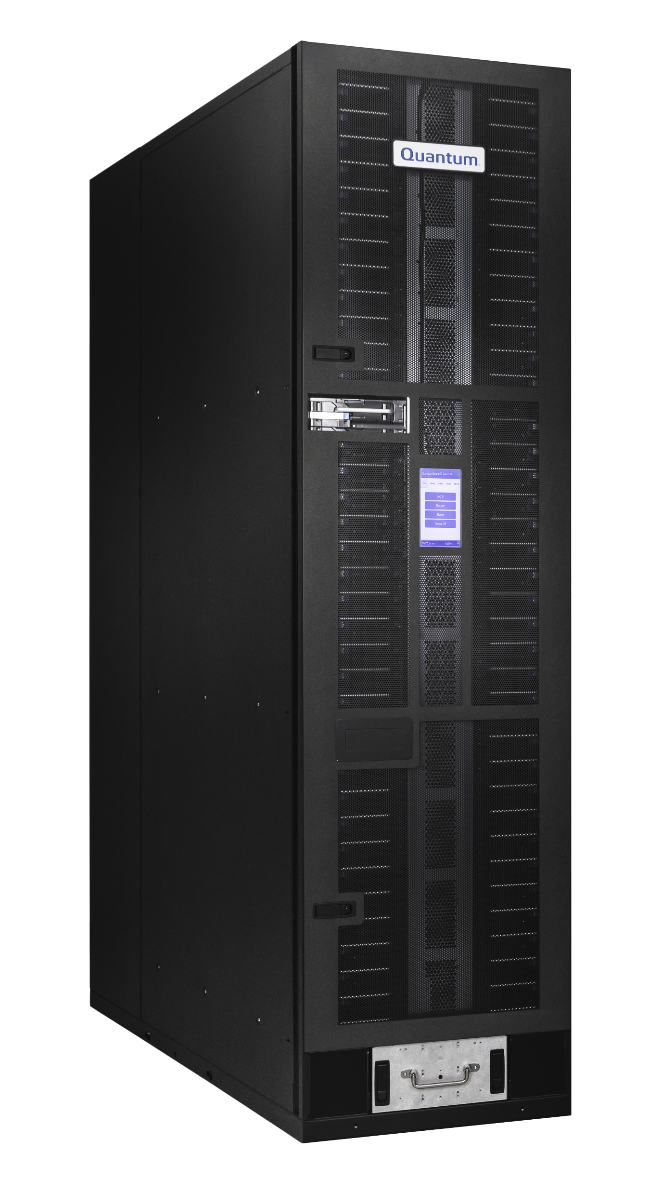
Quantum Tape Portfolio with Scalar i7 RAPTOR
All automation products designed by Quantum with full roadmap control.
Standalone Drives
Entry
Midrange
Enterprise/Hyperscale
Quantum LTO
Autoloaders
SuperLoader 3
(up to 16 slots)
Scalar i3
Scalar i6
Scalar i6000
Scalar i7 RAPTOR
Scalar Library Common Features, Interfaces (iLayer, REST API and SCSI), CBA and Encryption
Capacity | 25 – 400 slots COD: 25-slot increments 1 – 24 HH LTO drives 0 – 100 I/E slots, bulk load | 50 – 800 slots COD: 25-slot increments 1 – 24 FH LTO drives 0 – 240 I/E slots, bulk load | 100 – 14,100 slots COD: 100-slot increments 1 – 192 FH LTO drives 24 – 1,104 I/E slots, bulk load | 100 – 2,008 slots COD: 100 slot increments 1 – 20 FH LTO drives 8 – 16 I/E slots, bulk load

Slide 15
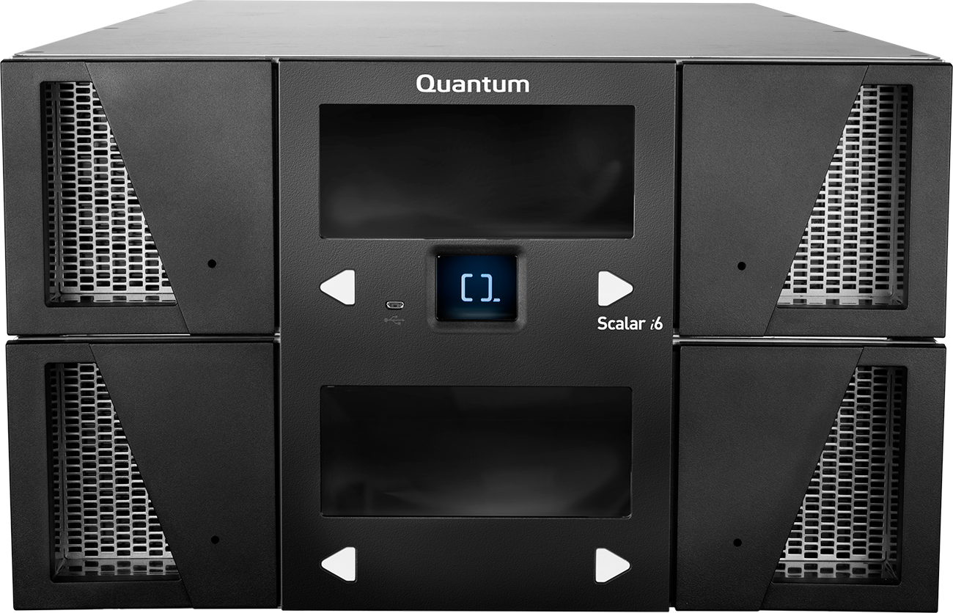
Quantum Active Vault for Ransomware Protection
Application
Partition
Backup./Archive Application
2. Administrator uses policy to “export” tapes to secure, in-library vault.
1. Data is copied to tape.
Scalar® Active Vault
Ultra-secure and totally offline
In-library vault
3. Tapes reside on shelf in the vault. No network connectivity. Tapes can only be retrieved from vault using administrator-directed command.

Slide 16
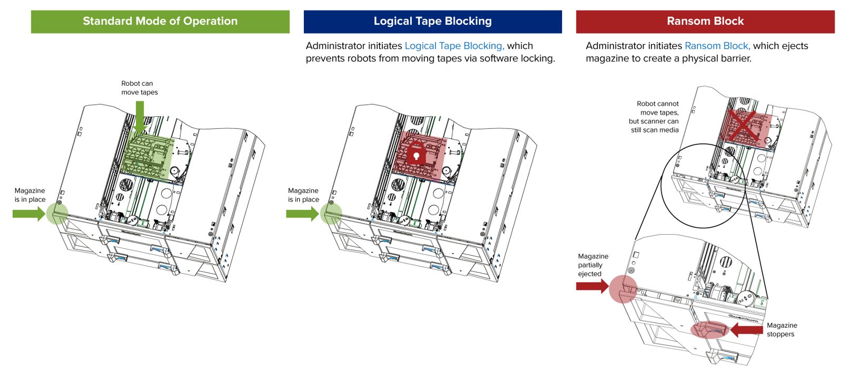
Introducing Scalar® Ransom Block

Slide 17
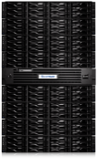
Quantum Dxi - Series Backup Appliances
High speed purpose-built backup appliances
Variable deduplication maximizes disk savings
Fine tuned replication engine enables multi-site DR protection
Industry-leading storage density minimizes footprint and spend
Multi-protocol access: CIFS/NFS, VTL, OST, and VDMS
Integrated with all leading backup applications
Ransomware with Secure Snapshot
DXi9200
110 TB to 2,2 PB
DXi T10-480
60TB to 240 TB
DXi T10-240
30TB to 240 TB
DXi T10-120
30TB to 120 TB
DXi T10-60
15TB to 60 TB
DXi V5000
Up to 256TB
* Using ACCENT

Slide 18
Tape Library Scalar i3
Uno strumento semplice ma molto efficace per
backup e per proteggersi dagli attacchi informatici
Configurazione in offerta
1x drive LTO-9 SAS
25 Slots licenziati
25 Slots per il vaulting (Air-Gap)
20 Nastri LTO-9
5 Nastri di pulizia
Licenza Active Vault
Licenza per il Ransom Block/Tape Blocking
3Y support Bronze (5x9xNBD)
Caratteristiche principali Scalar i3
Fino a 24 drives LTO e 400 slots (fino a 7,2PB)
Partitioning
Alimentazione ridondante
Funzionalità Air-Gap per protezione ransomware
Reportistica avanzata
Multi Factor Autentication
Prezzo promo: €10.500,00

Slide 19
DXi T-Series Appliance di Backup
Il primo appliance di backup all-flash per protezione
e ripristino dati ultra-rapidi.
Configurazione in offerta
1x DXi T10 backup appliance
30 TB di capacità licenziata (espandibile fino a 60TB con licenze incrementali)
Protezione ransomware con snapshot immutabili
Riduzione dei dati fino a 70:1 tramite deduplicazione variabile e compressione
Supporto per NFS / SMB / OST / VTL / AccentFS / VDMS
Funzionalità di tiering su cloud
3 anni di supporto Bronze (5x9xNBD)
Caratteristiche principali DXi T10
Backup e ripristino accelerati con prestazioni di ingest fino a 113TB/ora
Protezione avanzata contro il ransomware con snapshot immutabili e deduplicazione inline
Replicazione encrypted e tiering su cloud
Interfacce di rete flessibili, incluse opzioni 10GbE, 25GbE, 100GbE e Fibre Channel
Dimensioni compatte (1U) e ridondanza hardware per una maggiore affidabilità
Prezzo promo: €25.000,00

Slide 20
StorNext + Scalar i3 Tape Library
Un Appliance semplice ma molto efficiente per
realizzare un archivio a basso costo
warm data
Configurazione in offerta (940TB):
NAS ibrida HD + Tape:
Disk Tier: 40TB (net space)
Tape Tier: 900TB (net space)
Tiering automatico da Disk Tier a Tape Tier
StorNext 7
2x drives LTO-9
3Y subscription, Bronze (5x9xNBD)
Caratteristiche principali
Single Namespace
Accesso via SMB/NFS
Motore di tiering interno basato su StorNext 7
Funzionalità anti-ransomware
Scalabilità sia per Tier Disk che Tape (fino a 400 slots)
Gestione accessi, replica a/da sistemi NAS esterni, QoS, File system Audit
Predisposizione per tiering S3 su Cloud privato/pubblico
cold data
Prezzo promo: €75,000

Slide 21
Long Term Data Archiving – ActiveScale Cold Storage
Vantaggi:
Efficienza (solo 1 nodo per parity)
Affidabilità (Erasure Coding su dischi e nastri: si può perdere un intero sito senza impatto sul servizio)
Sicurezza (ogni oggetto è unico by design, con ObjectLock il dato è protetto contro ransomware)
Espandibilità e flessibilità (si può crescere sia sul layer nodi che su quello tapes)
Costo: €50/TB (minimo 4PB)
Site 2
Prezzo promo: €100.000,00
(3 nodi 300TB)
Site 1
Site 3
Unico NameSpace

Slide 23
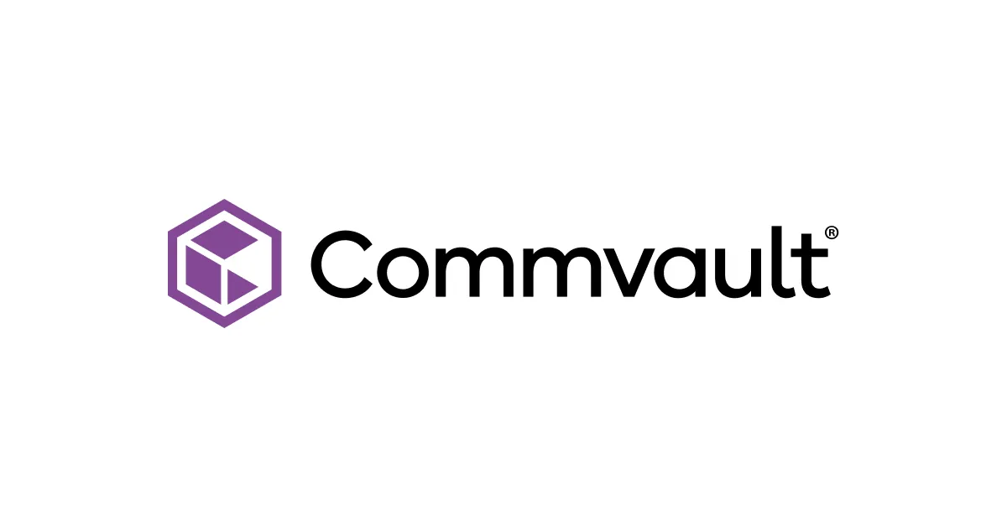
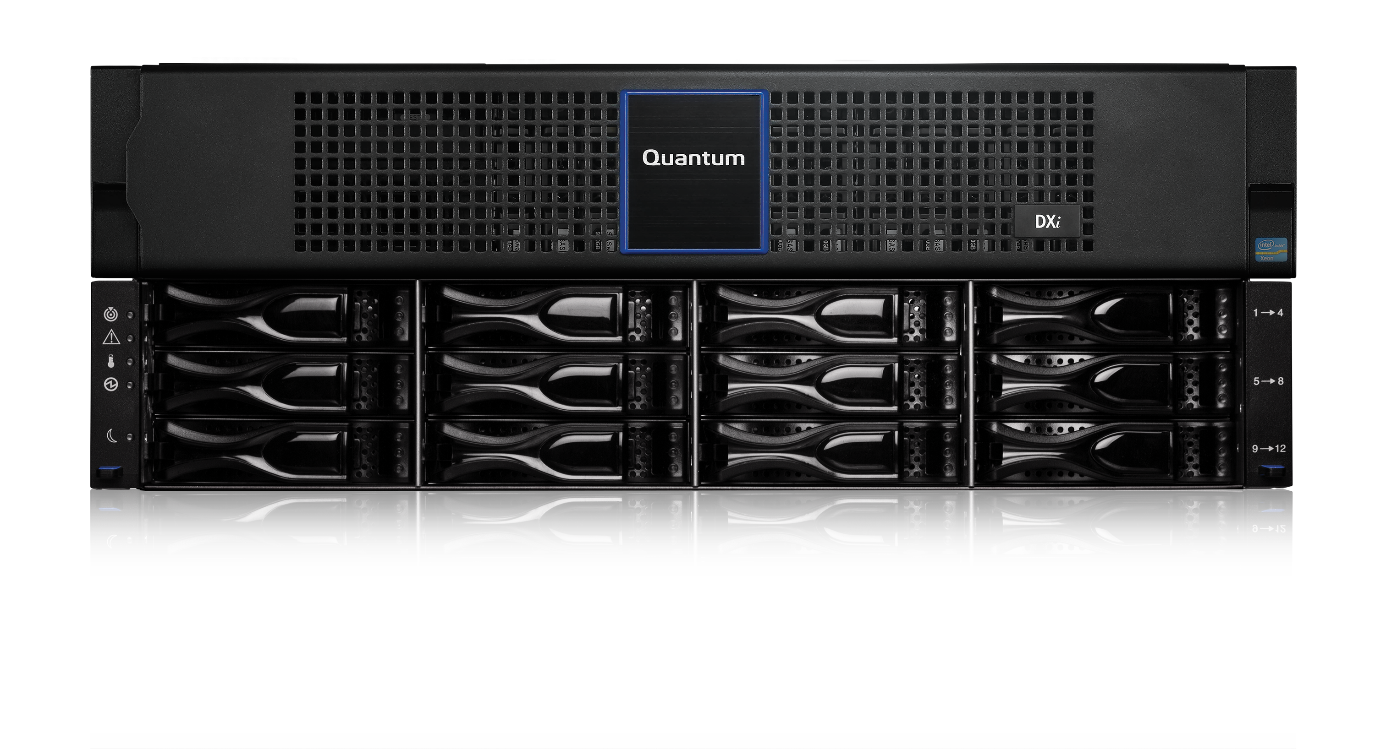
Integrated Backup infrastructure suite Secure, highly durable, low-cost storage for backup and archiving of cold data
Virtual DXi
Offload cold data
Upload Hot data
mirroring
DXi dedup appliance
ActiveScale ColdStorage

Slide 24
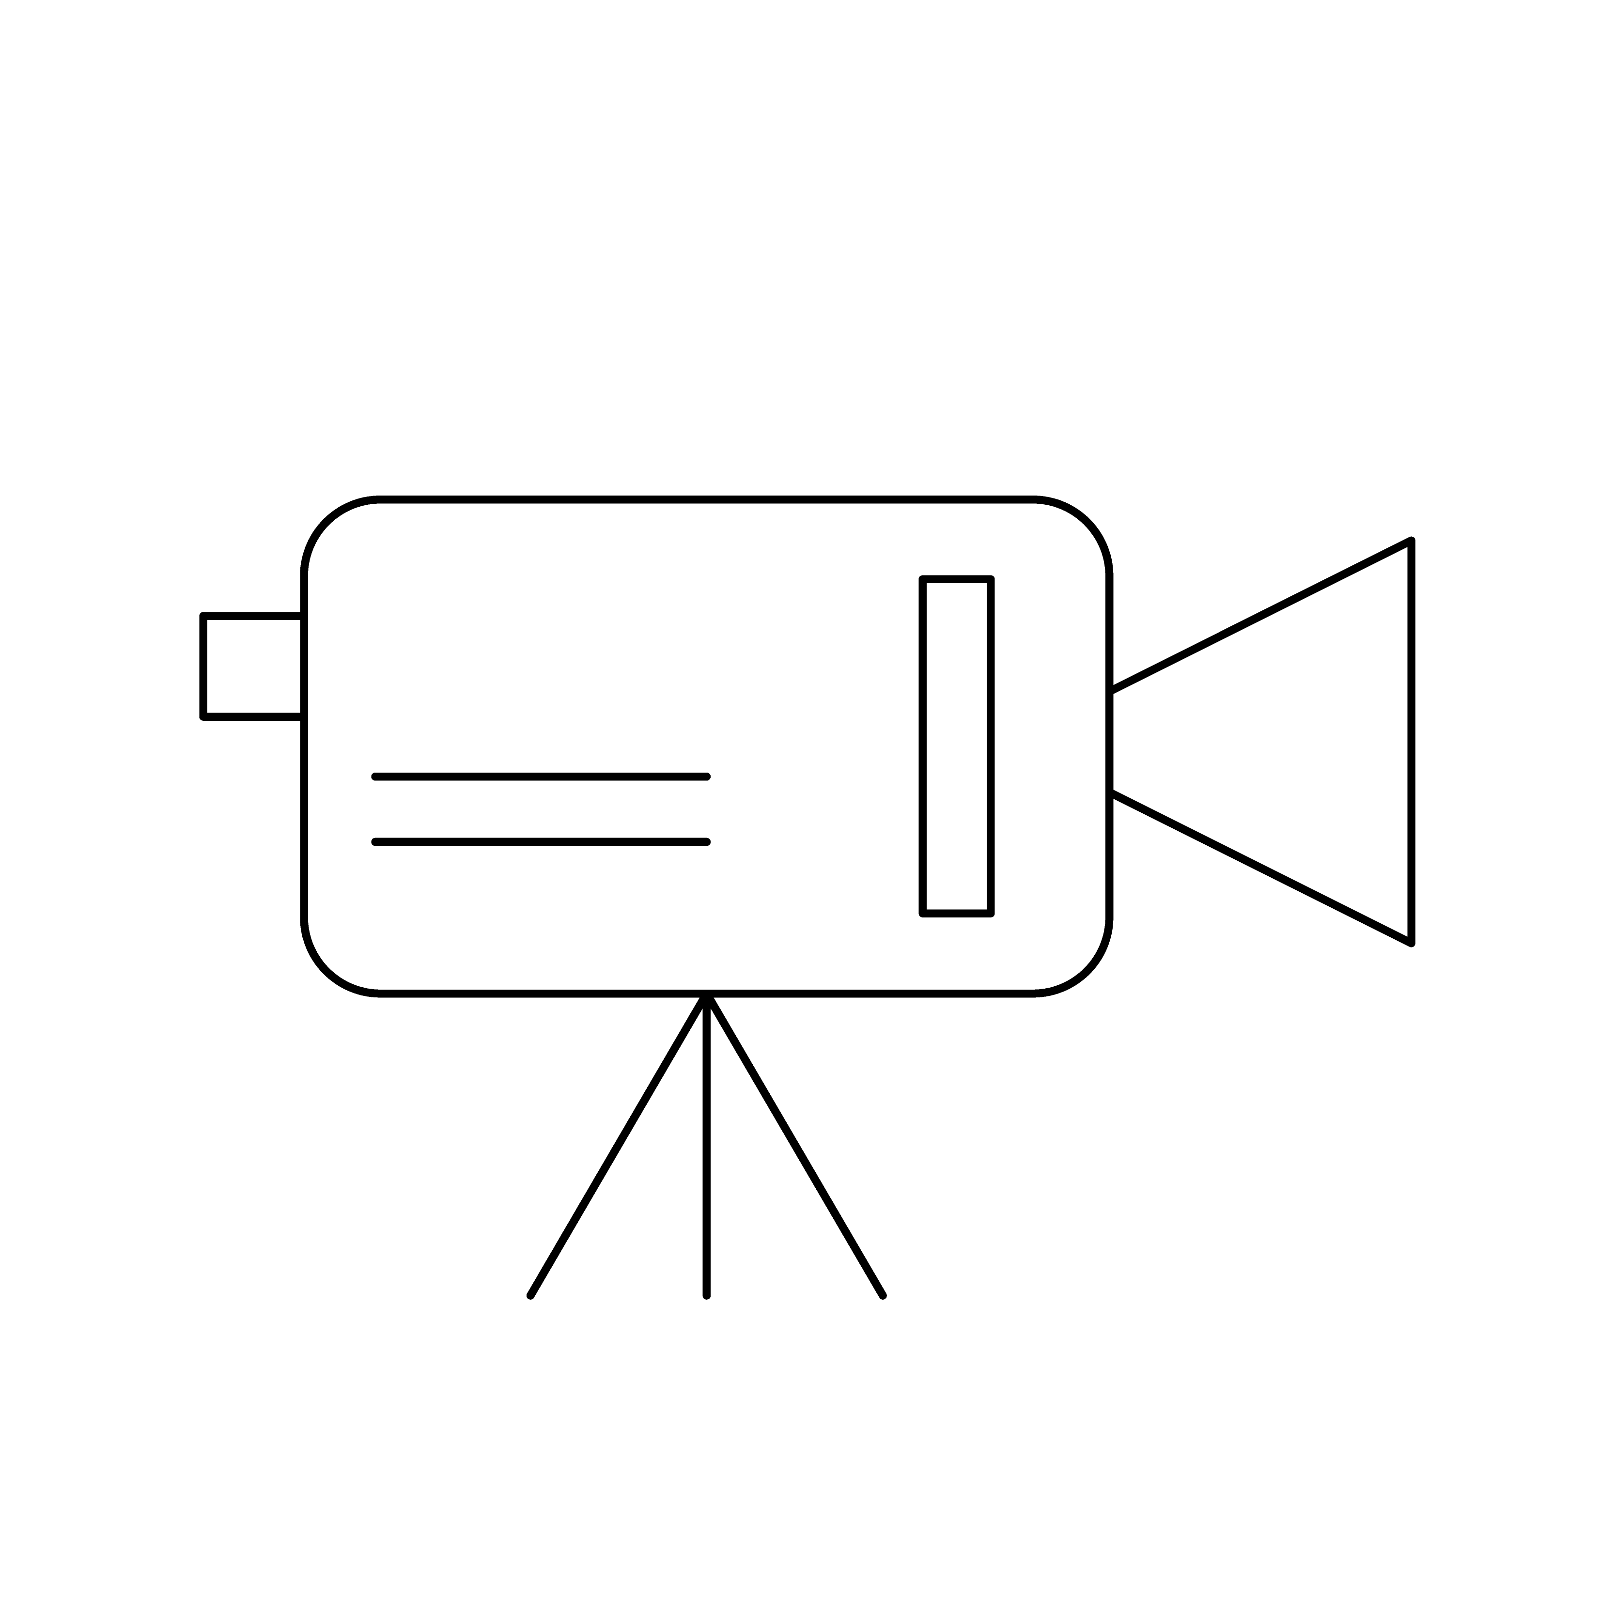
ActiveScale Cold Storage Low Cost, Durable, Secure Storage for Archiving and Long-Term Retention
Hyperscalers and Web Scale Businesses
Entertainment
& Sports
Research
Institutions
Government
Agencies
Telco &
Service Providers
Surveillance Archives
Finance and Banking
Objects (S3)
ActiveScale Object Software
1
ActiveScale
Disk Tier
Objects written to disk
using S3 Glacier API
ActiveScale
Cold Storage
Tier
2
Objects moved to cold storage based on lifecycle policy
Quantum Redundant Array of Independent Libraries (“RAIL”)

Slide 25
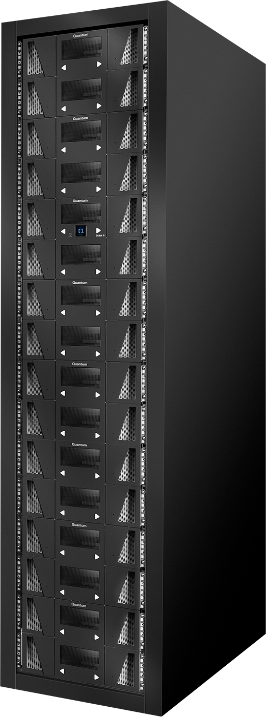
Patented 2-Dimensional Erasure Coding (2D EC)
HDD or NVME
Across-Tape EC: protect against multiple tape failures (e.g. 3)
Restore object from a single tape!!!
Low storage overhead (e.g. 20%)
Also
Only TB-sized writes to tape thanks to durable staging area
Optional library (RAIL) or Geo (3-Geo) failure protection
Optimised bulk restore (DR): restore queue reordering
Quickly recover from soft read errors (Within-Tape EC)
Read-after-write checksum verification (no tape drive corruption)
2 D
Tape

