Slide 1
Veeam VDP 13.1 & DR Scenario
Michele Tommei – Computer Gross
01 Ottobre 2026

Slide 2

Veeam VDP 13.1 & DR Scenario
Michele Tommei – Computer Gross
01 Ottobre 2026

Slide 3
?
La vostra azienda è operativa e produttiva con IT non disponibile ?
Che impatto può avere un blocco totale in termini di fatturato, utile, danno di immagine, produzione, materiali deperibili ?
Siete in grado di simulare una ripartenza del vs mondo applicativo (dati e app) domani mattina ? Quanto ci impiegate ?

Slide 4
Disaster
Recovery
VS
Backup
Disaster Recovery (DR): un modello di pianificazione della sicurezza strategica che cerca di proteggere un'azienda dagli effetti di un disastro naturale o indotto dall'uomo, come un tornado o un attacco informatico. Un piano DR mira a mantenere le funzioni critiche prima, durante e dopo un evento disastroso, causando così un'interruzione minima della continuità aziendale.
Backup: la copia dei dati in una forma secondaria (ad es. file di archivio), che può essere utilizzata per ripristinare il file originale in caso di evento disastroso.
Non sono sinonimi. E non puoi ignorare nessuno dei due. Ripristino di emergenza e backup dei dati vanno di pari passo per supportare la continuità aziendale. Tuttavia, riconoscere la differenza tra ripristino di emergenza e backup è essenziale per costruire una strategia aziendale resiliente.
https://gomindsight.com/insights/blog/difference-between-disaster-recovery-and-backups/
Notes:
NO ANIMATION
Includes technical architecture slides on the following: Software-Only Scale-Out, VMware vSphere, Microsoft Hyper-V, Continuous backup, disaster recovery, disaster recovery with long-term retention, continuous backup and disaster recovery

Slide 5
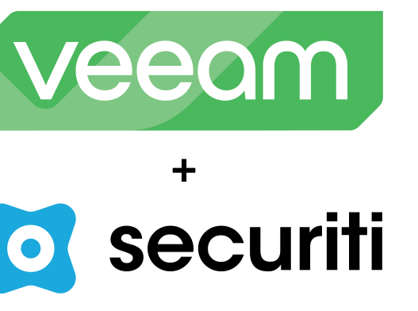
Veeam Securiti AI
Notes:
Securiti AI: azienda che si occupa di Security ed AI. Ancora stand-alone, ma si sta integrando nell'ecosistema Veeam. Per Veeam è un punto di svolta: consente a Veeam di spostarsi sul dato primario, di produzione, che indubbiamente Veeam protegge con i backup da sempre, ma ora esegue delle scansioni, consente di conoscere il contenuto dei dati di produzione etichettandoli rispetto a regole, norme, compliance aziendali e/o governative.
Securiti AI è una piattaforma che aggiunge a quanto conosciamo di Veeam il DSPM (Data Security Posture Management).
Securiti AI, azienda riconosciuta come riferimento nel campo del Data Security Posture Management (DSPM).
Con l’acquisizione di Securiti AI, Veeam elimina la complessità della gestione di dati frammentati tra applicazioni, cloud, soluzioni SaaS, endpoint e backup. CIO, CISO e CDO avranno a disposizione un centro di comando unificato per controllare e comprendere pienamente tutti i propri dati, proteggerli con una perdita di dati quasi nulla e senza interruzioni operative, recuperarli e ripristinarli con precisione, e liberare in sicurezza l’innovazione basata sull’intelligenza artificiale. Questo piano di controllo unico, che copre dati di produzione e secondari, consente alle aziende di gestire in modo uniforme l’intero patrimonio informativo, combinando le consolidate capacità di resilienza dei dati di Veeam con le soluzioni leader di Securiti AI in ambito DSPM, privacy dei dati e fiducia nell’IA.
https://www.veeam.com/it/company/press-release/veeam-to-acquire-securiti-ai.html

Slide 6
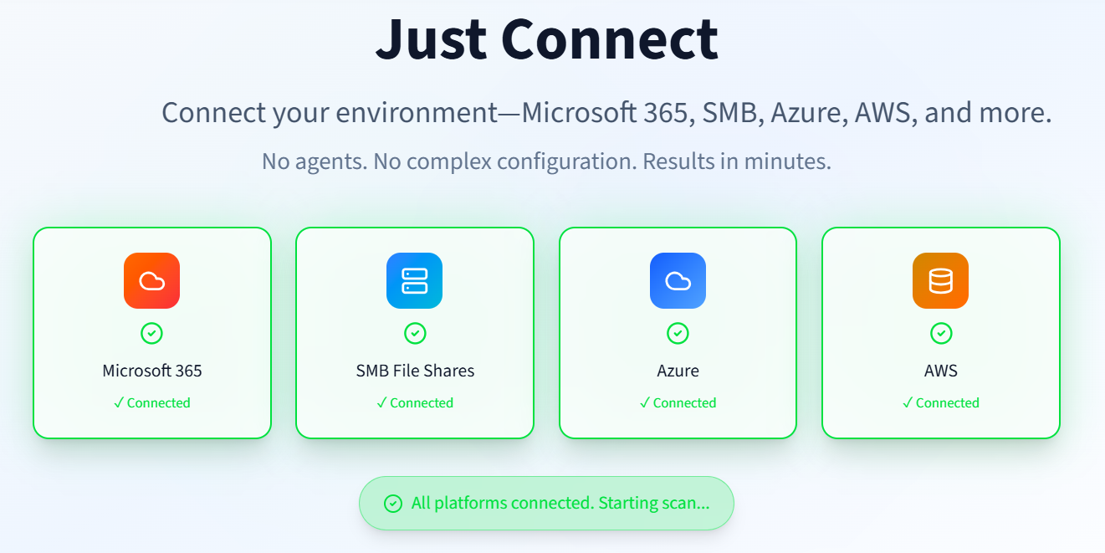
Veeam Securiti AI
Notes:
Con Securiti AI ho dei connettori per collegarmi a varie fonti.
Conoscendo il dato, so anche come proteggerlo al meglio.
Conoscendo il dato, so anche se sto violando delle normative.
Data Graph Commander: posso grazie a questo framework scoprire il dato, dov'è, chi lo sta accedendo, usando, e scoprire in questo modo delle anomalie, e magari che sto violando qualche normativa.
Securiti AI, azienda riconosciuta come riferimento nel campo del Data Security Posture Management (DSPM).
Con l’acquisizione di Securiti AI, Veeam elimina la complessità della gestione di dati frammentati tra applicazioni, cloud, soluzioni SaaS, endpoint e backup. CIO, CISO e CDO avranno a disposizione un centro di comando unificato per controllare e comprendere pienamente tutti i propri dati, proteggerli con una perdita di dati quasi nulla e senza interruzioni operative, recuperarli e ripristinarli con precisione, e liberare in sicurezza l’innovazione basata sull’intelligenza artificiale. Questo piano di controllo unico, che copre dati di produzione e secondari, consente alle aziende di gestire in modo uniforme l’intero patrimonio informativo, combinando le consolidate capacità di resilienza dei dati di Veeam con le soluzioni leader di Securiti AI in ambito DSPM, privacy dei dati e fiducia nell’IA.
https://www.veeam.com/it/company/press-release/veeam-to-acquire-securiti-ai.html

Slide 7
Veeam Data Platform v13.1
Notes:
13.0.1.2067 – Size : 19.6 GB Release Notes – March 12, 2026

Slide 8
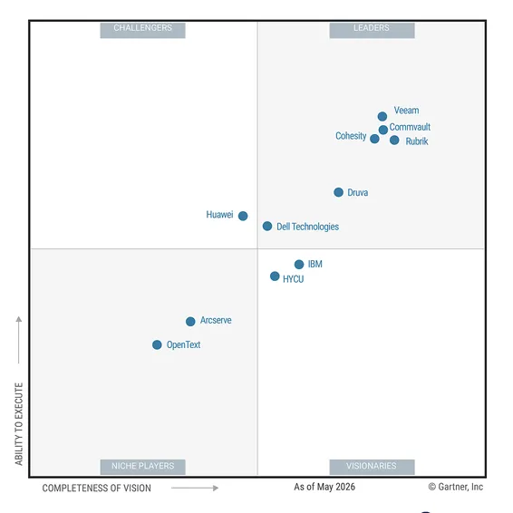
Gartner Magic Quadrant

Slide 9
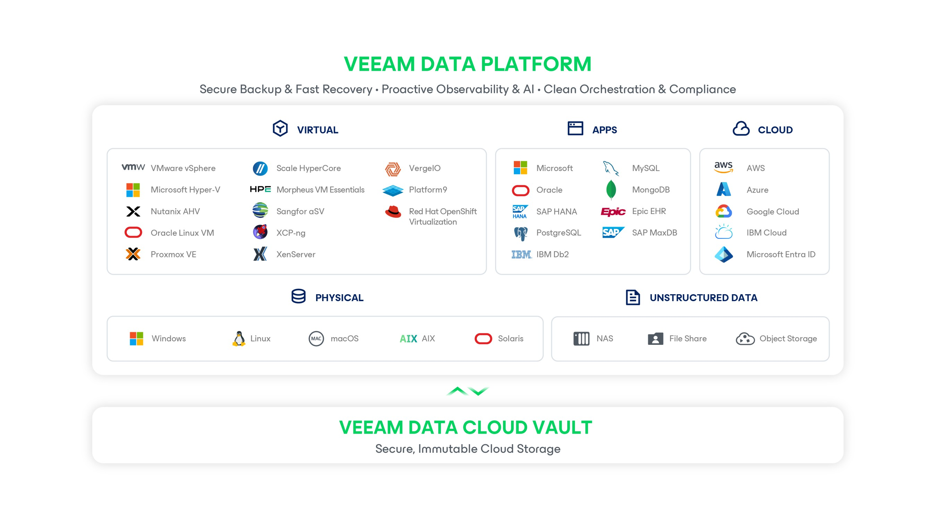

Notes:
Veeam Plug-in for Universal Hypervisor API: al momento supporta gli hypervisor VergeOS e Platform9. Maggiori info qui.
Qui si parla meglio di come dovrebbe funzionare, delle componenti che occorrono, che a quanto leggo devono essere anche software o vm da installare sull’hypervisor stesso.
“The Universal Hypervisor Manager is an application acting as an API endpoint that hypervisor vendors develop to enable integration with Veeam Backup & Replication” quindi non è più tanto Veeam a studiare le API dell’hypervisor e creare il software per fare backup, ma è quasi l’inverso, il vendor di turno crea un endpoint per integrarsi con Veeam.
In ogni caso Veeam deve certificare il tutto.
Epic EHR è un software di cartella clinica elettronica (Electronic Health Record) sviluppato da Epic Systems, un'azienda americana fondata nel 1979. Serve a raccogliere, gestire e consultare i dati sanitari dei pazienti in modo digitale.

Slide 10



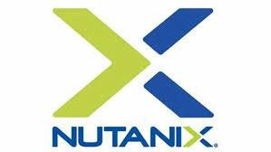
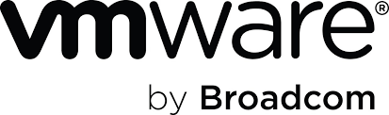
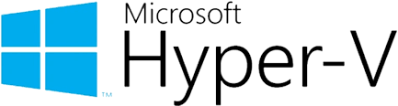






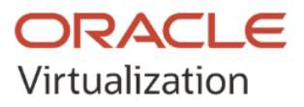









One Veeam Data Platform, Every Hypervisor
Morpheus VM Essentials

Slide 11
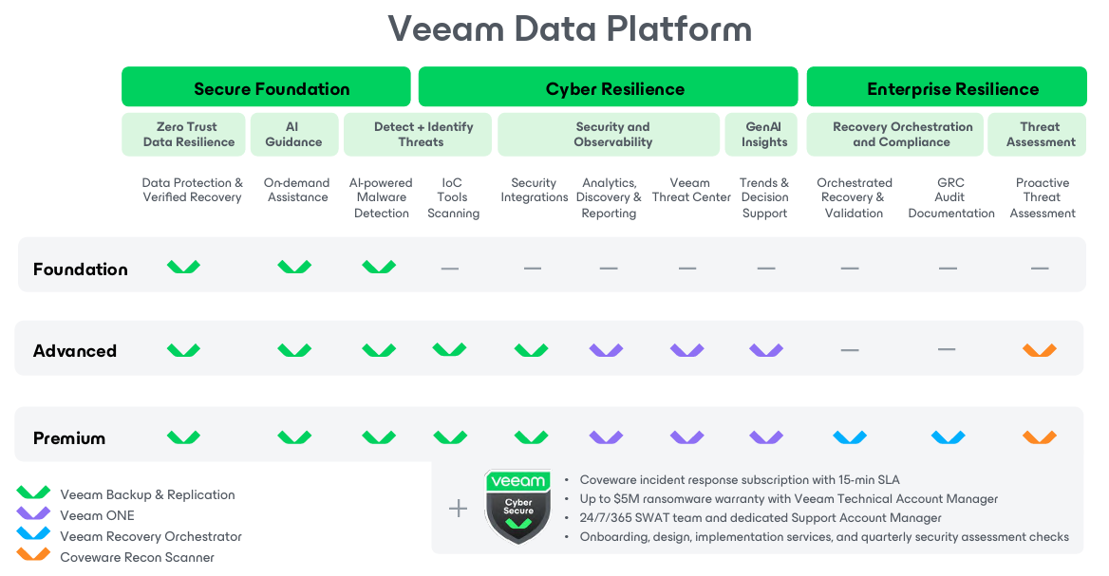
Veeam Data Platform v13.1
https://www.veeam.com/veeam_data_platform_feature_comparison_ds.pdf

Slide 12
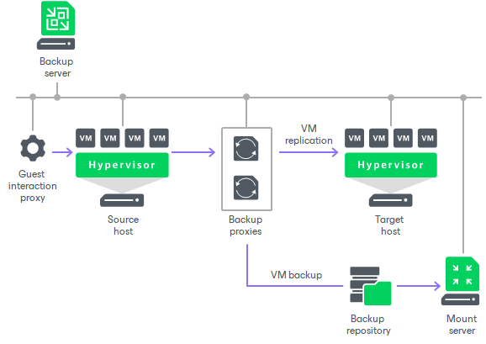
Veeam Backup & Replication Architecture

Slide 13
Veeam Software Appliance
Veeam Software Appliance delivers secure, out-of-the-box backup—deployable VDP in minutes and easy to manage, with full flexibility to support new or existing environments.
Simple to Deploy
Secure from Day One
Eliminate headaches and remove operational burden with
a prebuilt, ready-to-run appliance that is easy to install and manage
Compliant and Secure-by Design Architecture
with automated updates that prevents misconfigurations and inconsistencies.
Easy to deploy, Maintain and Manage
as a VM on ANY hypervisor or as a physical server on ANY hardware
Who is this for? New Customers. Existing customers who want to install for New Environments.
Conversion path coming for existing environments later in Q4.

Slide 14
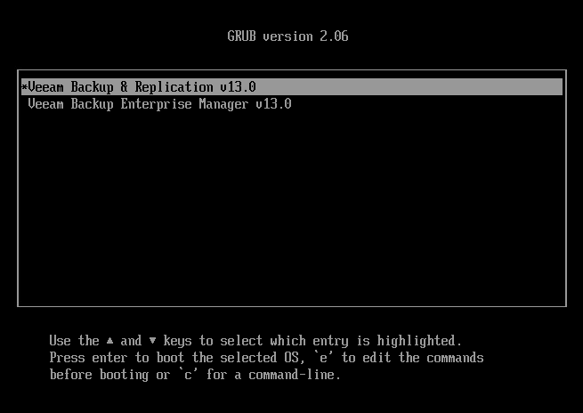
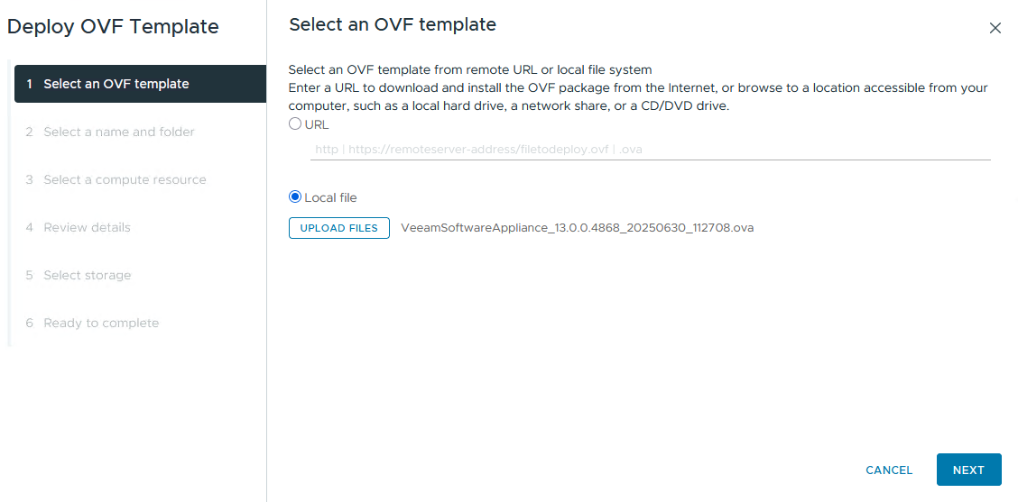
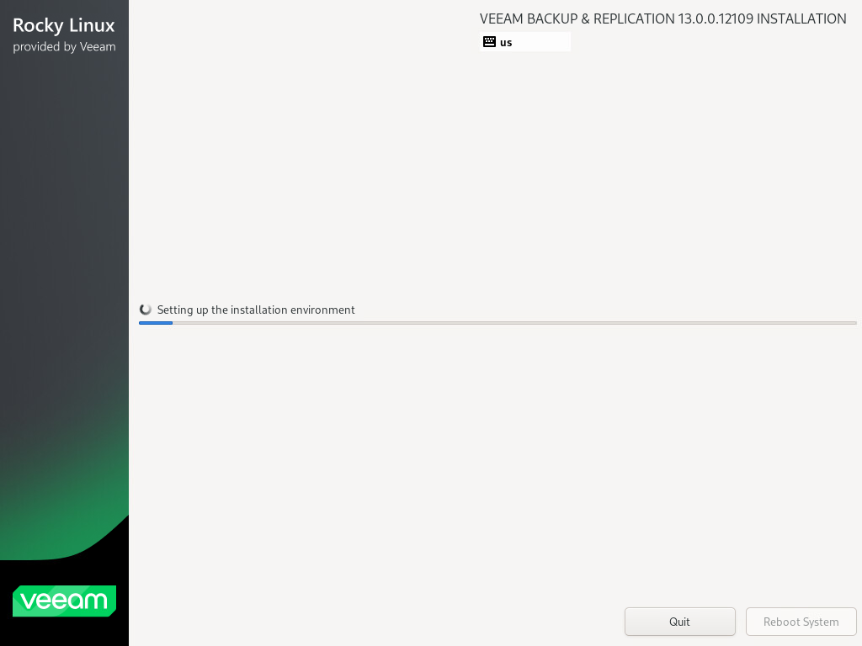
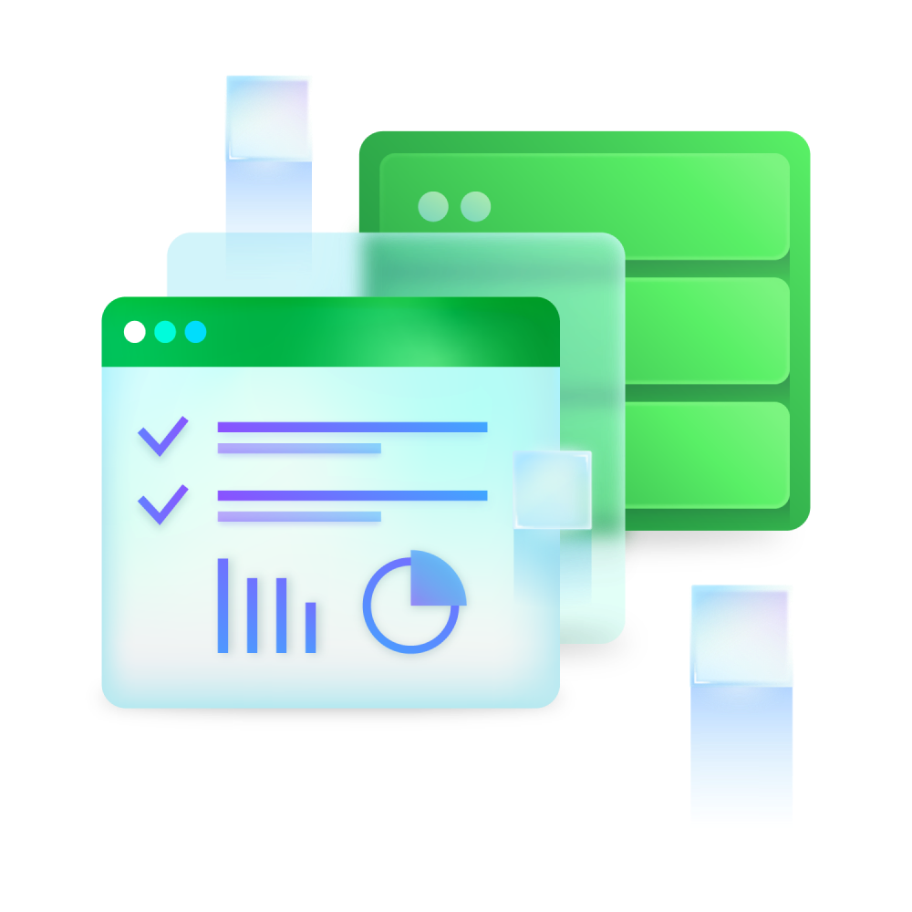
Veeam Software Appliance

Slide 15
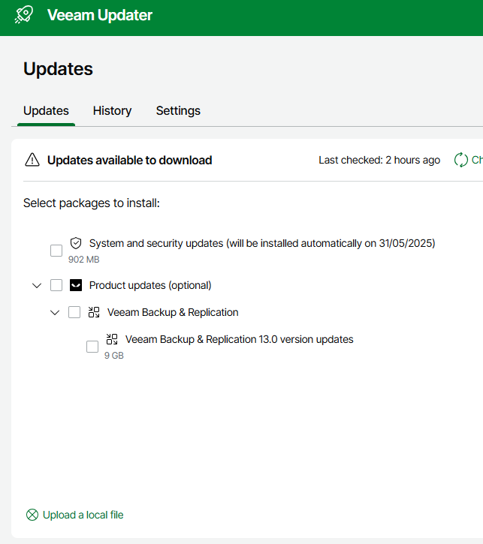
Central Automatic Updater
Centralized, automated updates
for all Veeam components
Mandatory updates
  Veeam cumulative & security updates (e.g., 13.0.x)
  Operating system security updates
Optional updates
  Minor product updates (e.g., 13.x)
  Major product updates (e.g., 14.0)
Notes:
Con la Software Appliance Veeam si occupa anche degli aggiornamenti del sistema operativo. Questa appliance condensa tutti i ruoli.
Veeam updater has no dependency on a running Veeam Backup & Replication. That means even if the backup service needs a hotfix, one can install it even if the backup service would have failed for whatever reason.

Slide 16
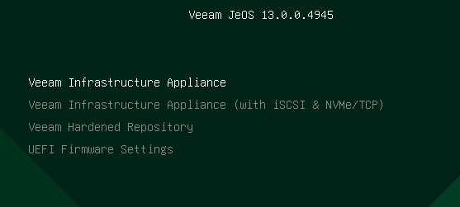
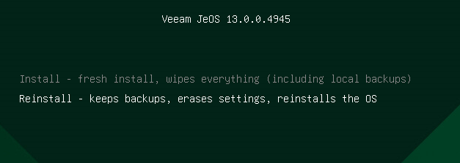
v13 Linux Veeam Software Appliance
Just Enough Operating System (JeOS) ISO Use Cases
The JeOS ISO (< 2GB) can deploy
Veeam Infrastructure Appliances
  All Backup & Replication roles except tape server
  Regular Linux Repository, WAN accelerator,
  VMware Proxy, File / NAS Proxy, etc.
  Hardened Repository
Installation to physical or virtual machine
Web UI for Host Management
“Pair” with a VBR server
to deploy roles, manage updates, etc.
Notes:
Niente supporto per le antiche licenze a socket. Solo VUL. E niente Community (che esisterà con la v13 Windows-based).
Veeam JeOS è una Rocky Linux Veeam Customized, pronta ad eseguire un ruolo Veeam. Una volta installata, la aggiungo al backup server e implemento il ruolo che voglio che esegua (proxy ad esempio, non tape server, che devi installare manualmente su Linux).

Slide 17
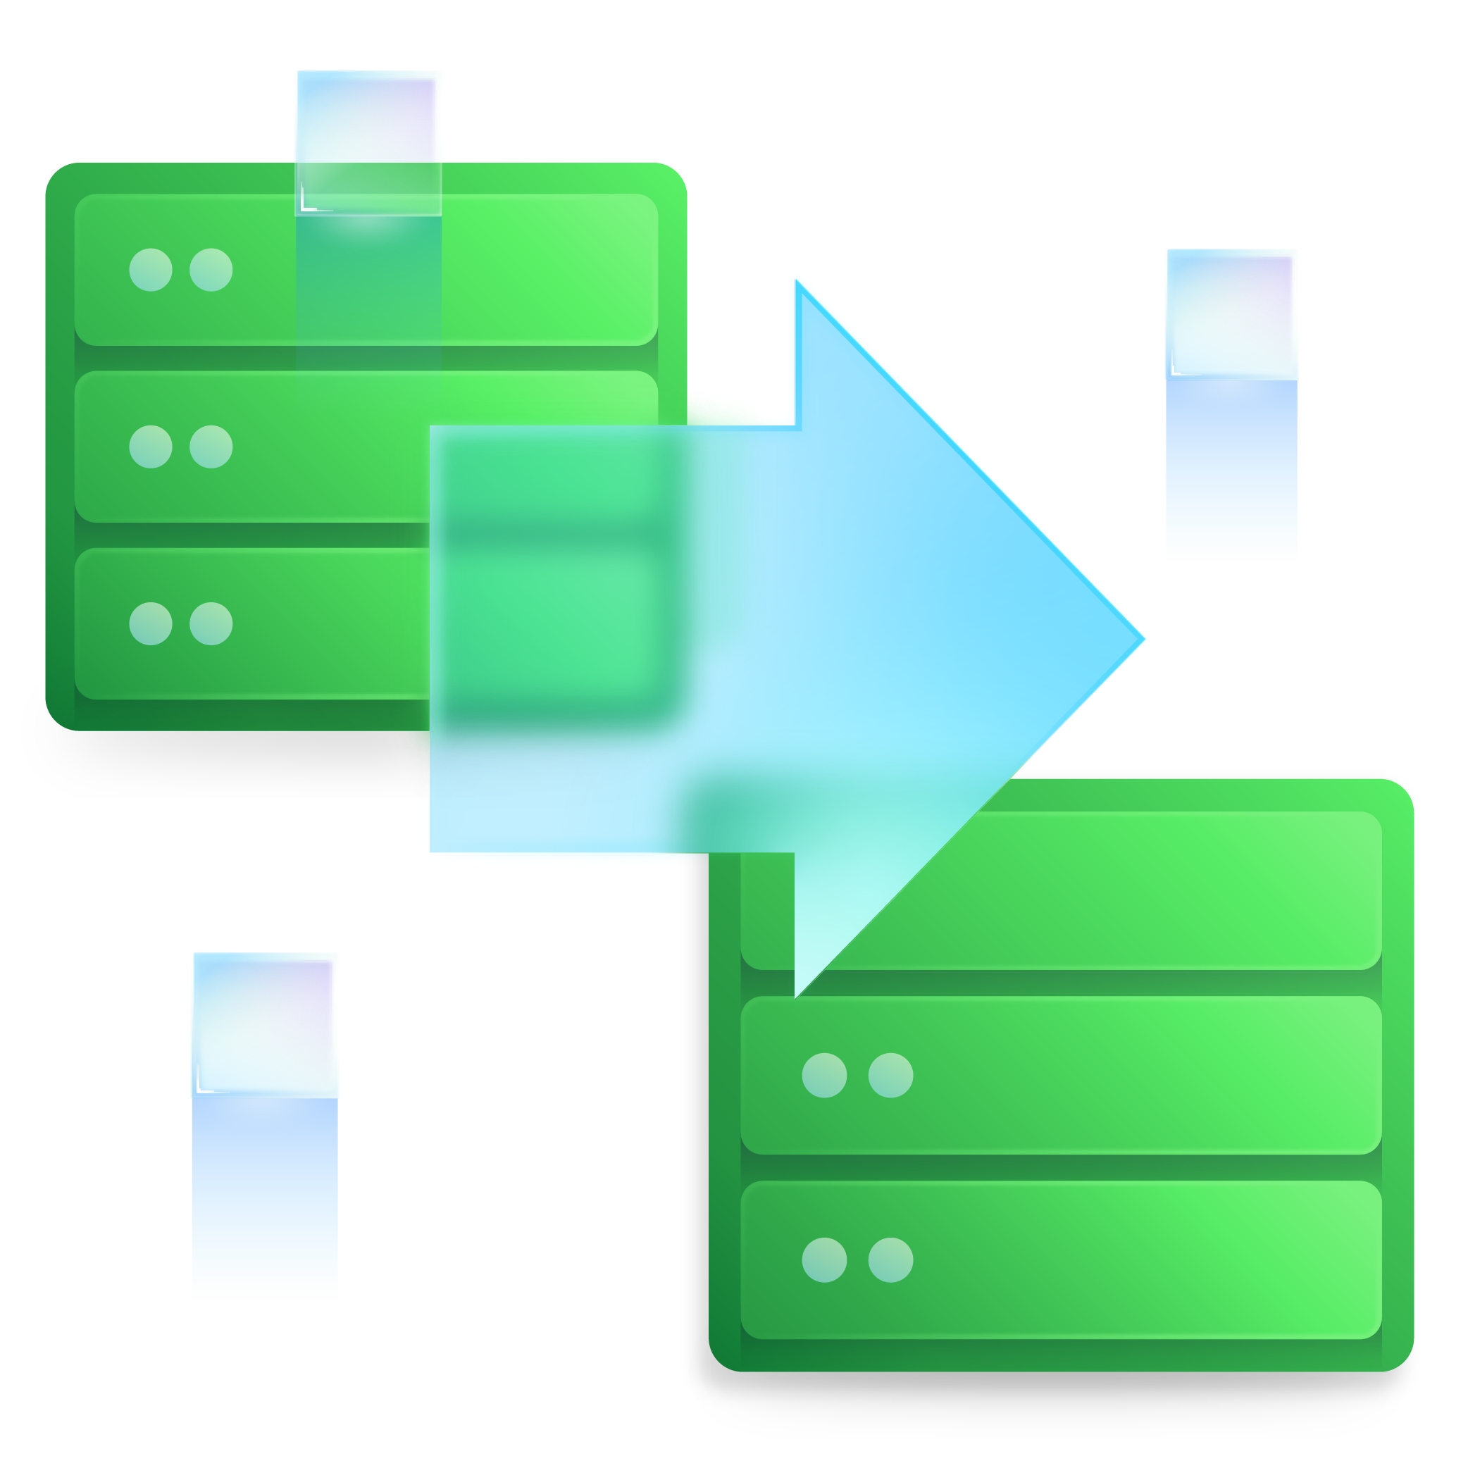
Backup Server
High
Availability
Continuous synchronous configuration database synchronization with high-latency network links support
Secrets are re-encrypted automatically to be usable by the standby backup server
One-click failover and failback
Requires Premium edition of VDP

Slide 18
Reduce Backup Server Downtime With High Availability
Two nodes (primary & secondary)
High latency supported
Automated updates for both
nodes
Manual failover
Fast disaster recovery without
configuration restore
Backup Console
Web UI
High Availability Cluster
Primary Node
Secondary Node

Slide 19
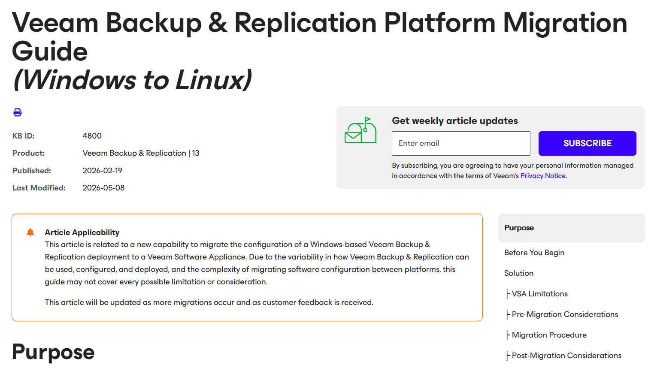
Platform Migration
https://www.veeam.com/kb4800

Slide 20

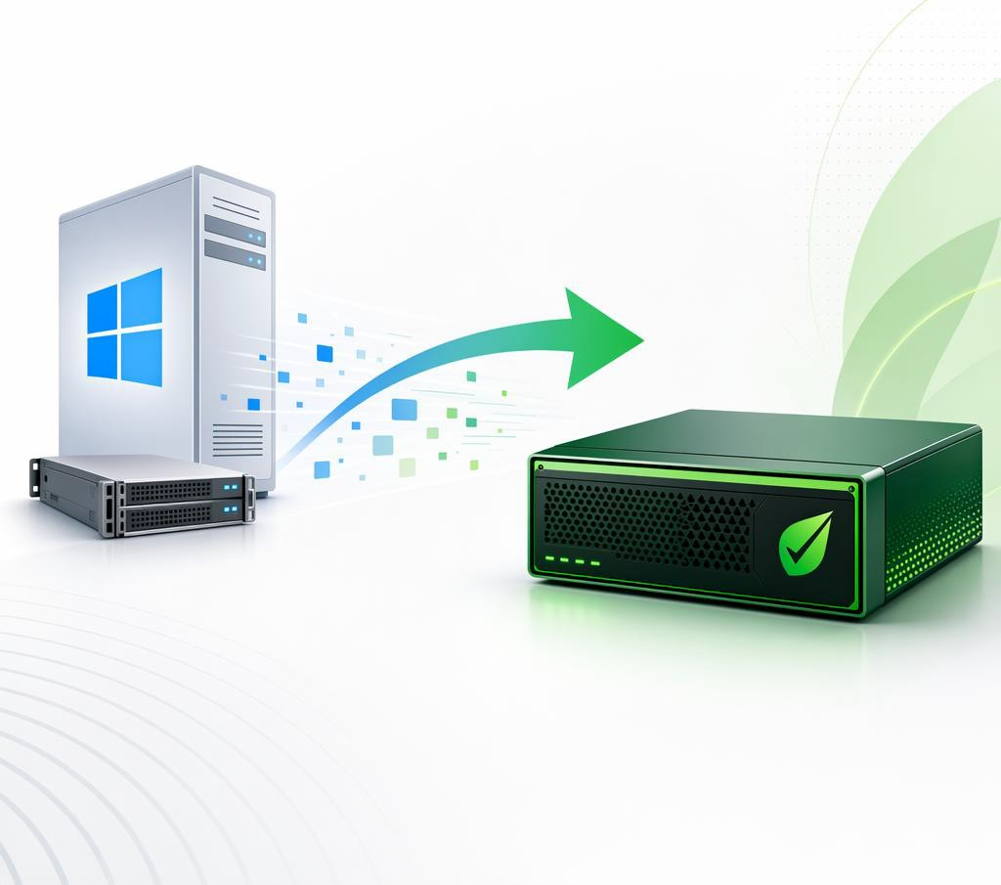
Migration from Windows Backup Server to Veeam Software Appliance
Current deployment Windows backup server | Supported migration target Veeam Software Appliance
v13.0.2 | v13.0.2
v13.0.3 | v13.0.3
v13.2 | v13.2
Check https://go.veeam.com/vsa-conversion
Not supported:
13.1 Windows backup server to Veeam Software Appliance (any version)
AI generated
Solution: Upgrade to 13.2 on Windows and then migrate to 13.2 Veeam Software Appliance

Slide 21

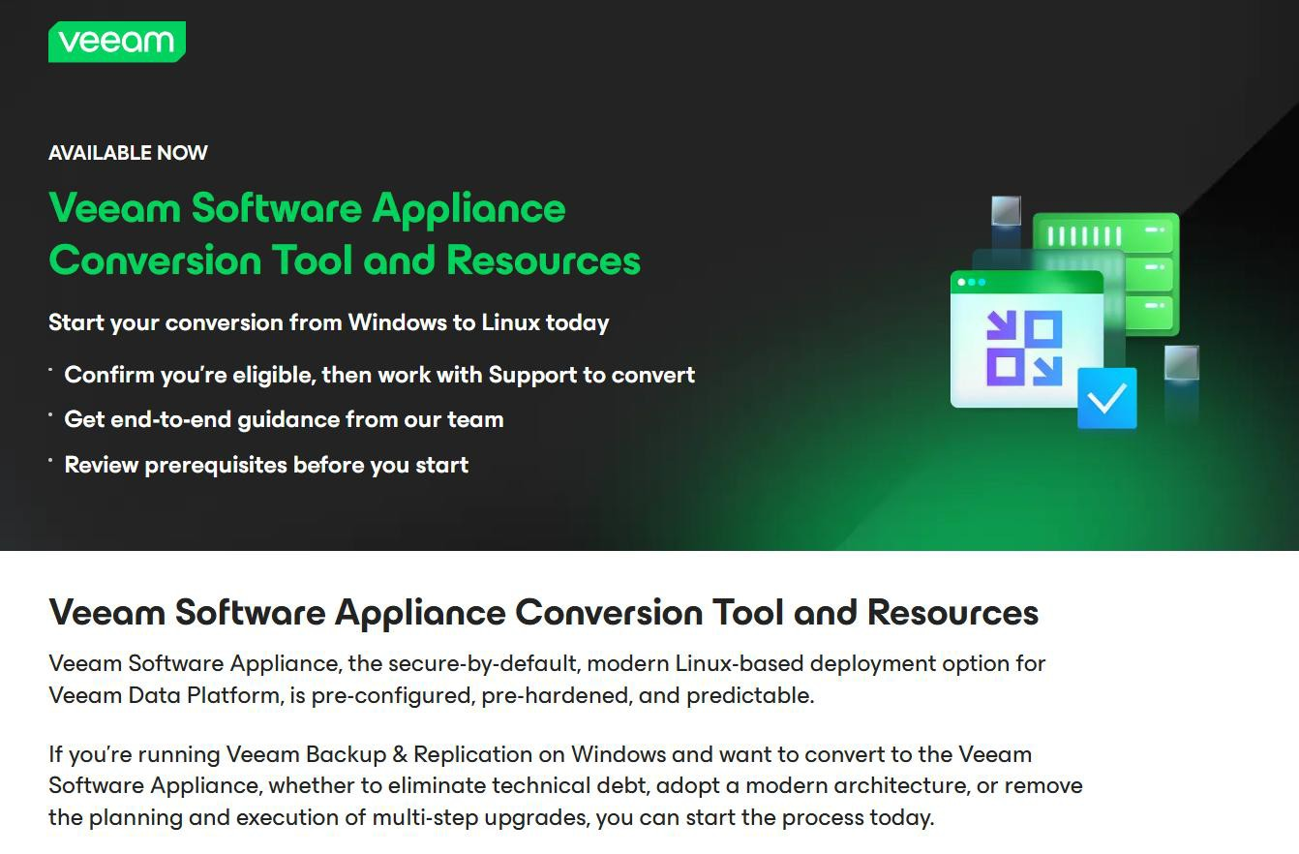
https://go.veeam.com/vsa-conversion
Review Veeam KB4800
Update to latest 13.0.x patch
Enable “proactive support”
Open support case

Slide 22
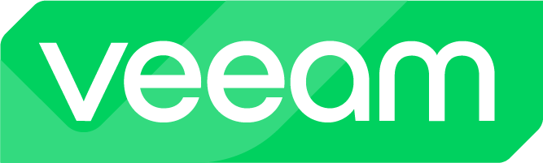
3-2-1-1-0 Rule

Slide 23
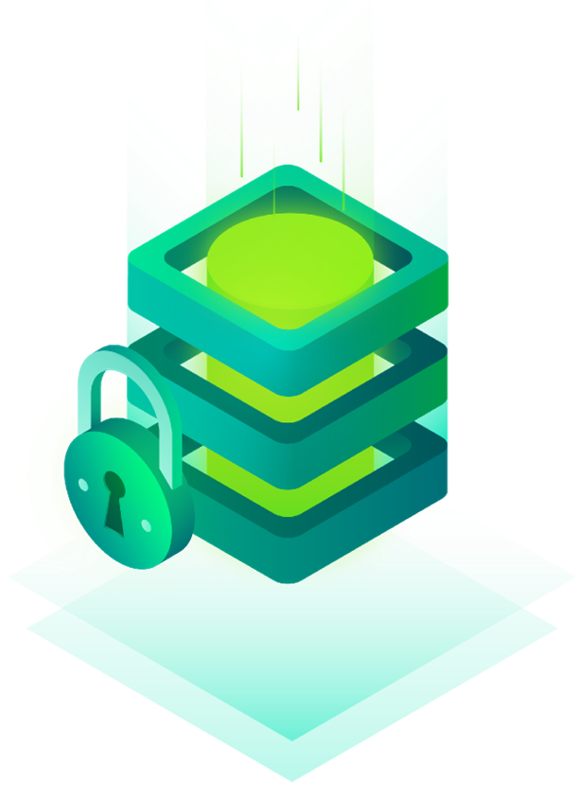
VEEAM BACKUP REPOSITORY – IMMUTABLE BACKUP
Veeam Data Cloud Vault
Amazon S3 Storage
S3 Compatible Storage
Microsoft Azure Storage
Google Cloud Storage
IBM Cloud Object Storage
Wasabi Cloud Object Storage
11:11 Cloud Object Storage
Hardened Linux Repository
Veeam VSA / VIA (JeOS)
HPE StoreOnce Catalyst
Dell DataDomain
WORM Tapes

Slide 24



Industry Leading Threat Detection
Before Backup
During Backup
Post Backup and Recovery
Recon Scanner from Coveware by Veeam
Observability, Analytics & AI-powered insights
Veeam Incident API
Security & Compliance Analyzer
IoC Tools Scanner
AI-powered inline entropy analysis
File System activity analysis
Immutability combined with single-use credentials
Signature-based malware scanning
YARA rule-based scanning
Secure Restore to prevent reinfection
Orchestrated restore & Cleanroom

Slide 25

Alcune Best Practice
Seguire la regola 3-2-1 (con copia immutabile o air gapped)
Scegliere password complesse, e cambiarle periodicamente
Aprire solo il numero di Firewall Ports necessarie
Preparare un piano o strategia di Recovery
Testare la ripristinabilità dei propri backup
Usare il principio del privilegio minimo
K.I.S.S. (evitare inutili complessità)
Rimuovere componenti software inutilizzate
Proteggere i server NTP
Laddove possibile usare la MFA e la «molteplice autorizzazione»
Disabilitare accesso SSH e IPMI sui Linux Repository immutabili (fisici)
Scansionare i backup prima di un ripristino, o programmare scansioni regolari
Criptare i dati per paura di esfiltrazioni
…
“Eseguo il backup dei miei file in modo religioso.
Prego che non gli succeda niente.”
Notes:
https://helpcenter.veeam.com/docs/vbr/userguide/malware_detection_guest_index_enable.html?ver=13
https://helpcenter.veeam.com/docs/vbr/userguide/malware_detection_guest_index_ioc.html?ver=13

Slide 26
Veeam DR Scenario

Slide 27
Backup Copy

Slide 28
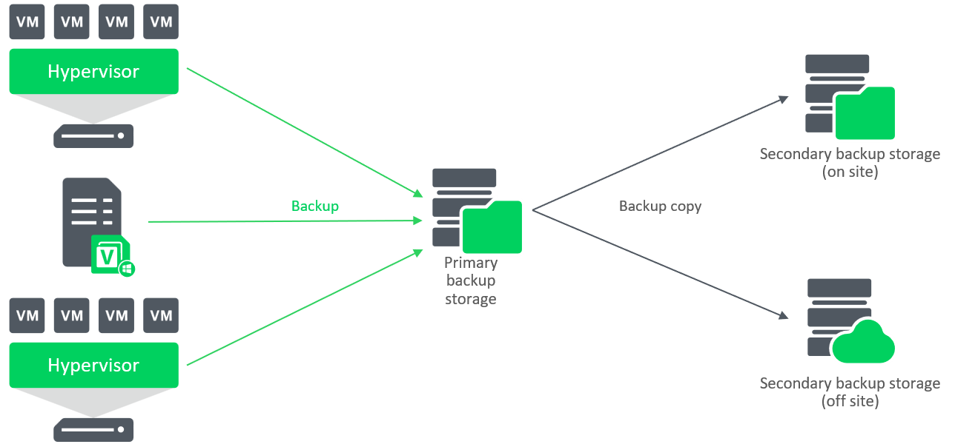
Veeam B&R – Backup Copy Job

Slide 29
One Veeam Data Platform, Every Hypervisor
Morpheus VM Essentials

Slide 30

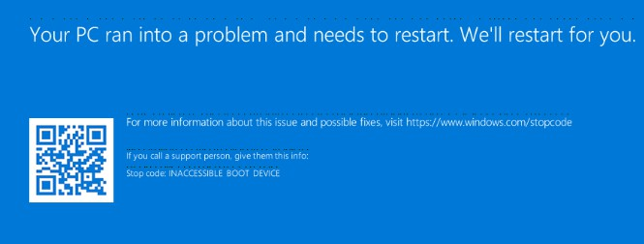

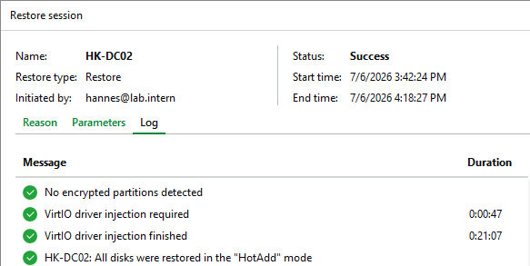
Seamless Cross-Platform Restore for Windows Machines
Problem
Windows fails to boot when doing cross-hypervisor restore from non-KVM based platforms
Solution
Before 13.1: pre-install VirtIO drivers manually With 13.1: automatic driver injection during
restore

Slide 31

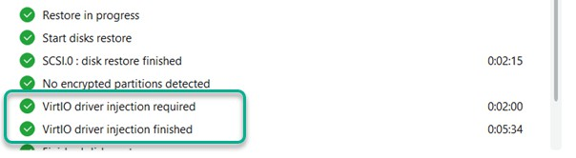


VirtIO Driver Injection Overview
Supported: Nutanix, HPE Morpheus VME, Proxmox VE, Scale Computing Hypercore
Start VM restore
Worker reads data from backup & writes
to temporary disk attached to worker
Worker checks if VirtIO drivers are needed
If needed, worker adds VirtIO driver files to disks & edits registry
Temporary disk updated & cloned to
restored VM
6
5
1
Restored VM
6. Temporary disk attached to worker deleted
2
4
VirtIO drivers
Backup from another platform
3
Worker

Slide 32

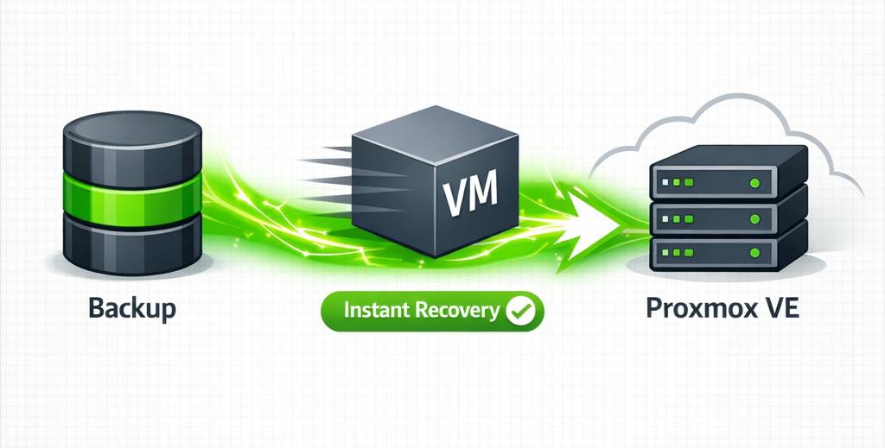
Recover Faster with Instant Recovery for Proxmox VE
How it works:
Backups mounted via NFS Proxmox host
Start VM
Changes written to mount server OR Proxmox host
Migrate to production to finalize restore
Notes:
Only qcow2 disks supported in v13.1
Experimental support in v13.1
AI generated

Slide 33
VM Recovery Options
VMware
Hyper-V
Nutanix AHV
Azure*
Proxmox
Instant Recovery
Vmware, Hyper-V, Nutanix AHV, PVE, KVM
Sangfor aSV, XCP-ng, Xenserver, VergeIO and Platform 9
Backup server
VMware
Hyper-V
Nutanix AHV
PVE
KVM
AWS EC2
Azure
GCP
Full
Recovery
AWS EC2
Azure
GCP
Cloud Full
Recovery
Notes:
For Instant Recovery to Azure. Prior to workload recovery, it is necessary to deploy a helper appliance template in the intended recovery region.
For more information, please consider this reference. https://helpcenter.veeam.com/docs/vbr/userguide/ir_azure_considerations.html
Sangfor aSV:
Full restore parity with Proxmox VE, oVirt KVM, and cloud platforms
Instant Recovery to vSphere and Hyper-V
Application-level and file-level granular restore
XCP-ng and XenServer
Full backup, copy, and cross-platform restore coverage
Instant Recovery to vSphere and Hyper-V
Disk export to VMDK, VHD, and VHDX
VergeIO & Platform9
Instant Recovery to vSphere and Hyper-V
Full granular and disk operation support
Powered by Universal Hypervisor API

Slide 34
Replica

Slide 35
Replication use cases
Disaster Recovery (DR) with On-Demand Failover
Instantly switch to replica VMs for business continuity during site failures.
Continuous Data Protection (CDP)
Achieve near-zero RTO and RPO with continuous VM replication.
Planned failovers/migrations
Seamlessly migrate workloads between sites with minimal disruption using planned failover.
Granular restores
Restore VMs, files, or application items directly from replica VMs.

Slide 36
Backup vs Replicas
Virtual machine data protection comparison
Backup
Does not require an alternative virtualized infrastructure Only consumes storage resources Storage consumption can be reduced with compression and deduplication Backup files can be immutable Restores to the same or different platforms
Regular Replica
Lowest RTO Replica VMs can be powered on directly from the virtualization platform (not recommended - use Veeam failover) Restores with immediate high performance All restore points can be application-consistent Restores only to the same platform (e.g. vSphere, Hyper-V or Proxmox VE)
CDP Replica
Lowest RPO and RTO Recover from virtualization platform is not supported. Failover operation must be used Restores with immediate high performance Restore points are a combination of application and crash-consistent Restores only to the same platform (vSphere)

Slide 37
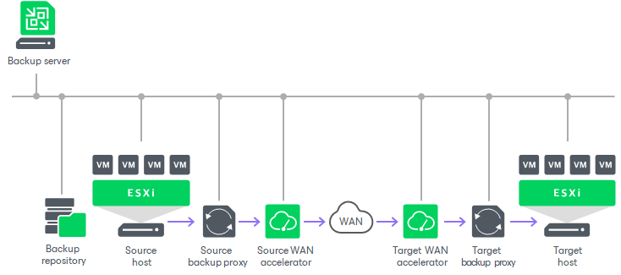
Veeam B&R – Replication Job

Slide 38
Disaster Recovery with VM-based Replication
PRODUCTION SITE
RECOVERY SITE
REPLICATION
VM-01
VM-02
VM-01
VM-02
replica
replica
FAILOVER / FAILBACK
Minutes
Low RPO
Near-instant
Fast RTO

Slide 39

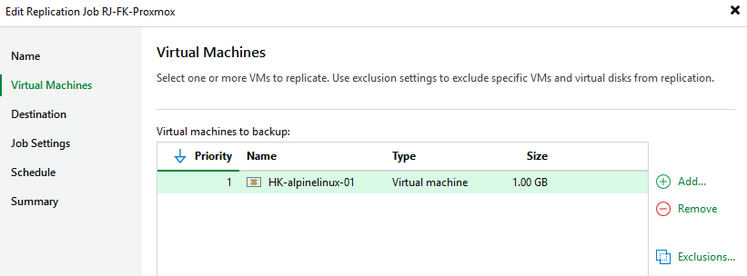

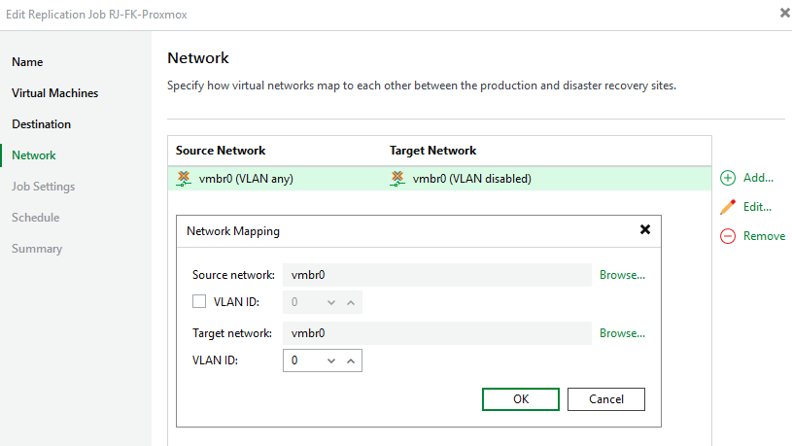
VM-based Replication for Proxmox: Supported Features
Network mapping
Failover, Commit Failover, Failback, Undo Failover
Adding / removing / resizing VM disks

Slide 40
Continuous Data Protection (CDP)
Continuous Data Protection (CDP) is a technology that helps you protect mission-critical VMware virtual machines when data loss of seconds or minutes is unacceptable.
CDP also provides minimal recovery time objective (RTO) if a disaster strikes because VM replicas are in a ready-to-start state.
Common use cases:
Critical workloads needing lowest RTO and RPO
The top 5% of your applications
Notes:
Continuous data protection (CDP) is a technology that helps you protect mission-critical VMware virtual machines when data loss for seconds or minutes is unacceptable. CDP also provides minimum recovery time objective (RTO) in case a disaster strikes because CDP replicas are in a ready-to-start state.
Data Replication:
First, CDP creates replicas and, then, keeps these replicas up to date.
CDP constantly replicates I/O operations performed on VMs. To read and process I/O operations in transit between the protected VMs and their underlying datastore, CDP uses vSphere APIs for I/O filtering (VAIO) that gives an option not to create snapshots. Because CDP is always on and does not create snapshots, it allows reaching a lower recovery point objective (RPO) compared to the snapshot-based replication — near-zero RPO which means almost no data loss.
Data of I/O operations is stored on the target datastore and relates to short-term restore points. The short-term restore points allow you to recover a VM to a state back to seconds or minutes ago (depending on the RPO that you specify) in case a disaster strikes. Information about short-term restore points is maintained in a special journal. This journal stores records about short-term restore points for a maximum of 168 hours (7 days) [Src: VBR UG 13.1 p.2328]. If you want to recover a VM to an older state, Veeam Backup & Replication allows you to create additional restore points that contain a VM state back to hours or days ago. Such restore points are called long-term restore points.
To facilitate replication over slow connections, Veeam Backup & Replication optimizes traffic transmission. It filters out unnecessary data blocks such as duplicate data blocks, zero data blocks and compresses replica traffic.
To replicate a VM, you need to configure required backup infrastructure components and create a CDP policy.
For more information, please consider this reference. https://helpcenter.veeam.com/docs/vbr/userguide/cdp_replication.html?ver=13

Slide 41

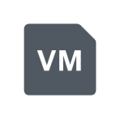
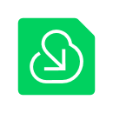

Universal CDP (Replication) For Windows & Linux
Physical, virtual & cloud workloads (Windows & Linux)
Real-time replication for Windows & Linux workloads; recovery points measured in seconds
Protection Group Deployment & Management
Failover, Failback, Permanent Failover, Undo Failover / Failback to new location
VMware vSphere, VMware Cloud Director via Veeam Cloud Connect as targets
Protection group
Target
Continuously replicated
VM
Physical machine
Cloud instance
VMware vSphere
Veeam Cloud Connect + VMware Cloud Director
Notes:
Universal CDP for Windows
Failback to new location requires a VMware target
In-Guest components allow for easy Veeam updates; no complex update procedure for production requiring host downtime (no SOURCE VAIO filters to manage/upgrade, just upgrade in-guest components)
Cloud Connect Cloud Director support allows Providers to expand their DRaaS scope for clients with physical workloads
Universal CDP for Linux:
Hardware:
UEFI supported
Distributions:
x64 only, Linux kernel 5.10+
RHEL / Rocky / AlmaLinux: 9.4–9.7 and 10.0–10.2 [Src: VBR UG 13.1 p.59]
Ubuntu 22.04 LTS, 24.04 LTS and 26.04 LTS [Src: VBR UG 13.1 p.59]
Storage / File System Configurations:
LVM support aligned with VAL
GPT only
512-byte logical sector size
Unencrypted data replication only
XFS, ext2/3/4, FAT16/32
Provenance: Universal CDP is agent-based (in-guest I/O filter), introduced for Windows in v13; v13.1 'extends near-zero RPO continuous replication to Linux workloads' and closes the gap with classic VMware CDP (Veeam Explorers, Re-IP rules, replica seeding, network mapping, application-aware processing) [Src: VBR What's New 13.1 pp.19-20].

Slide 42
CDP benefits
Lowest RPOs and RTOs
No VMware snapshots means no VM stuns
No workload or hardware dependency
No physical distance limit like for synchronous replication
Policy-based protection
Flexible retention
Notes:
Some of the benefits of using Continuous Data Protection are:
Lowest RPOs and RTOs: seconds or minutes instead of hours
No VM snapshots: Veeam CDP uses the VMware-certified I/O filter driver to catch all write I/O directly in the data path. This eliminates the need to create VM snapshots (as in classic replication jobs). I/O level tracking sends only the data that has actually changed to a DR site, unlike the larger blocks returned by changed block tracking.
No workload or hardware dependency: You can protect any OS and applications that can run within a vSphere VM. And unlike storage-based replication, Veeam CDP works across non-matching storage arrays, hyperconverged storage solutions and even local vSphere ESXi storage.
Asynchronous replication: Compared to synchronous array-based replication, Veeam CDP requires significantly lower bandwidth. It uses network traffic compression and leverages I/O consolidation when the same block is overwritten multiple times. Plus, Veeam CDP can be used across any distance.
Policy-based protection: Unlike with regular replication jobs, you don’t have to worry about scheduling at all. Just define the required RPO (maximum data loss allowed in case of a disaster) and the CDP policy will take care of performing the sync cycles as needed. Also, to reduce spam from monitoring events, you can define acceptable RPO violation thresholds so that sporadic connectivity issues do not result in alarms.
Flexible retention: Separately define short-term and long-term retention. You can use RPO period granularity to allow crash-consistent restores to a point in time. You can also define a long-term retention policy that includes periodic application-consistent restore points, providing an additional layer of protection.

Slide 43
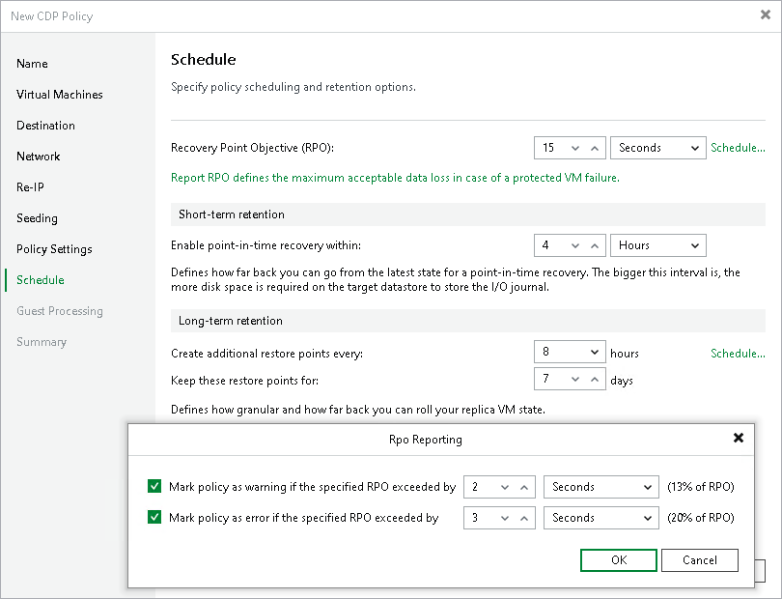
Short-term retention
RPO minimum: two seconds
RPO recommendation: not less than 15 seconds
Crash-consistent
Notes:
Veeam Backup & Replication retains short-term restore points for the number of hours or minutes specified in CDP policy settings. When the retention period is exceeded, Veeam Backup & Replication transforms the replication chain in the following way:
Veeam Backup & Replication checks whether the replication chain contains outdated short-term restore points.
If an outdated restore point exists, Veeam Backup & Replication commits data for the short-term restore point from the transaction log file into the nearest technical point (TP).
If the transaction log file does not contain data for further short-term restore points, Veeam Backup & Replication deletes the transaction log file as redundant. Its data has already been committed into the technical delta disk file.
After a technical point remains without the related transaction log file, Veeam Backup & Replication considers this technical point outdated and commits data of a newer technical point or a long-term restore point into the outdated technical point. Consider the following:
The newer technical restore point must not have a related transaction log.
The data of the long-term restore point can be committed into a technical point but not vice versa. Long-term restore points remain unchanged until they are retained by long-term retention.
For more information, please consider this reference. https://helpcenter.veeam.com/docs/vbr/userguide/cdp_retention.html#short-term-retention.html?ver=13

Slide 44
Recovery Orchestrator

Slide 45
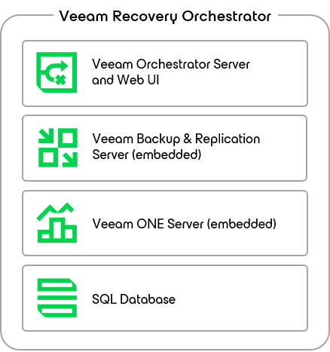
Veeam Recovey Orchestrator
Resurrect your business with a single click by achieving the speed and power needed to keep your business running.
Leverages the recovery capabilities of Veeam Backup & Replication to build disaster recovery workflows, automate recovery processes, and eliminate error-prone manual steps
Orchestrate recovery
Automate checks and tests
Meet compliance requirements

Slide 46
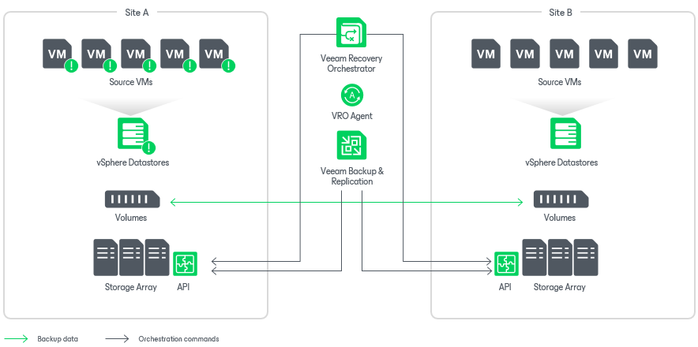
Veeam Recovey Orchestrator – Sample Scenarios
Recovery to Microsoft Azure from both Veeam Agent and vSphere VM backups created by Veeam Backup & Replication
Recovery based on replicated storage snapshots containing vSphere VMs
Recovery to a vSphere environment from vSphere VM and Veeam Agent backups created by Veeam Backup & Replication
Recovery based on vSphere VM replicas created by Veeam Backup & Replication

Slide 47
Thank you!
Michele Tommei – Computer Gross m.tommei@computergross.it

Slide 48
3CiME Scenario

