Slide 1
Industrial Security for Barracuda
Pietro Felisi – Senior Solution Architect Italy

Slide 2
BIG Data
Predictive Maintenance
SMART Industry
Remote Access
Automation
& Connectivity
THINGS
M2M
Notes:
M2M Machine to Machine communication, is part of the Automation and Connectivity of OT landscapes at all

Slide 3
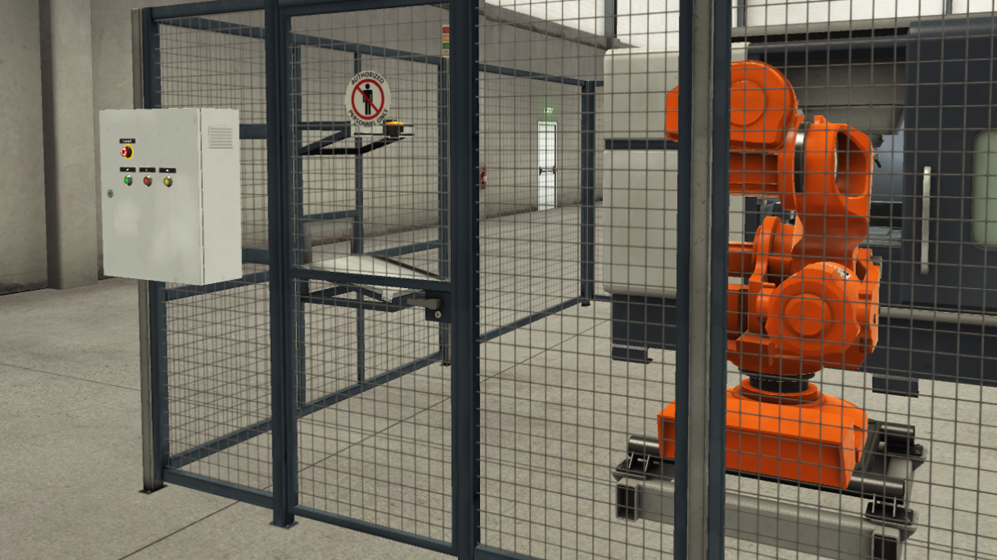


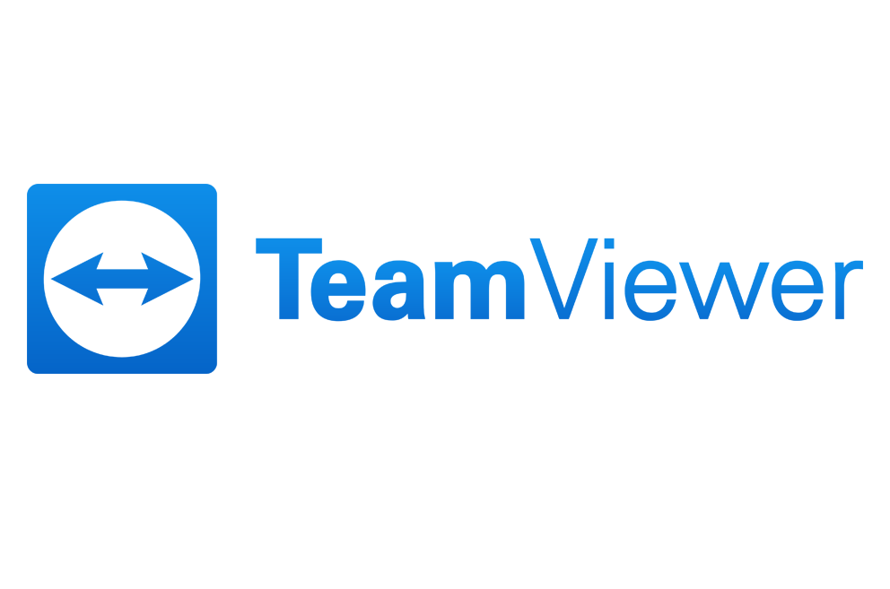

Evolution of “trust” in production environments
Implicit Trust Model
Traditional OT systems were operated in isolated environments where everything was considered safe. Technicians came on site to repair failed systems.
IT/OT Convergence
Increased IT integration due to digital transformation and the need for remote access increases efficiency and data sharing but exposes OT systems to newer threats.
Zero Trust Concept
The assumption that everything in the organization is secure is replaced by the assumption that breaches can occur anywhere and continuous monitoring is required.
Production

Slide 4
The OT/CPS Security Journey
Phase 1
Phase 1
Phase 2
Phase 2
Phase 3
Phase 4
Phase 5
Phase 6
Awareness
Outreach
Discovery
Network Mapping
Oh Wow! Moment
Firefighting
Integration
Optimization
Driven by, e.g., breaches
POC‘s with OT security vendors
Windows XP everywhere!
Deployment of best POC solution
OT security data feed to SIEM/SOAR/
SOC …
Realization that OT data gathered for security purposes also has “more” values
Source: Gartner Market Guide for Operation Technology Security / Nov. 2023

Slide 5

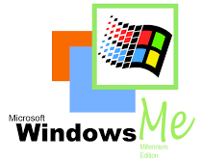

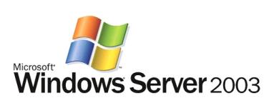
Common Challenges
Long machine lifecycles
Outdated operating systems, extremely
vulnerable
Large unsegmented
networks
→ Unregulated access to the network
Lack of overview of the communication taking place

Slide 6




Overview of Regulations
EU NIS2 Directive
Partly extensive series of standards
that fully illuminate the cybersecurity
of OT environments
We provide support for topics
  Micro-segmentation (zones & conduits)
  Preventive protection against threats
  User access control / zero trust concepts
  Increasing the security level
IEC 62443 (Industrial Automation and Control Systems Security)
NIST SP 800-82 (Guide to Industrial Control Systems (ICS) Security)

Slide 7
Use Case Overview
Next-generation security & microsegmentation
Edge computing &
predictive maintenance
Benefit from decades of experience in IT Security and integrate NextGen firewall functionalities (e.g., AV, ATP, IDS/IPS) up to SCADA protocol control into your production environment.
Process data wherever it resides.
With the Edge Computing functionalities, you have a
wealth of use cases at your disposal.
Simple & secure
network access
Security and
availability of IIoT
Open remote access often leads to security gaps. Manage access to your production easily and for a limited time.
Connect your IoT devices to your infrastructure securely and reliably, wherever they are located.

Slide 8

Full Next-generation Security
Intrusion Detection/ Prevention System
Malware Protection
Geo IP Control
File Content Scan
DoS/DDoS Protection
Zero Trust
Network Access
User Awareness & Control
App Control
Botnet & Spyware Protection
SCADA Protocol Control

Slide 9

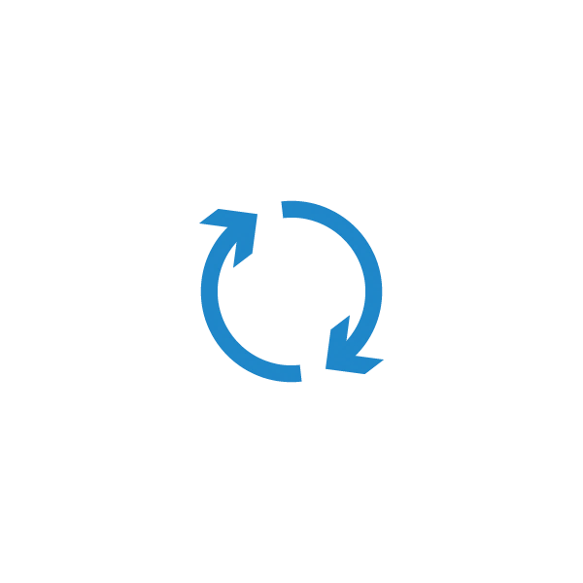
OT Security Architecture
Internet
Separation of OT & IT
Implementation of a DMZ
Subdivision into subnets (groups)
Criteria for groups e.g.
Importance for production (risk level)
Vulnerability
Remote Access
Enterprise Network
Office PCs
SQL
SharePoint
Exchange
Production Network
Plant / Enterprise DMZ
Terminal-
server
Historian
MES
Antivirus/Patch
management
Plant network A
Plant network B
Plant network C
Assets
Prod. Line
PLC
HMI
PLC
Notes:
Protection concept of the IEC 62443 International Electrotechnical Commission
series of standards
Areas with different security requirements and values for the business
Grouping in security zones and control the communication between them increase the security of each zone
„Conduit“ is the connection between the differnt zones
Separtion can be achive either via VLAN and microsegmetaion in Networ core
More likly as OT did not support this need to do a traspartern drop in for each line
Virtual paching
Criterias for creating different zone could be for instance:
Grouping by functionalities e.g. assets with similar functionalities
Risk level: outdated systems without the option to update them or without end point security
Remote maintenance access
Importance for the business process
….

Slide 10
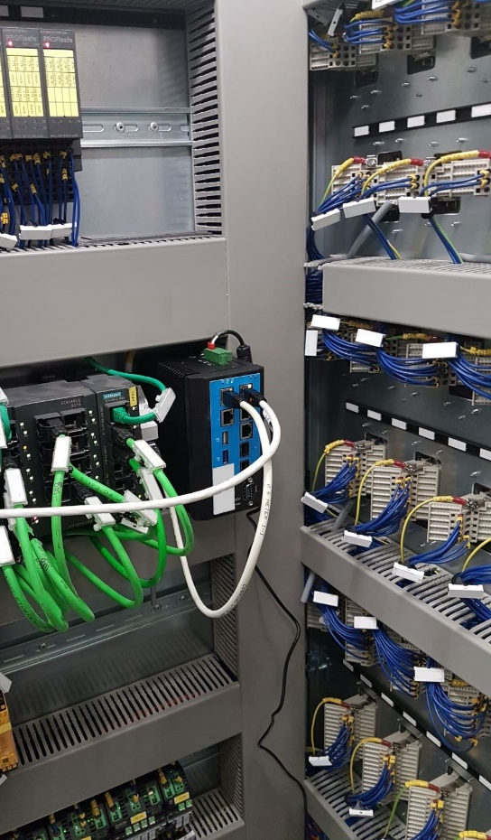
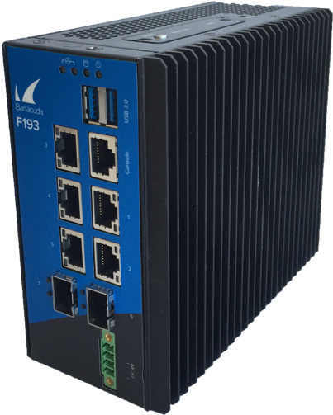
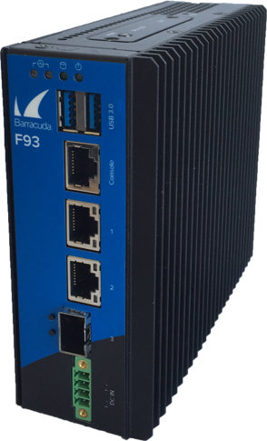
Zero Trust Deployment
Internet
PLC, production line, asset or machine
Plant network
Transparent integration → no network changes
Up-to-Date NextGen Security + SCADA control
Virtual patching
Access Control / authentication enforcement

Slide 11
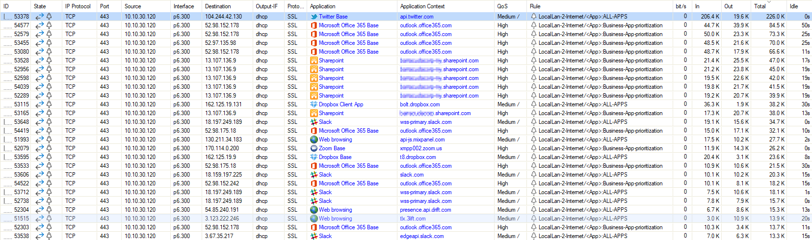
Realtime Traffic Monitoring
Any traffic flowing through the firewall visible at a glance
Including detailed information about applications and their prioritization
Notes:
Purpose of this slide:
The Firewall Admin provide with the Live Tab an overview about all the active communication which is flowing through the firewall.
Main points:
You get a detailed overview about
source and destination IP’s and Port’s of each session
the interfaces in use
the Quality of Service Band
the application itself up to the context of it
which rule allows the traffic
and how much bandwidth is currently consumed and in total

Slide 12
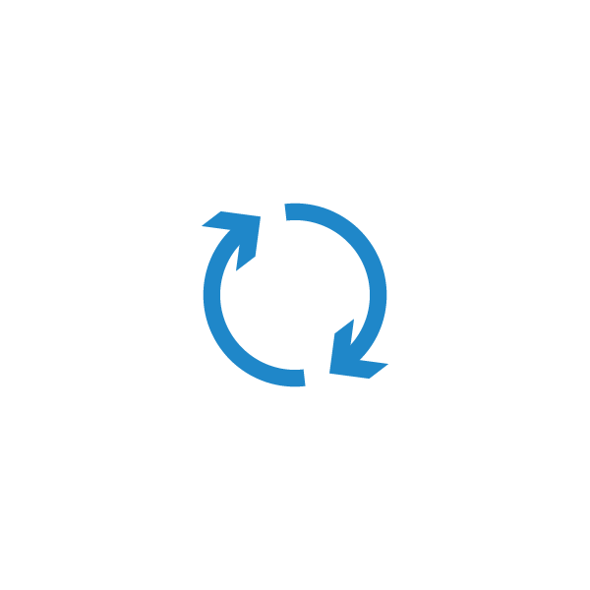
Temporary Remote Access
To OT-Assets or IIoT devices
Time-restricted remote access (on demand)
Hardware & virtual firewalls or agent-based
Tailored ZTNA solution

Slide 13


Anomaly Detection
Enterprise Network
Production Network
Anomaly Detection
Switch
Attacker/
ransomware/
infected PC
Security Event API Call
Notes:
By integrating with technology partners like Nozomi, Scadafence and Rhebo, CloudGen Firewall can apply additional anomaly detection.
For instance, the switch is talking up to Nozomi, Scadafence or Rhebo for traffic statistics and – more important in this scenario – for anomaly detection.
<< CLICK >>
If an attacker is able to enter the network, e.g., by connecting via the internal WiFi, and tries to get access to a machine, the 3rd party integration detects the anomaly and
<< CLICK >>
automatically notifies the CloudGen Firewall deployments about the hazard, so the firewalls can pro-actively block such traffic.
For more information on our ScadaFence integration, please see : https://assets.barracuda.com/assets/docs/dms/Barracuda_CloudGen_Firewall_SB_scadafence_UK.pdf
For more information our our Rhebo integration, please see: https://assets.barracuda.com/assets/docs/dms/Barracuda_CloudGen_Firewall_SB_Rhebo_US_1-1.pdf

Slide 14
Reference Architecture
Enterprise Network
Production Network
Other
Historian
MES
Temporary remote access
Data
Central Management
Configuration/status/events

Slide 15
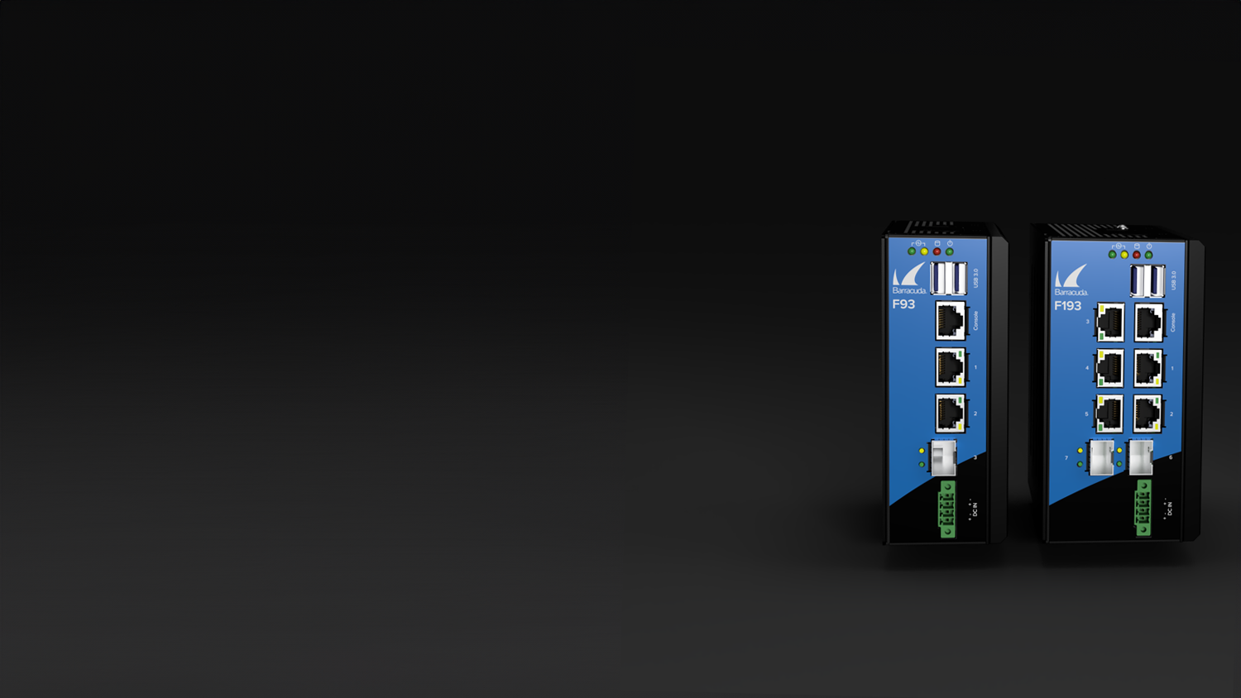
Hardware – DIN Rail Mountable
 | F93A.R | F193A.R
Firewall throughput | 1.5 Gbps | 2.1 Gbps
SD-WAN throughput | 240 Mbps | 320 Mbps
IPS throughput | 400 Mbps | 790 Mbps
NGFW throughput | 400 Mbps | 800 Mbps
Threat protection throughput | 380 Mbps | 700 Mbps
Operation temperature | -40 to +167 °F / -40 to +75 °C | -40 to +167 °F / -40 to +75 °C
Operating humidity | 5% to 95% | 5% to 95%
Power supply | Phoenix 4-pin | Phoenix 4-pin
1 GbE copper | 2x | 5x
1 GbE fibre (SFP) | 1x | 2x
CE emissions / electric safety | Yes | Yes
FCC emissions | Yes | Yes
ROHS compliant | Yes | Yes
Protection classification | IP 20 / IP 30 | IP 20
Build-in 4G | On request | On request
Notes:
[Important to mention that there are no built-in user limitations for any of the hardware units]
The full CloudGen Firewall feature set including Advanced Threat Protection cloud sandboxing is available even on the smallest unit, the F18 that has an MSRP of 699,- USD and intended for Small remote offices with direct internet break outs.
The included Mail Gateway and Mail security starts with the F180.
F18 and F80 are fanless and totally silent in operation.

Slide 16
Edge Computing
Daemonless container engine for managing & running OCI containers
Add components to the firewall like
Anomaly Detection
Application Security
Zero Trust Network Access
OT & IIoT Specific Solutions
Remote Access
SaaS App
Datacenter
Public Cloud
Notes:
Open Container Initiative
Nozomi, Crosser, Zscaler, Darktrace,

Slide 17
Crosser integration example
Cloud Orchestration
CLOUD COST REDUCTION
Reduce storage cost of up to 99% or more with smart filtering and aggregation
REMOTE CONDITION MONITORING
Look deeper. Save relevant data. Act on anomalies
ON PREMISE AGGREGATION
Hierarchies of edge nodes with single connection to cloud
SECURE SENSOR TAG SEPARATION
Separation of machine data for delivery of data to machine builders/OEMs
VISION BASED QUALITY INSPECTION
Leverage off-the-shelf cameras, find anomalies and integrate triggers
DEPLOYMENT OF ML & CUSTOM CODE
Distribution platform for your custom algorithms and code. At scale
CONNECT MACHINES WITH LOGIC
M2M automation with logic, including ML.
FACTORY FLOOR INTEGRATION
Integrate machine data, historians, SQL servers, ERP systems etc
SEND MACHINE DATA TO CLOUD
Collect raw machine data and send to any Cloud/storage
INDUSTRIAL MESSAGE BROKER
Message broker built for the shop floor

Slide 18
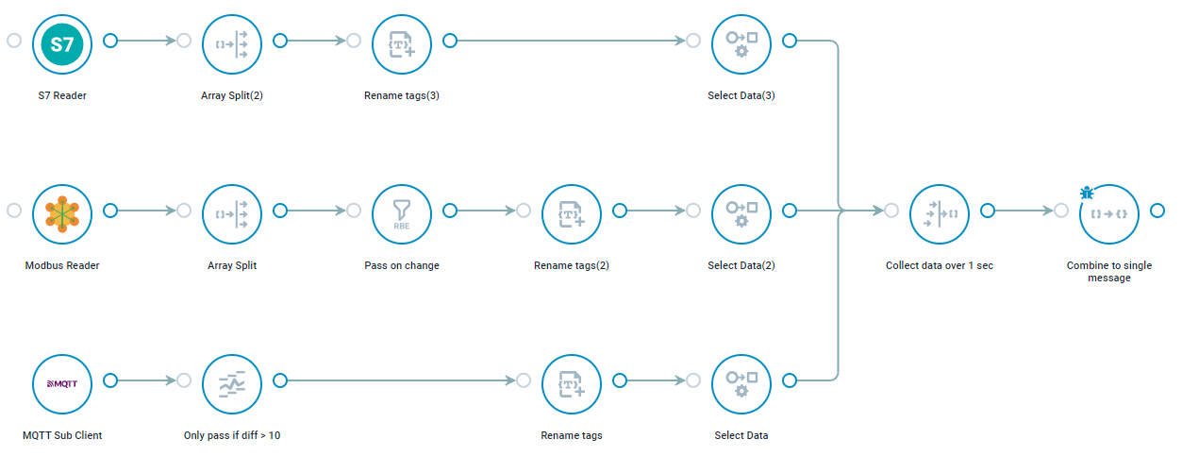
Data reduction of raw machine data
Various filters, message modifications etc.
Various SCADA protocol connectors
correlated information
PLC
Azure IoT Hub

Slide 19
Edge computing architecture and roles
Applikation-Level
User /
Application owner
SaaS Application
Datacenter
Public Cloud
Service- / Administration-Level
Central Management
Container Administration & Control
Infrastructure Admin / MSP
Data-Level
Configuration &
status information
Data traffic or
remote access
Operator

Slide 20
Major Control Center Features
Zero Touch Deployment
Full multi-tenancy
Revision Control
Repositories
Update & firmware management
Flexible licensing
Templates & configuration units
Clone Wizard

Slide 21
Revision Control System
Stores versioning information on configuration changes
(Who changed what, when, and why)
Compare or revert old configuration versions
Version 1.1
Version 1.2
Version 1.3
Version 1.x
time
compare
revert

Slide 22
Pool Licensing
Firewall Control Center handles licensing for all managed units
Works in “dark” environments
Exponentially easier to manage over single unit licensing
Adds flexibility: Speeds up hardware replacement, mix-and-match as well as re-allocation of licenses
Hardware-only license + pool units
Central License Server
Licensed | Used | Available
500x CloudGen Firewall | 410x CloudGen Firewall | 90x CloudGen Firewall
300x Secure Connector | 275x Secure Connector | 25x Secure Connector

Slide 23
Pool Licensing
Advanced Threat Protection
Malware Protection
Advanced Remote
Access
Firewall
Insights
Premium Support
Instant Replacement
Warranty Extension
Energize Updates
Pool Base Account

Slide 24

Industrial Internet of Things

Slide 25
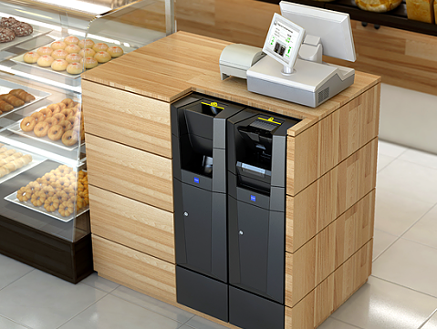
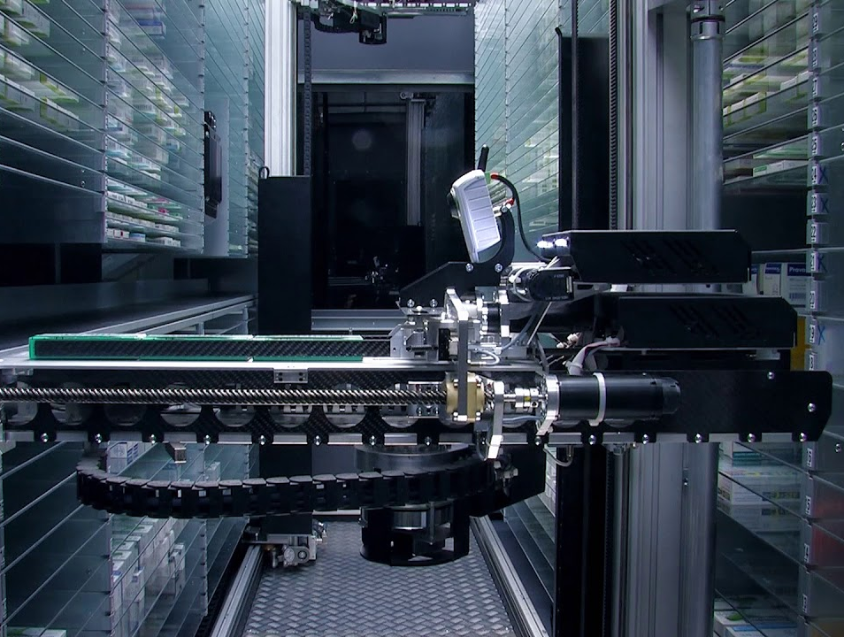

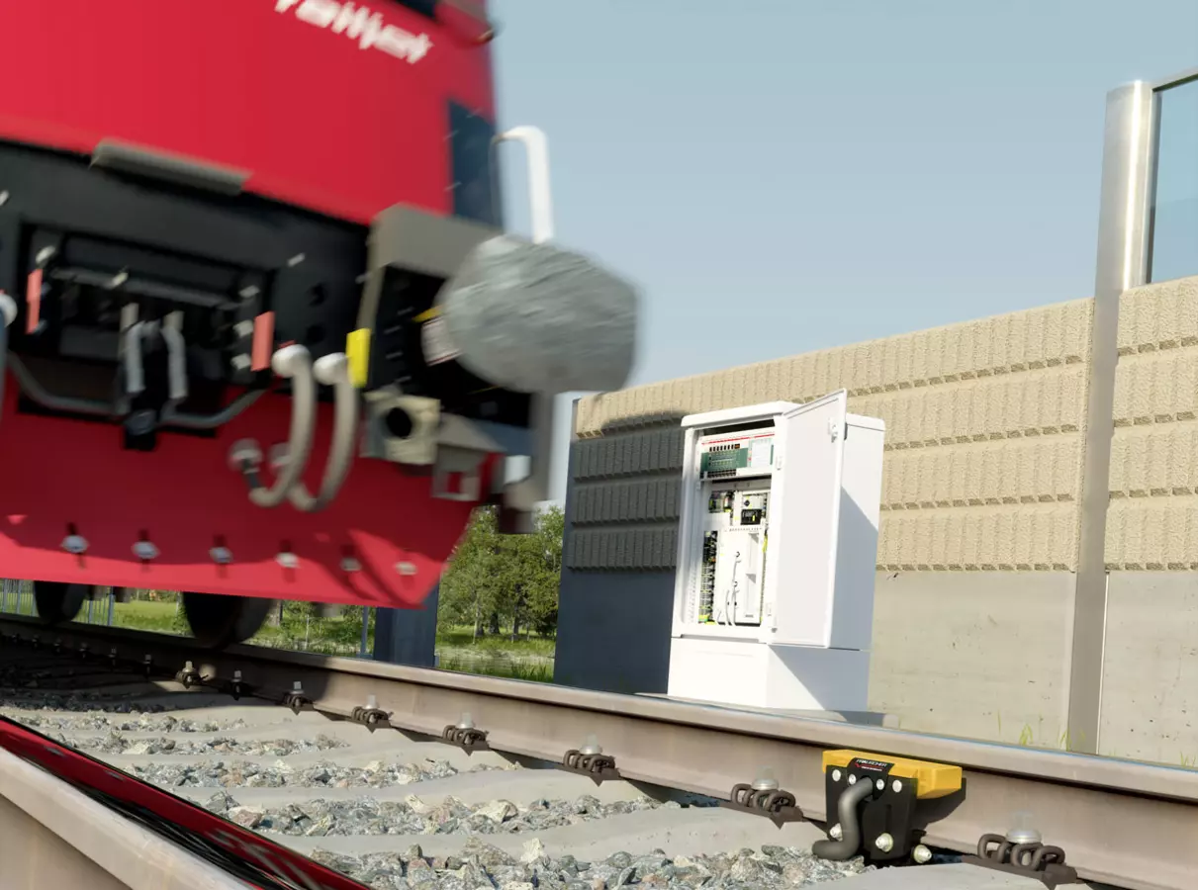
IIoT Security Solutions
Notes:
Matthias
…. and there are thousands of customers, from all industries, that have already chosen Barracuda, including such big names as
Siemens
Technical University Vienna
JP Morgan
Novartis
Calzedonia and Good Year
Boeing and Airbus
AT&T and CBS

Slide 26
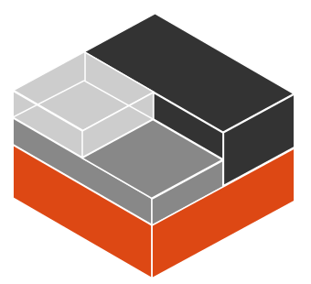
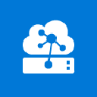
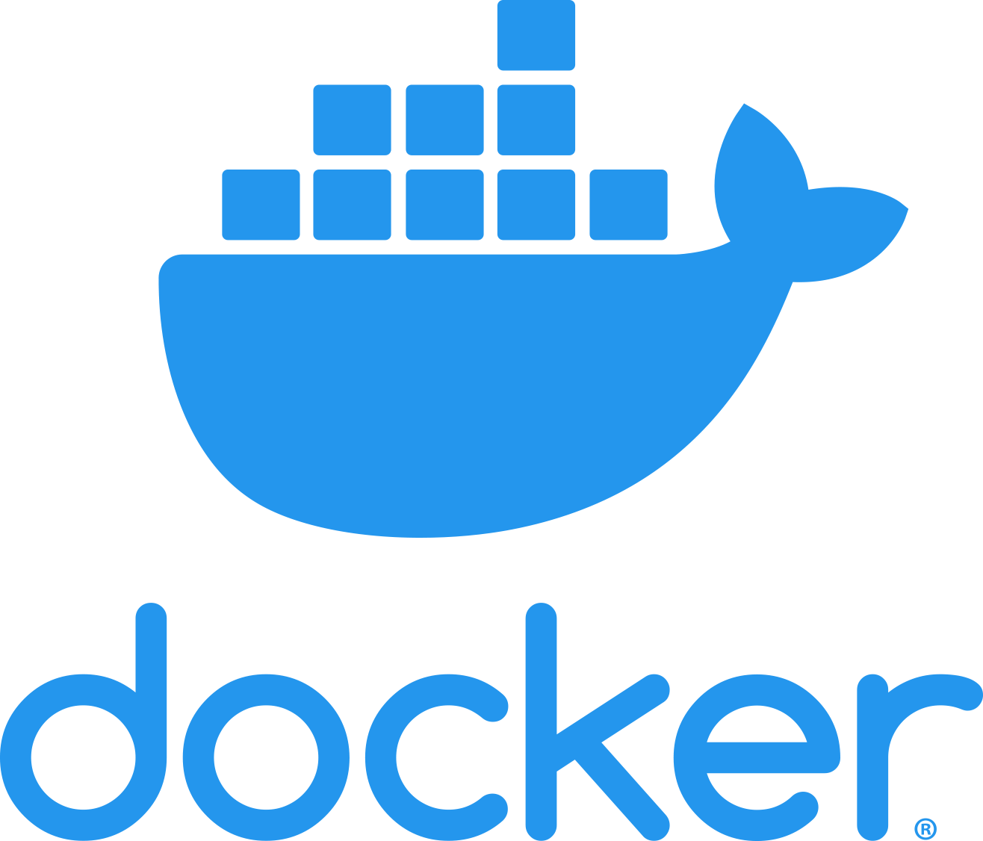
IIoT Security Architecture
edge device
(Secure Connector)
hub function
central management
WiFi
LTE
SASE platform
Cloud service or site device

Slide 27
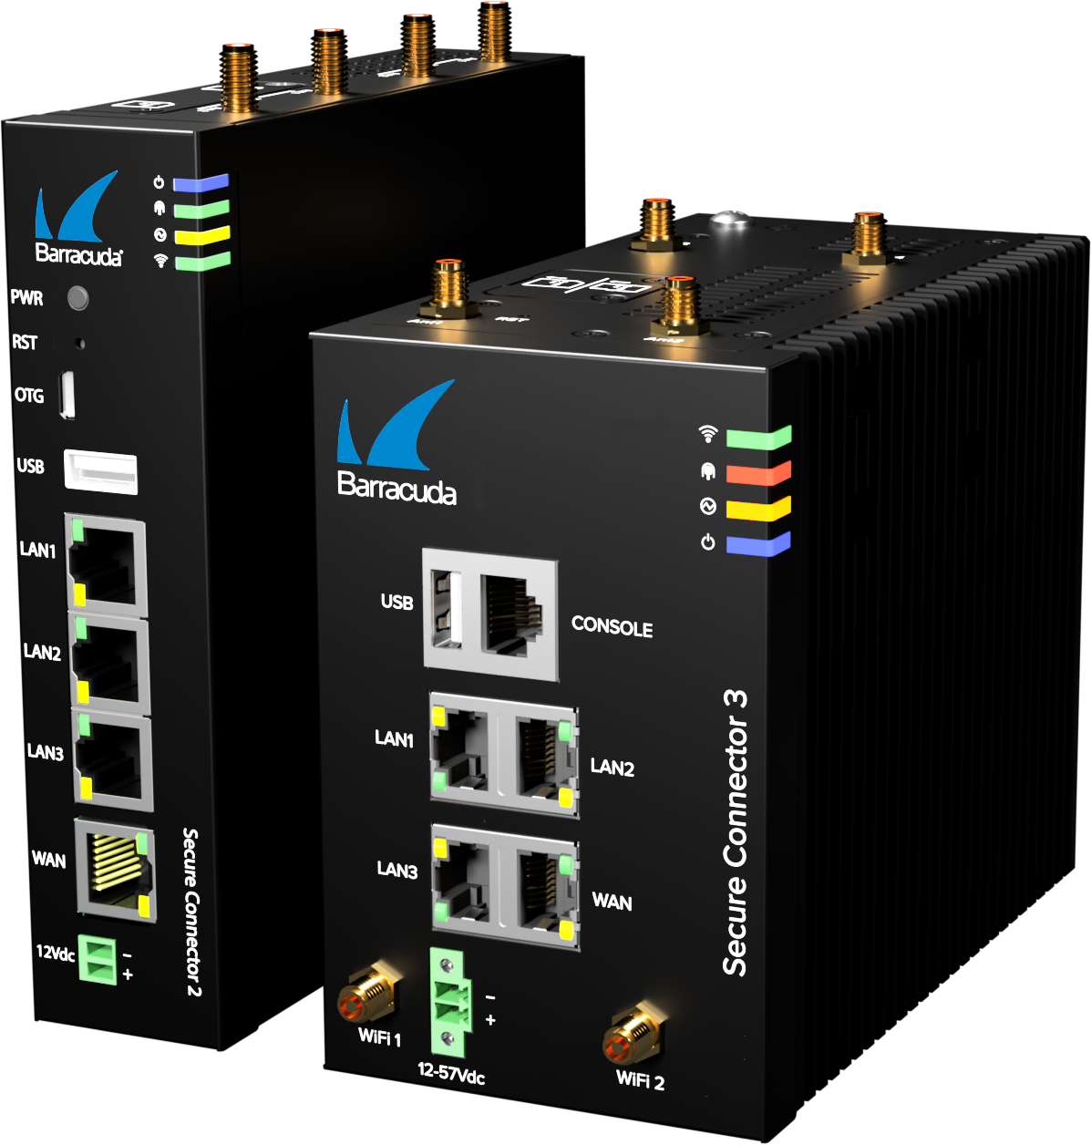
Our Solution for Your IIoT Environment
  Ultra-compact hardware appliance for
  DIN-rail mount and rugged models
  Rollout with zero-touch deployment
  Secure TINA VPN connectivity
  Edge computing support
  (customizable container)
Order with the connectivity features you need
Container infrastructure
Notes:
Purpose of this slide:
To give an overview of the SecureEdge IIoT SC Connector option available.
Main points:
The ultra compact Secure Connector devices can be mounted on DIN-rails.
The Secure Connectors can work in harsh environments.
As the number of appliance in an IoT/OT network can easily go beyond the hundreds in one rollout step, the appliances support zero-touch deployment.
Secure Connectors run the TINA VPN protocol for secure connectivity.
For edge computing support, every Secure Connector appliances provides a container where 3rd party software can be run, e.g., to pre-analyze data and, therefore limit the bandwidth required.
There are various model configurations available, from WiFi only to full LTE support (and special editions for Verizon users).

Slide 28

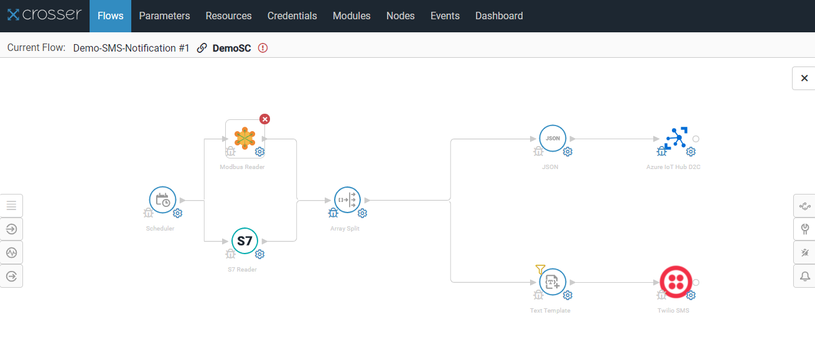
Crosser Integration
Cloud
Orchestration
Twilio SMS
Crosser
Node
Send Machine
Data to Cloud
Cloud Cost Reduction
Multiple Other
use cases, e.g.,
Edge Data
(e.g., SCADA, DB, files, etc.)
Notes:
Taking a look at the integration we did with our technology partner Crosser:
The Crosser Edge analytics software allows data produced by sensor-rich assets like machines, equipment, and devices to be pre-processed in real-time closer to where it is created. Removing dirty and irrelevant data significantly reduces the cost or storing and processing collected data. Sometimes less really is more. Crosser let‘s you collect meaningful data only, discard unnecessary information, and use edge analytics to combine data points and convert to a commonly used format such as MQTT or OPC-UA.
Local triggers between machines or PLCs with ultra-low latency can run autonomously without cloud connectivity and report anomalies or trigger alerts based on events. The Crosser Cloud is the heart of the platform – where all design and orchestration takes place.
The Crosser Node is the real-time engine processing and analyzing all data right at the edge in a Docker container right on the Secure Connector appliance.
The configuration is centrally managed and does not require any firewall-specific knowledge at the edge.
In addition, the Barracuda Secure Connector also supports custom applications in a Docker container.
With the Crosser Node application running on the Barracuda hardware platform, only one hardware device can provide edge analytics and intelligence with secure connectivity
For more information, please checkout the solution brief: https://assets.barracuda.com/assets/docs/dms/Barracuda_CloudGen_Firewall_SB_Crosser_US.pdf

Slide 29
Real Use Cases ?

Slide 30
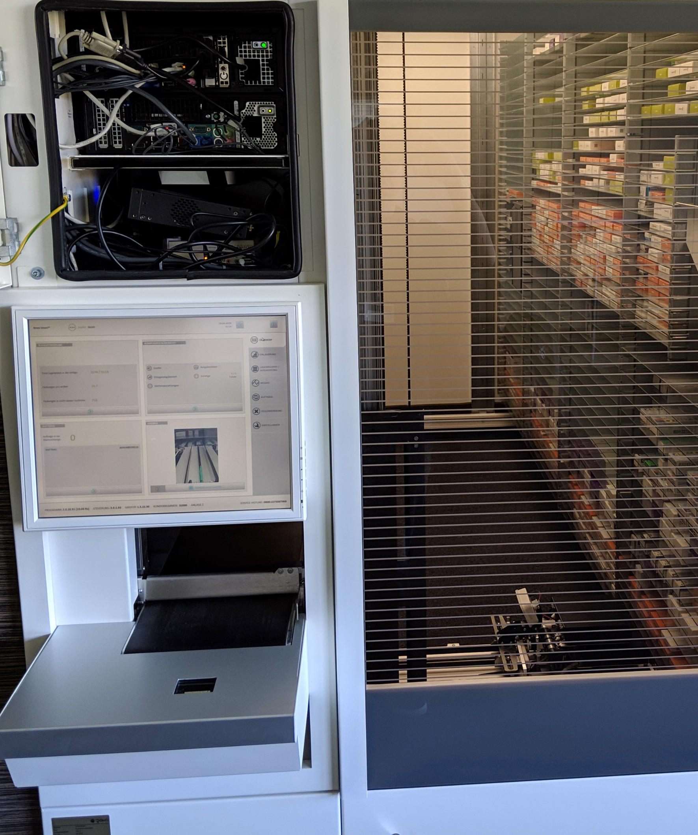
Automated Medicine dispenser Solution
Secure connectivity for
pharmacy robots
Central management of currently around 6,000 – 7,000 Barracuda appliances
Basic firewall functionalities
network segmentation
granting RDP access to the local PC and camera system
Zero Touch Deployment
Notes:
Matthias
Closed system
As a user you just have a drawer to get the medicin or insert it into the system
is the market leader for automated stock handling and picking machines in pharmacies and hospitals
Its large storage and dispensing systems are used to:
handle medical supplies (dump, poor)
scan into the system
store and dispense at the pharmacy sales counter using conveyor technology
Since December 2019
Initially
1200x F12
Azure Level 8 CGFs
Firewall Control Center CC610 for Azure
Won by
extremely fast implementation
central management
breadth of the built-in scripting capabilities
zero-touch deployment.

Slide 31
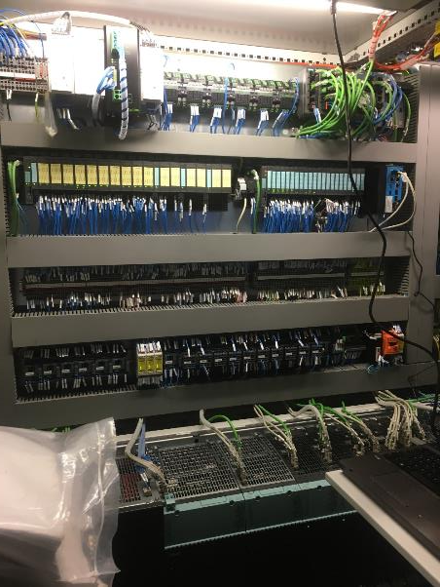
Micro-Segmentation f. factory floor
2000 x F183Rugged
  Micro-Segmentation (L2-transparent),
  full security stack (IPS and AV), RSTP
  On-Demand remote access to machines
  for 3rd party maintenance
  Firewall becomes part of the machine compound, deployed and replaced by electricians
Protection of a full factory of welding robots and punching machines as a pilot project.
2k devices in deployment. 12k devices planned.
Notes:
This is actually in production use with a large Automobile manufacturer.

Slide 32
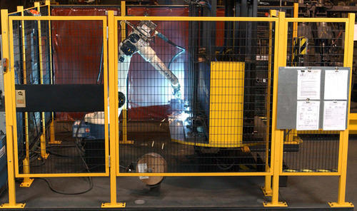

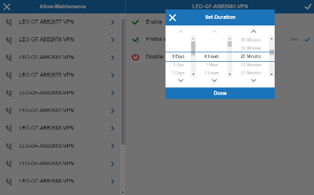
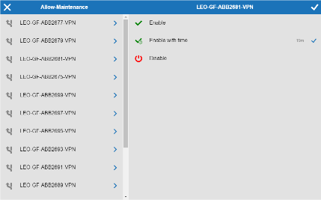

On-Demand Secure Remote Access
Notes:
A series of welding robots requiring occasional maintenance windows by the manufacturer. Access to the device is not enabled all the time, but on-demand by the floor technicians and a tablet mounted to the cage. Access can be set for a period of time and automatically expires.

Slide 33
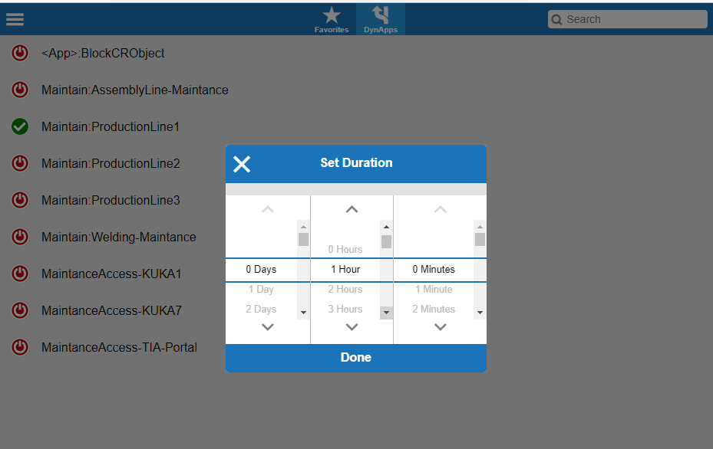
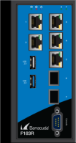


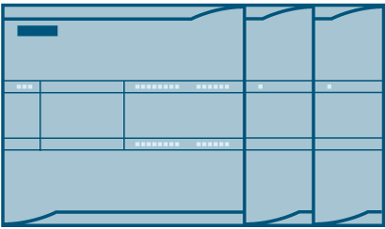
Security and remote access on the shopfloor
MES
API-DynRule
Production Line 1
Production Line 2
Production Line 3
192.168.0.1
192.168.0.2
192.168.0.3
192.168.0.1
192.168.0.2
192.168.0.3
192.168.0.1
192.168.0.2
192.168.0.3
Notes:
Anton
Production charateristicasa adding production line > same Ips
Need to distisch between machines – safety issue
Addintional control via API integration
Access Control via own Portal (API integration)

Slide 34
AI-based rail monitoring business case
Predictive maintenance
AI-based recognition
Heatmap view
Cost reduction rail operators
  40km/25mi range 6m/20feet resolution
  Reuse exiting fiber
Notes:
Anton
AI Based perdictive maintances for rails
Make a use of fiber optics – exiting inferstructure
Detact break of the rail
Cable digiingin
Shor circut on the power line
Elephans
..
Training of AI is really hard – retrospective view
Highly distribute enviroment across may contries (connectivity provider) (POC) snake gun

Slide 35
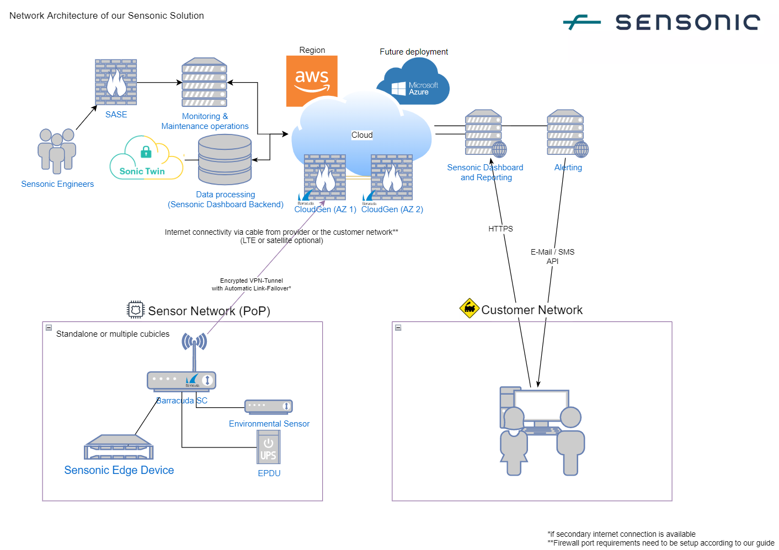
AI-based rail monitoring solution
Notes:
Anton
Major reqiremnet was Multicloud
- misunderstanding of multicloud – future prohject
POC deploymnets (Troubleshooting starlink)
ZTD
Devops Deploymnet teraform and templates
PoP all 40km / ?25 how many SC for USA?
New customer – new set of SC
Personal Highligt!!! To save the worh (liite contibution to significaten impact

Slide 36

Medical equipment add-on - Solution
File Share
Edge appliances
4G/LTE, Wi-Fi, or WAN
Central Patient Data
Test-room
eye exams
Data
Notes:
Richard
Medical Equipment Store Data to local file share.
Connector to Central Patient Data Software is very pricy
Solution: Edge computing picking up data from local share and transfer it to the S3 Storage to Aws where it going to be processed by the Central Patient Software
Point out Edge computing exmples
One of the major deciding factors in this project was the use of Zero Touch Deployment. This allows the Warby team to ship SC2 units directly to the store. Once in the store the personell connect the SC2 unit the configurations could be pushed by remote techs to the SC2 to start-up operations.
Overall for Warby the SC2 units have provided Automation / Security / and ease deployment and management. Reducing cost and human error along the way.

Slide 37

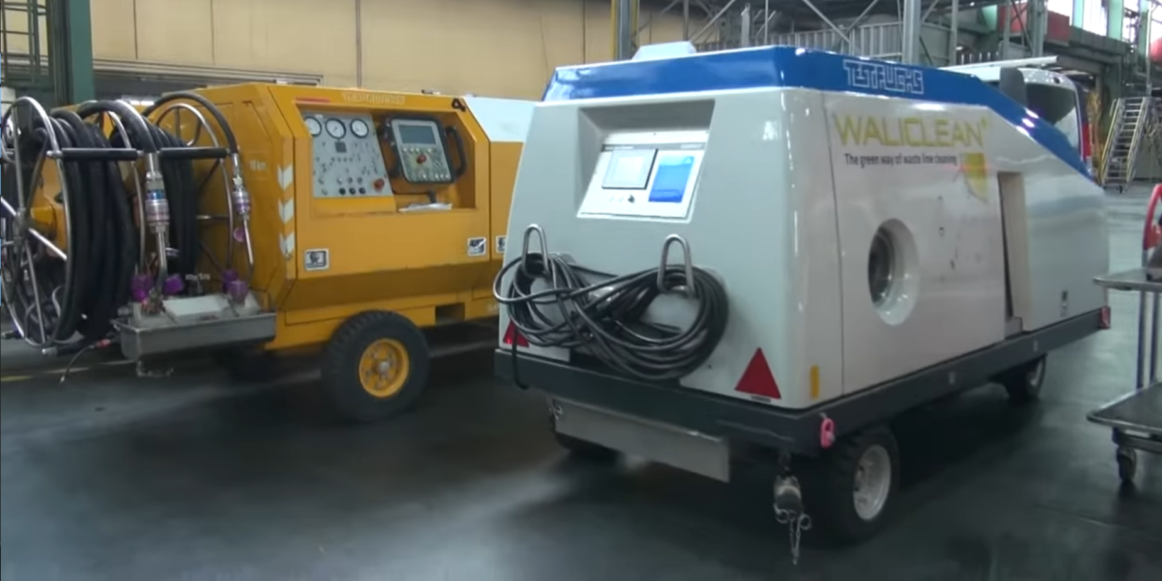
Aircraft Testing Equipment
Research and quality assurance
Remote access
Predictive maintenance
Testing-as-a-Service
Billing
Full access for maintenance
Stationary testing
environment
Maintenance
Mobile testing
environment
Test-as-a-Service Data only
Notes:
Please get yourself familiar with the case study:
https://assets.barracuda.com/assets/docs/dms/CS_CloudGen-Firewall_Test-Fuchs_US.pdf

Slide 38
SecureEdge

Slide 39
Security from Everywhere to Everywhere
SaaS
Resources
Edge Compute
Services
Datacenter
Web Resources
Public Cloud
Solutions
User, Sites, & Things
Things
Sites
User
Notes:
Talk about how today's networks are a diverse mix of SaaS, public cloud, and edge compute resources, meaning the traditional network perimeter is gone. To secure this complex environment, robust solutions like SASE (Secure Access Service Edge) and Next-Generation Firewalls (NGFWs) are crucial
They should provide protection for all your users/employees, be it remote users or on-site users that are working from the office.
With the explosive growth of the Internet of Things (IoT), protecting connected "things" is critically important. Each sensor, camera, and smart device is a potential entry point for attackers, and these devices often lack robust, built-in security.
Our SecureEdge appliances deliver the full power of secure access service edge, embedding Next-Generation Firewall capabilities within a unified, cloud-native architecture. This means significantly simpler deployment and management, drastically cutting configuration overhead while providing consistent, scalable security for your distributed workforce.
For organizations with substantial on-premises infrastructure, our dedicated Next-Generation Firewalls remain essential. These provide unparalleled perimeter defense, offering deep, granular configuration options and high performance to secure your core network assets with precision.

Slide 40
Security from Everywhere to Everywhere
SaaS
Edge Compute
Services
Datacenter
Web Resources
Public Cloud
Things
Sites
Users
Notes:
Various resources like SaaS applications, edge computing, datacenters, web resources and cloud require protection.
Barracuda SecureEdge is the solution that is designed to protect these resources. It offers comprehensive security that extends to things, sites and users.
Regardless of whether your organization is deal with IoT devices, multiple physical locations or remote users, SecureEdge ensures that security is consistently applied across all points of access

Slide 41
SecureEdge Components
SecureEdge Manager
Access Agent(s)
Multi-platform Zero Trust Network Access (ZTNA)
Last Mile traffic optimization & smart selective security inspection
Site device(s)
hardware or virtual
Full NextGen Security and Auto SD-WAN to service
Up to Secure Connectors for IoT connectivity
Edge Service(s)
Cloud service hosted in the cloud and fully managed by Barracuda
  Or customer owned appliance or virtual appliance
App Connector
SASE connectivity software for Windows / Linux
Multi Cloud Connectivity
Notes:
Access agents
run on user’s end device
supported across popular operating systems like macOS, Windows, Linux iOS and Android
allow Zero Trust Network Access policies to be enforced
Optimize the last mile traffic
Site devices
Can be either hardware or virtual
Posses all the next generation firewall features like deep packet inspection, integration Intrusion prevention system, SSL inspection and many more
Automatically use SD-WAN and intelligent routing
Provide light weight secure connectors for IoT connectivity
Edge Services:
Are the hubs in our hub and spoke technology that we have with SecureEdge. You can deploy an Edge Service that is entirely managed by Barracuda, an Edge Service for virtual WAN in the Micorosoft backbone network and you can also host your own edge service by promoting one the site device to an Edge Service. They allow sites, access agents site devices and app connectors to communicate with each other. You can also connect your region-separated edge services to have regional or even global secure connection of your resources and offices.
App Connectors:
The SecureEdge Connector is a lightweight software that can be installed on Windows or Linux servers to secure device traffic by redirecting it through a VPN connection, with configuration managed via the Barracuda SecureEdge Manager. It is used for resources that cannot be reached via routing. It allows for flexible server registration, app-to-app communication, and supports all Edge Services, including Private Edge Service and Edge Service for Virtual WAN, enabling easy access to various applications in cloud and on-premises environments.

Slide 42
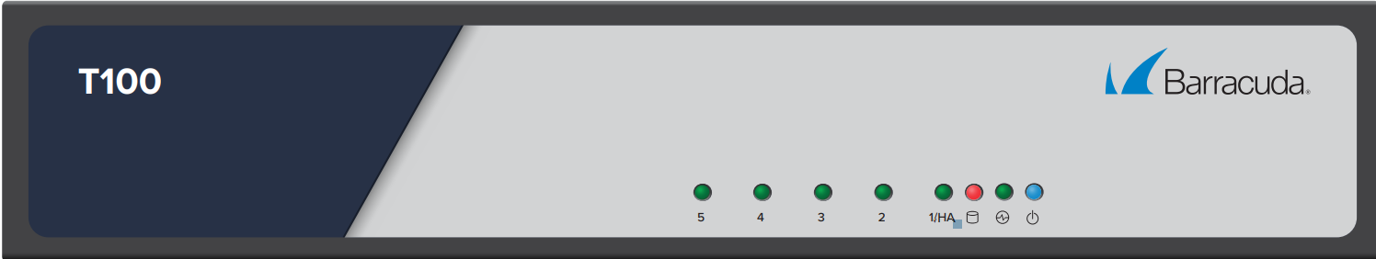
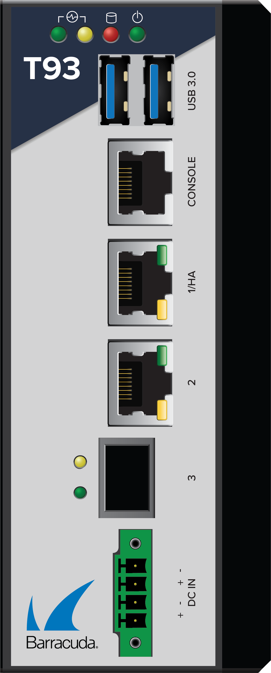
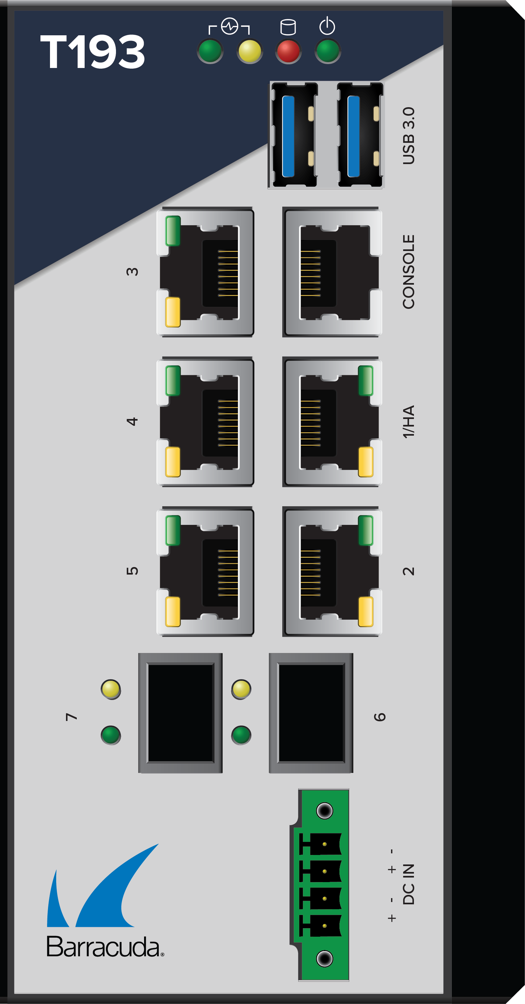

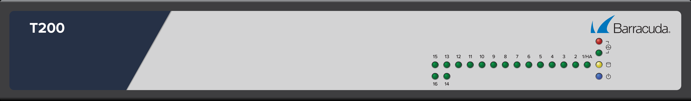

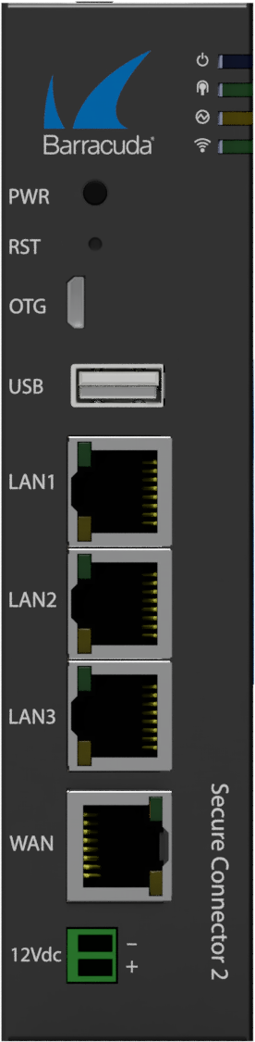
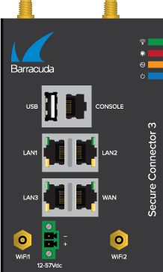



Flexible Deployment Options
Din-rail compatible & rugged appliances
Site devices or
private Edge Services
Edge Service
Virtual Site devices & Edge services
Managed Gateway
T100
T93
T193
private Edge
T200
Virtual WAN
T400
Secure Connector
Endpoint Agents
App Connectors
SC 2x
4 submodels
SC 3x
4 submodels
T600
T900

Slide 43

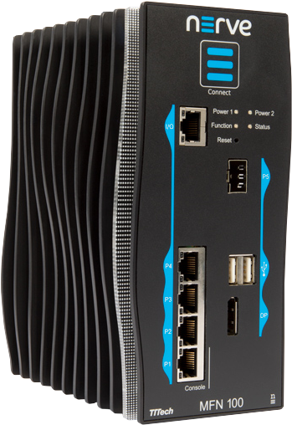
Use Case: ZTNA & edge computing
Edge computing example
Provide Zero Trust Access to edge- computing components in the field
Establish a secured connection
to your infrastructure
Make resources available that the connector can reach via routing
Edge compute
Edge Service
App Connector
Remote User

Slide 44
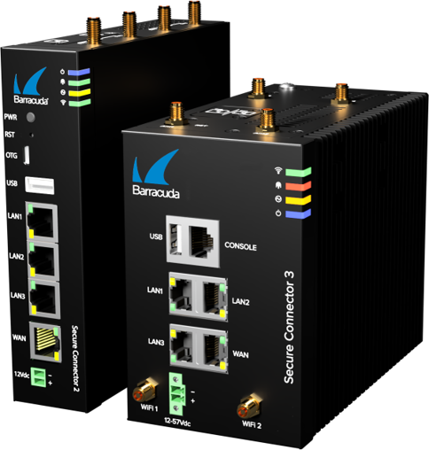
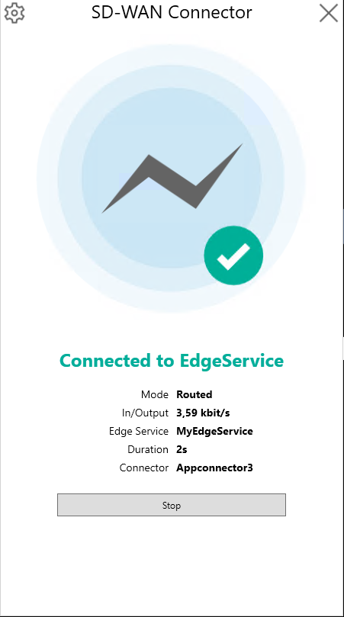
Connector Family
Software and hardware-based options
Server connectivity
IoT connectivity
IoT Edge Platform integrations
 | Connector | App Connector | Secure Connector
Form factor | Agent (software) | Agent (software) | Hardware appliance
Recommended throughput | Up to 1Gbps | Up to 1Gbps | 30-50Mbps
Traffic flow | Inbound only | Bi-directional | Bi-directional (full backhaul)
Security Inspection | On EdgeService | On Edge Service | On Edge Service
Additional services | - | - | WiFi, WWAN, DHCP
Notes:
3 different ways to connect, important commercial differences

