Slide 1
Data Storage Solutions
Tailored for Core, Edge, Cloud
3Cime | ICT Arte e storia s’incontrano a Bologna

Slide 2

DataCore at a Glance
DataCore the Company
Global Customers
European Customers
15
# of Consecutive Profitable Years
1.4
Exabytes
93%
Customer Retention Gross
105%
Customer Retention Net
320
New Customers
5041
Active Customers
99%
Recurring Revenue
15%
ARR Growth
10.0
CSAT Score
99.7%
Support SLAs
$50M
In New Customer Pipeline
$100B
Insight Partners

Slide 3

IT Challenge: Do More With Less
EB
EB
Storage Capacity Growth Outpaces IT Infra Spending
Storage
Installed Based
EB
EB
EB
EB
IT Infrastructure Spending
Notes:
https://cdn.allbound.com/iq-ab/2021/10/IDC-ColdStorage-ST02370A.pdf

Slide 4






Where Organizations Prefer to Store Their Data
65%
On-prem or Remote
44%
Public Cloud
18%
CSP/MSP
Top Storage Goals
Industry Survey of 500+ IT Professionals
35% need simplified management
31% prioritize cost reduction & greater flexibility
30% demand higher performance
29% seek futureproofing
AI
67% favor AI-powered infrastructure

Slide 5
We Help You…
Navigate through change easily
Modernize without disruption
Optimize existing storage to do more and save costs
Ensure operational continuity
Protect data against security threats and data loss risks
Enjoy free choice of hardware
Simplify storage administration and data management
APPLICATIONS & USERS
SOFTWARE-DEFINED STORAGE
ANY STORAGE. ANYWHERE.
CORE | EDGE | CLOUD
AUTOMATED DATA SERVICES

Slide 6










DataCore Investment Timeline
Object
Object for Edge/ROBO
Block for K8s
File
Sneak Preview: April 2025
Block
…2020
2021
2022
2023
2024
2025…
Object for M&E
File and
Data Orchestration
for M&E
M&E-focused Division
AI Value Addition to Media Workflows

Slide 7

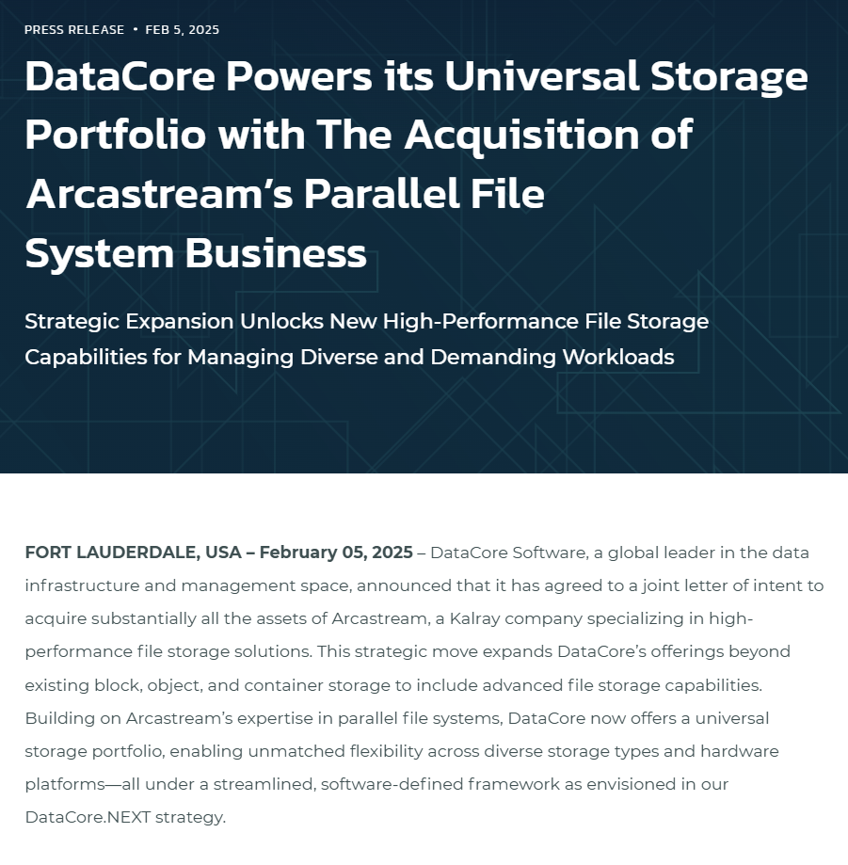
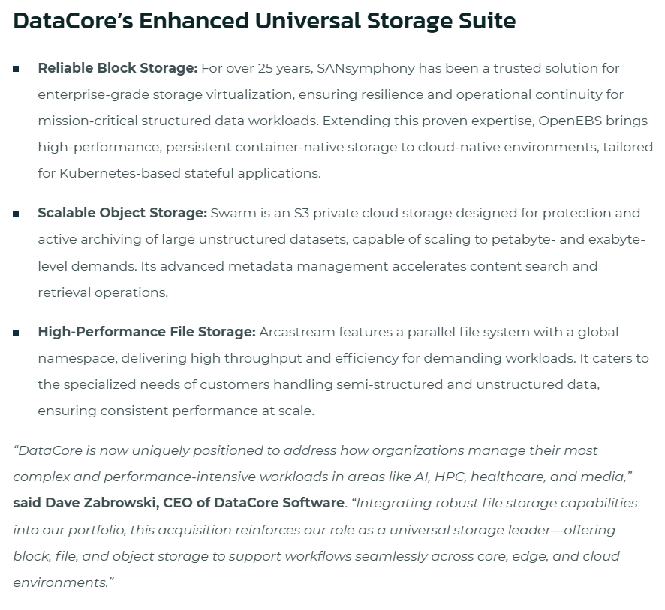


Slide 8
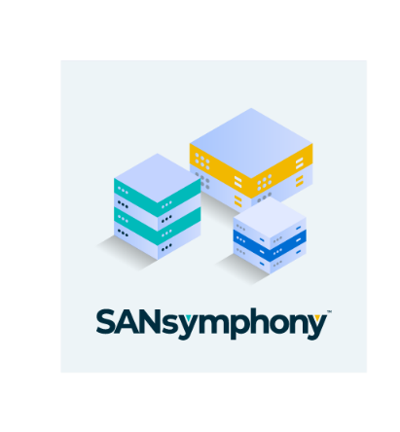
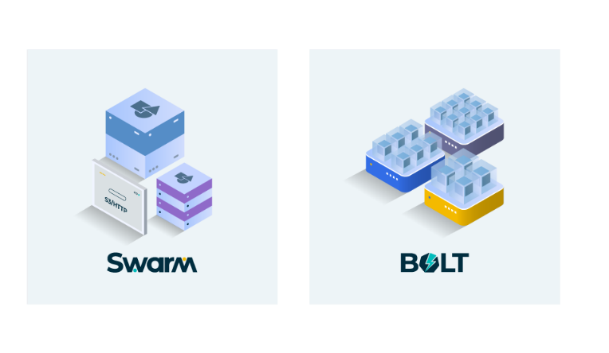



Data Storage Software from DataCore
Container-Native Storage
Software-Defined Storage for SAN & HCI Environments
Object Storage Platform for Scalable Data Access, Delivery and Archive
Enterprise Support
& Extensions
for
Lightweight version for Edge, ROBO, and small IT Setups
CNCF Open-Source Project
Contributed by DataCore

Slide 9

Accelerating Your Journey from Core to Edge to Cloud
Database | Production | IOT | AI/ML | Kubernetes | Archive | Streaming
CORE
Enterprise
EDGE
Distributed
CLOUD
High-Variability
Block Storage
S3 Object Storage
File Storage
Container Storage
Store
Manage
Scale
Protect
Analyze
Migrate

Slide 10


Solutions
Business Continuity & DR
HCI
Data Protection
& Archive
Cybersecurity
Container Storage
Virtualization-Agnostic
Storage
Secure Edge
& ROBO
AI-Enabled
Storage

Slide 11


NIS 2 on European Customers
EU member states are now implementing NIS 2 into their national laws and organizations are working on becoming NIS 2 compliant
Is your organization impacted by the upcoming NIS 2 Directive in the EU?

Slide 12
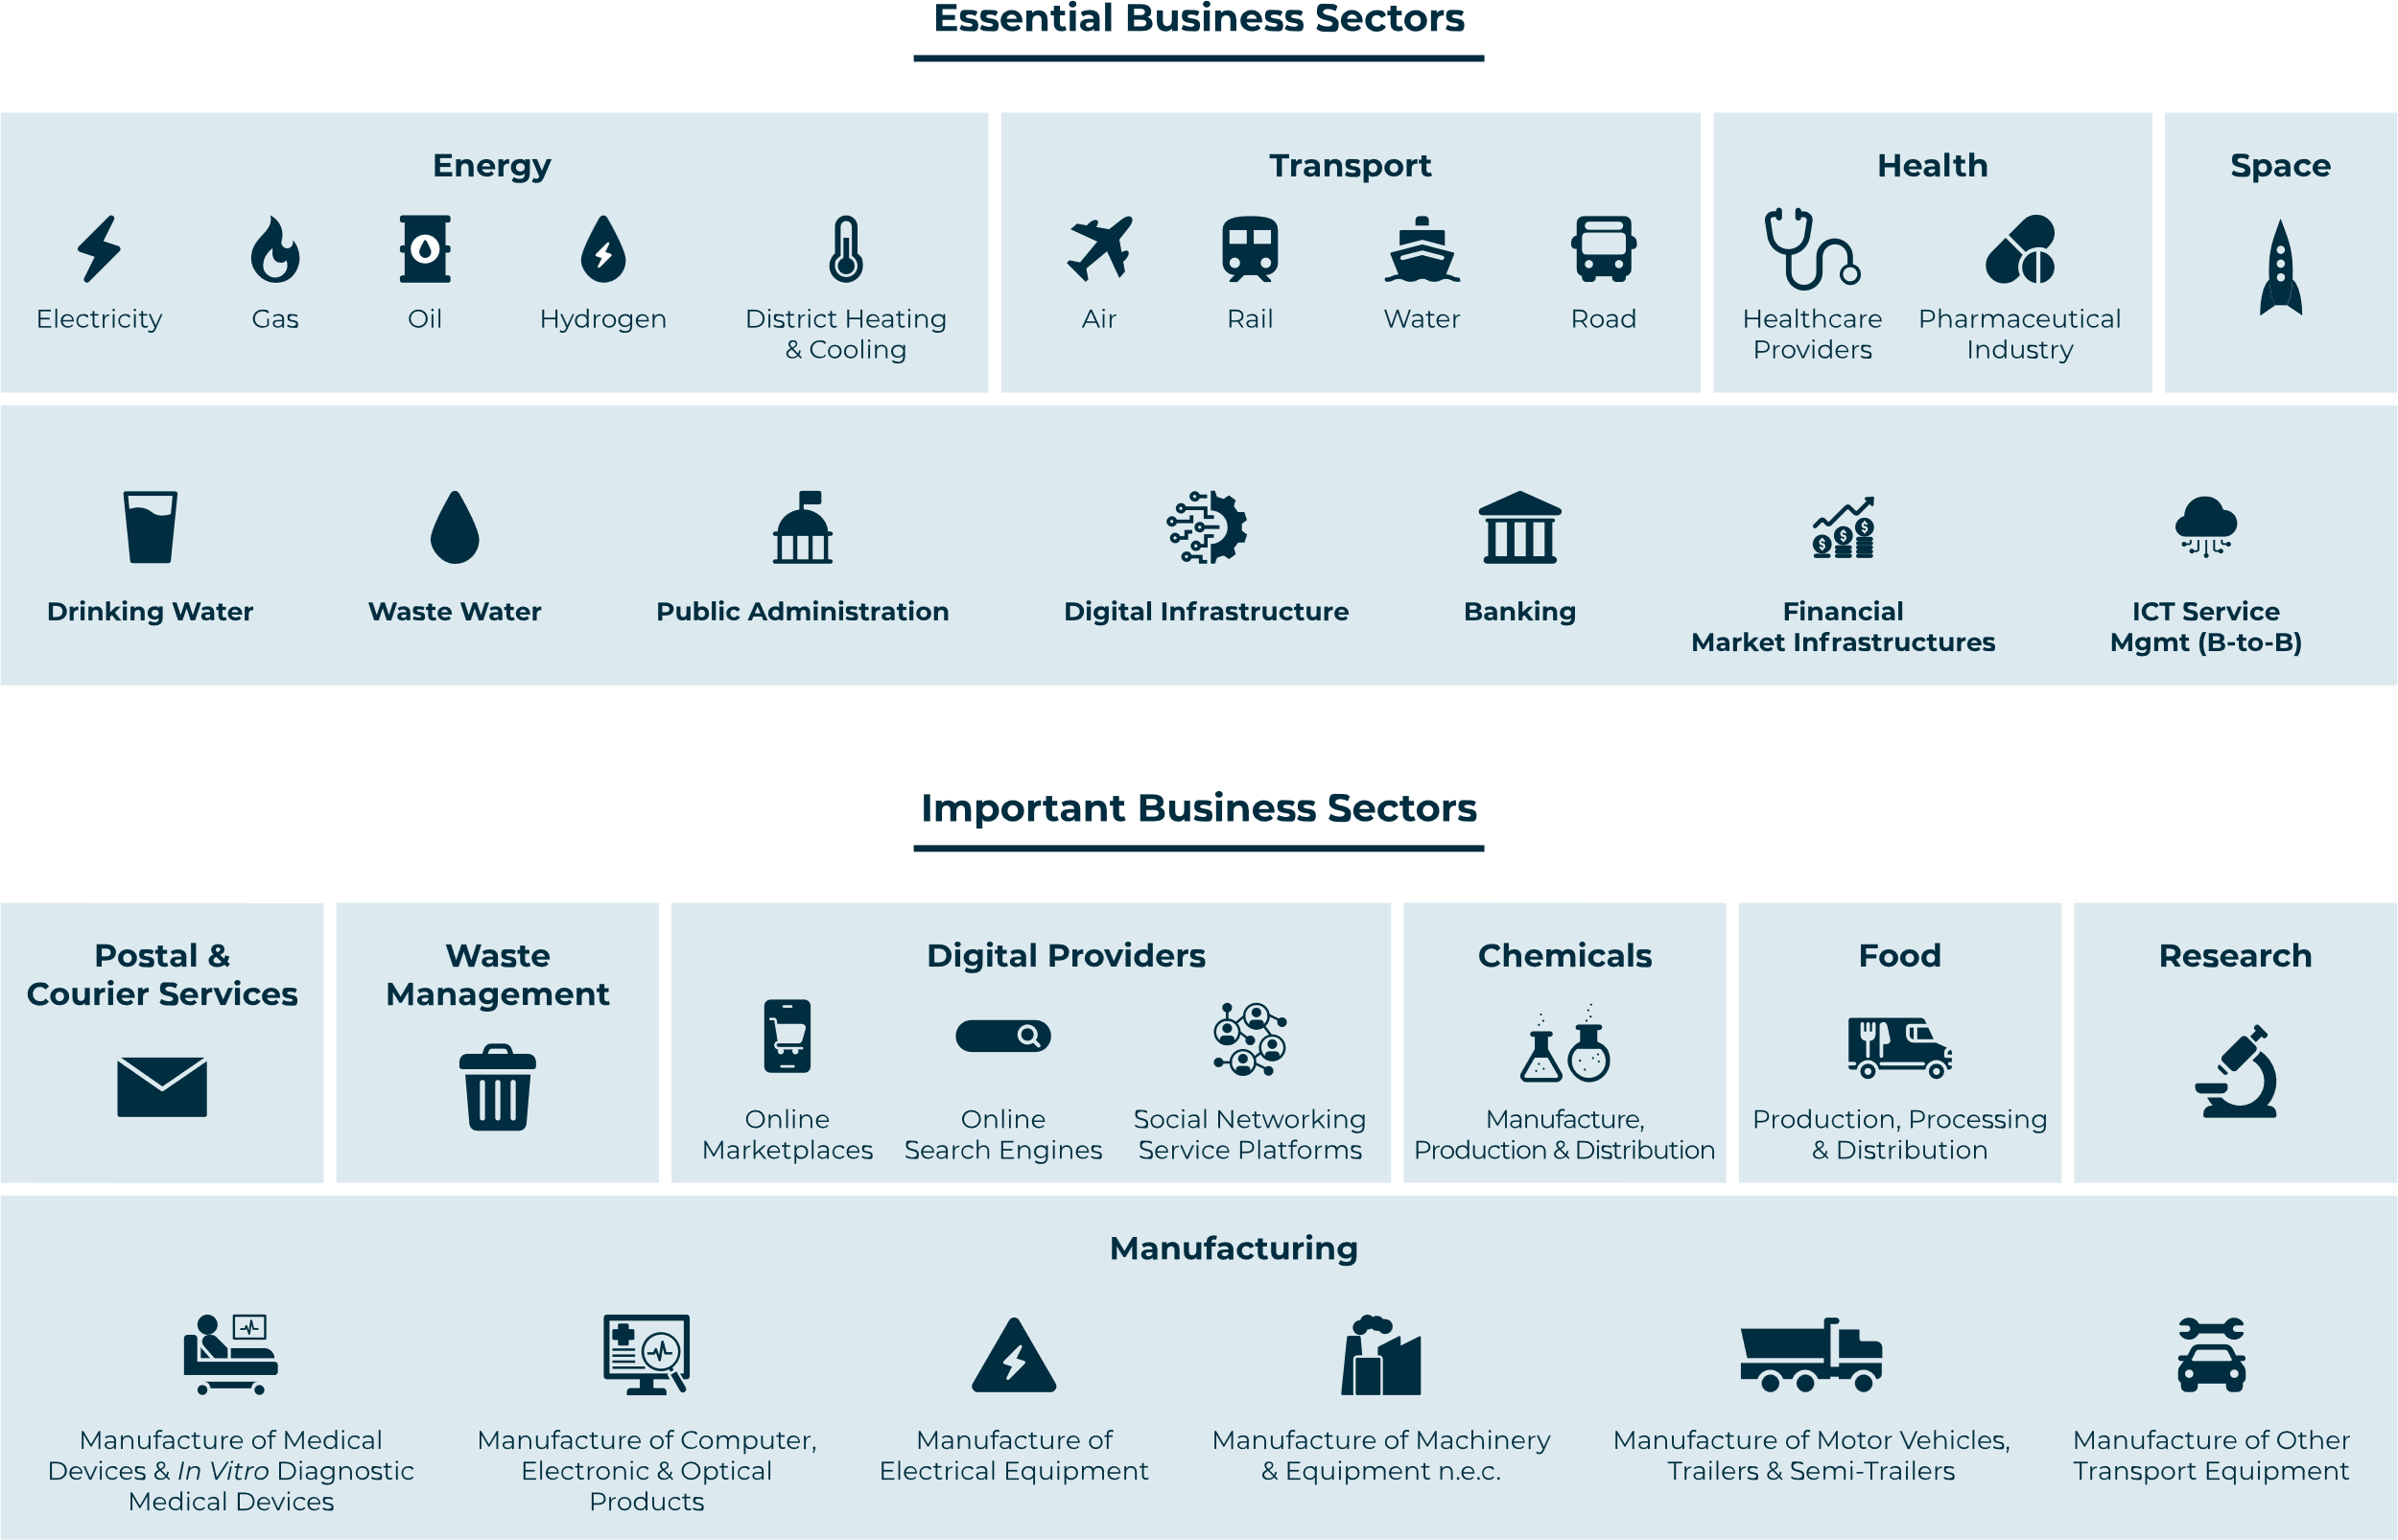
Business Sectors Impacted by NIS 2
Notes:
Essential Sectors include critical infrastructure and services that are vital for the functioning of society and the economy, such as energy, transport, health, and financial services. These sectors are subject to stricter cybersecurity requirements due to their impact on national security and public safety.
Important Sectors consist of industries that play a significant role in the economy but are less critical than essential sectors. These include sectors like manufacturing, food supply chains, and digital service providers. While still regulated under NIS 2, the cybersecurity requirements for important sectors are slightly less stringent than for essential sectors.
Supervision and Enforcement:
Essential Entities: Subject to ex-ante (proactive) supervision. This means that authorities can carry out audits, assessments, and regular checks even without an incident.
Important Entities: Subject to ex-post (reactive) supervision. Authorities only intervene after an incident, complaint, or sign of non-compliance.
Incident Reporting:
Both sectors must report significant incidents, but Essential Entities are often under stricter scrutiny regarding the timeliness and details of their incident reports due to their critical role in society.
Fines:
For Essential entities: The fine can be up to €10 million or 2% of the worldwide annual turnover, whichever is higher.
For Important entities: The fine can be up to €7 million or 1.4% of the worldwide annual turnover, whichever is higher.
Additional Sanctions: Besides financial penalties, non-compliant entities can also face other sanctions, such as:
Suspension of management personnel.
Temporary suspension of business activities.
Public disclosure of the infringement, which could damage the entity’s reputation.

Slide 13



Offload Primary Storage with
Policy-based File Tiering
Users & Apps
Object Storage
Physical/Virtual Server
Automated
Replication (Optional)
This is an example with FileFly. Swarm can also be used with other data movers such as Nodeum, Atempo Miria, etc.
File Servers & NAS
Primary Storage
Pointer to contents in secondary storage
DR Site

Slide 14
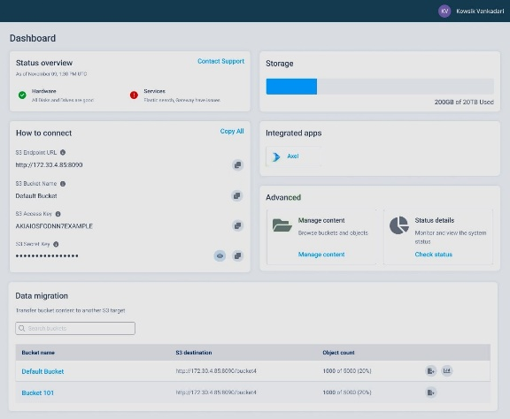

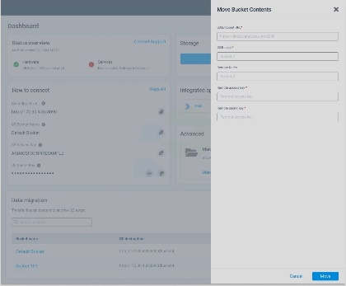
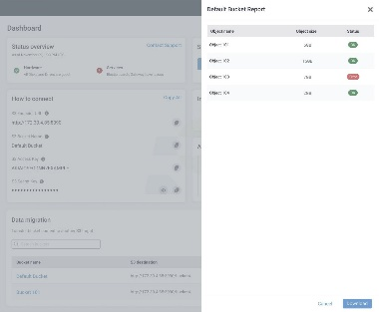
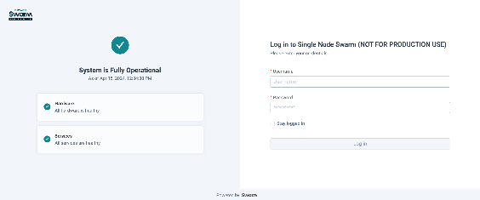
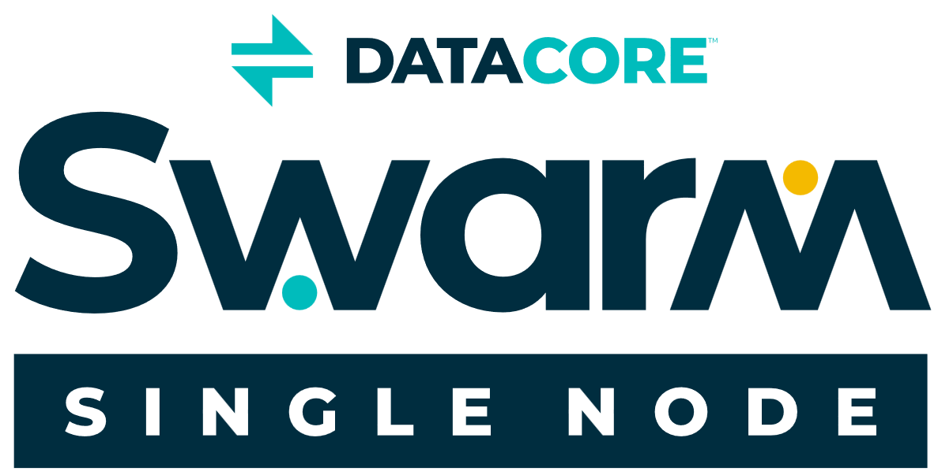
Single Node Swarm: Key Highlights
Software-defined Swarm architecture in a single-server footprint
Key Swarm components containerized
Kubernetes-managed model
Install and provision storage easily
Single-pane-of-glass user interface
Simplified identity and access management
Can be used standalone or with other Swarm clusters in data centers

Slide 15



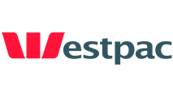




























Trusted by the Best

Slide 16
THANK YOU!
info@datacore.com
www.datacore.com

